Slide 2
Learning Outcomes By the end of today, you should be able to: n Describe what climate change is n Explain what the greenhouse effect is and how human activities contribute to this n Discuss the impacts that humans have on the marine environment and the cutting edge scientific work that Yorkshire Wildlife Trust are carrying out to restore important habitats to the Humber estuary

Slide 3
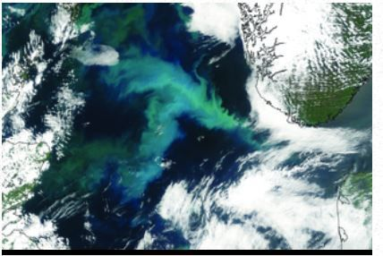
What is climate change? Climate change is the long-term change in the Earth’s average conditions, such as changes in air temperatures, sea temperatures and rainfall. Over long periods of time the Earth’s climate naturally fluctuates.

Slide 4
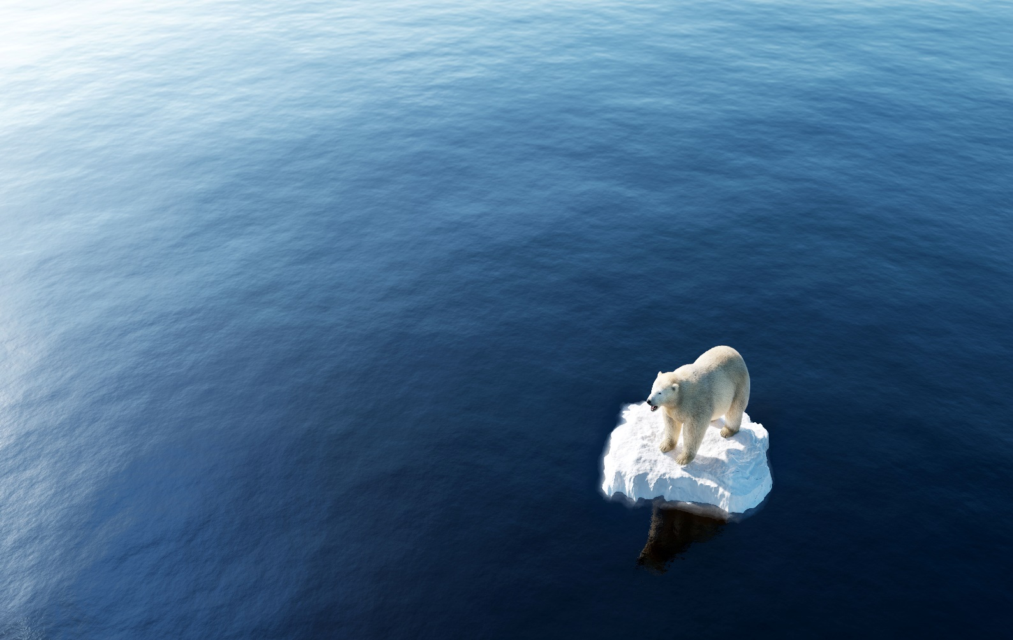
What is climate change? In recent years, the Earth’s climate has been changing far more quickly than previously seen because of human activities – this is called man-made climate change.

Slide 5
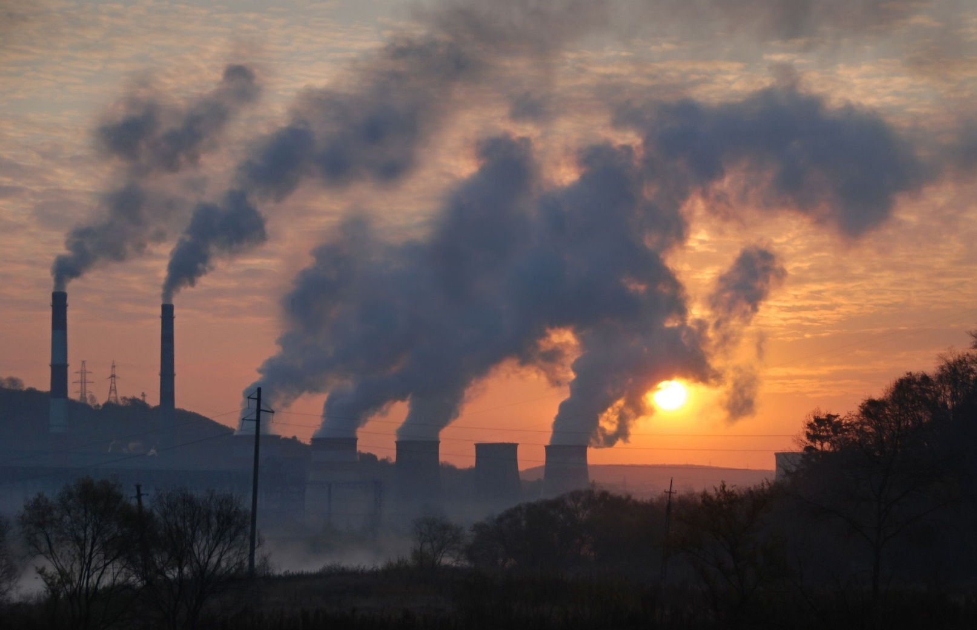
What causes climate change? Burning fossil fuels releases greenhouse gases. Greenhouse gases include carbon dioxide, methane, nitrous oxide and CFCs (chlorofluorocarbons). Greenhouse gases retain heat from the Sun in the Earth’s atmosphere, leading to global warming. Global warming is the rise in the average temperature of the Earth's surface.

Slide 6
What is the greenhouse effect? The greenhouse effect is the retention of heat in the atmosphere caused by the build-up of greenhouse gases. The greenhouse effect is natural and keeps Earth at a temperature that allows life to flourish. However, in the last century, carbon dioxide in Earth’s atmosphere has been rising due to human activities. More greenhouse gases in the atmosphere lead to more heat being trapped by Earth’s atmosphere, causing global warming.
Sun
Atmosphere
Earth

Slide 7
What is the greenhouse effect?
The Earth’s surface loses heat but some of that heat is trapped by greenhouses gases in the atmosphere and reflected back to Earth.
Sun
Atmosphere
The Sun radiates heat onto the Earth’s surface. Most of the heat is absorbed but some is reflected back into space.
Earth

Slide 8
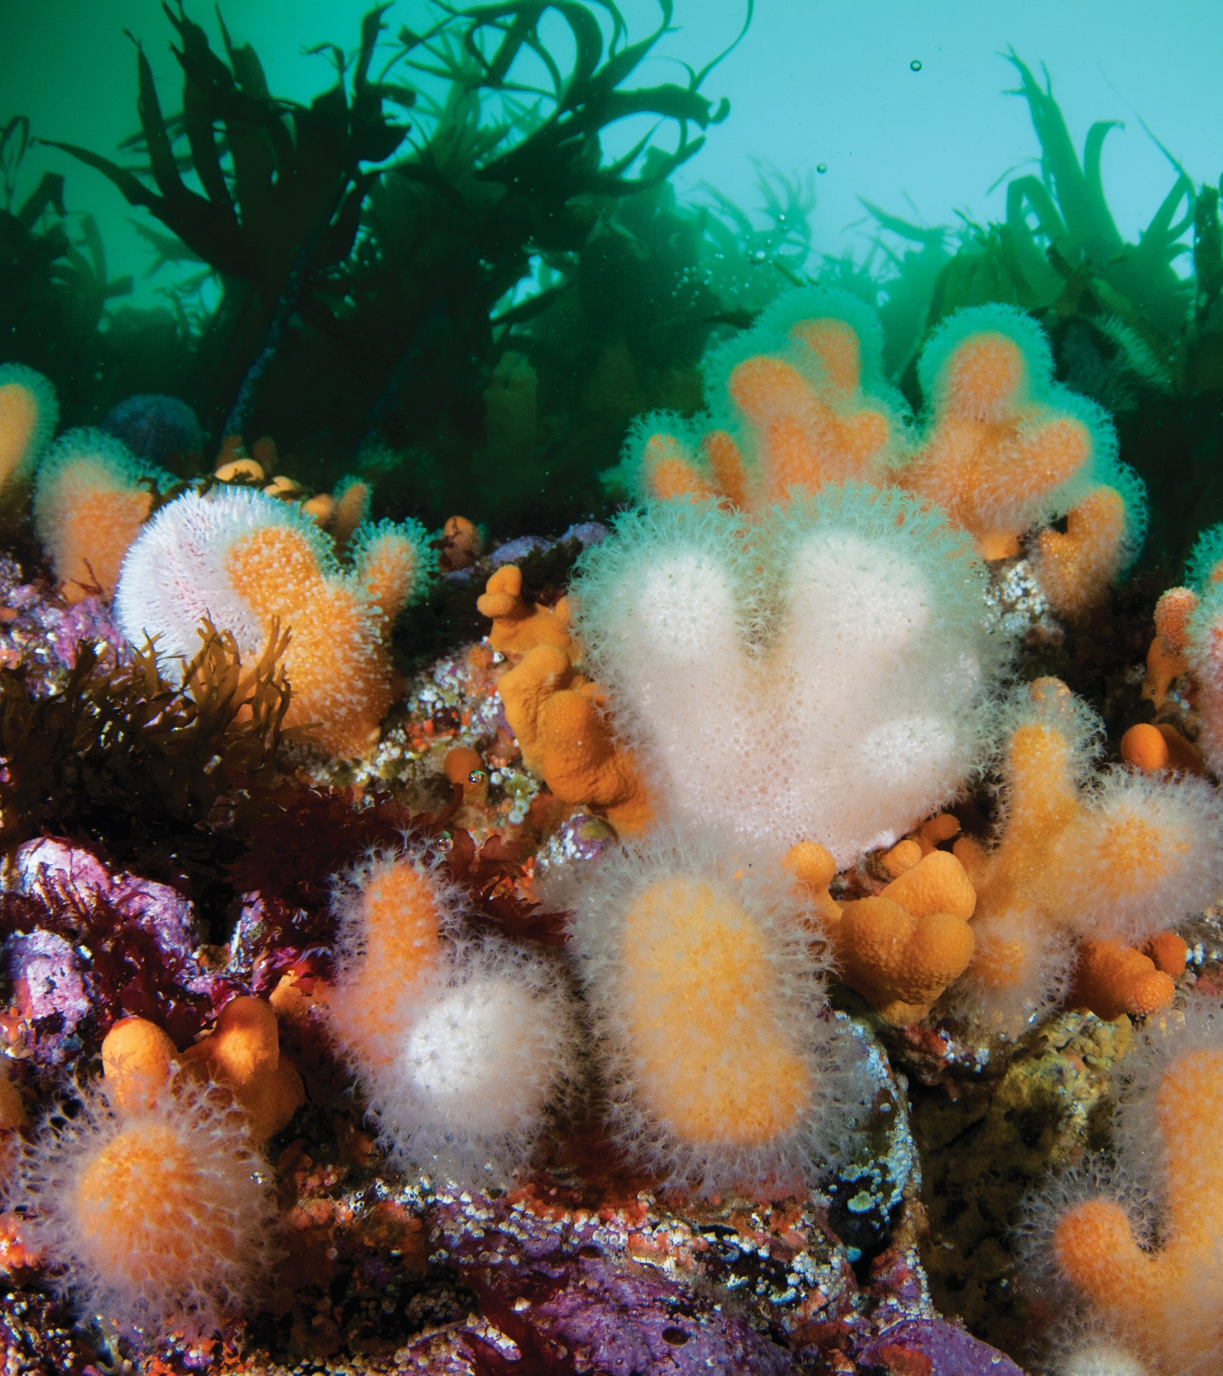
Climate change and the marine environment Since the 1970s, the oceans have absorbed more than 90% of the excess heat energy trapped by greenhouse gases. As a result, the oceans have warmed by about 1°C. Many marine organisms are sensitive to small changes in their environment and are under threat as a result of climate change.

Slide 9
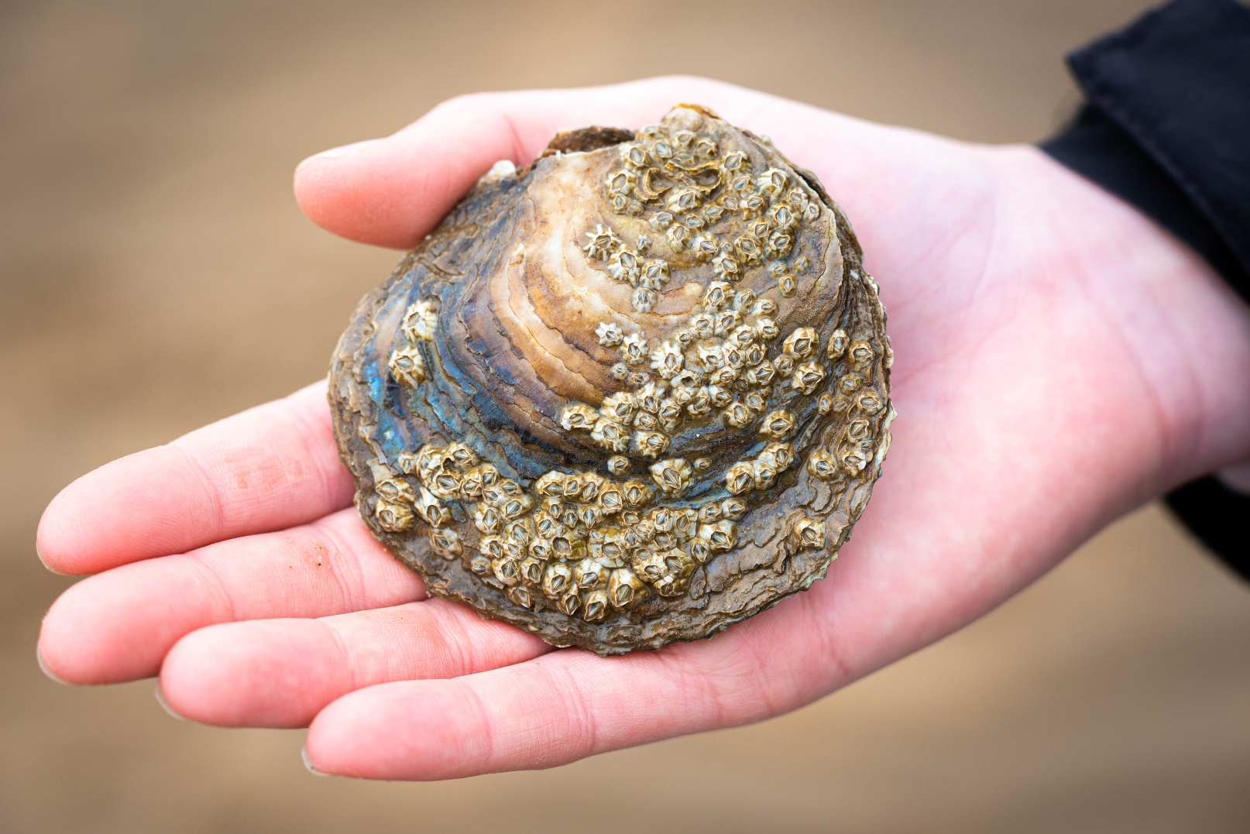
Oysters in Yorkshire There used to be a flat oyster reef so large in the Humber estuary that it stretched across the entire width of the estuary and was so big that the oysters’ hard shells were a danger to ships! Sadly, because of overfishing and pollution, that oyster reef is now a distant memory and only a few flat oysters remain. Yorkshire Wildlife Trust are working hard to bring flat oyster reefs back to the Humber estuary.

Slide 10
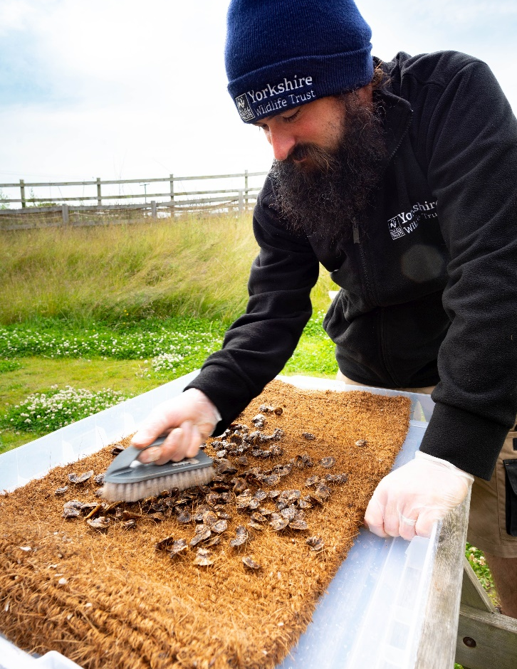
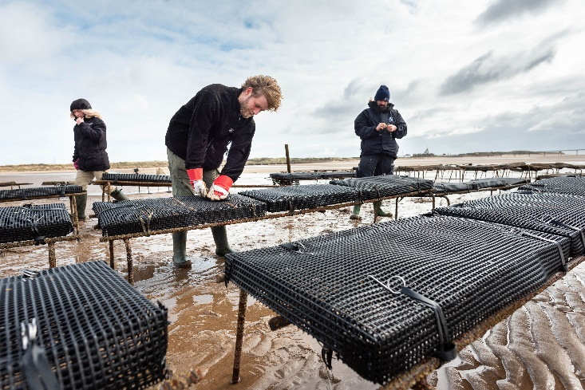
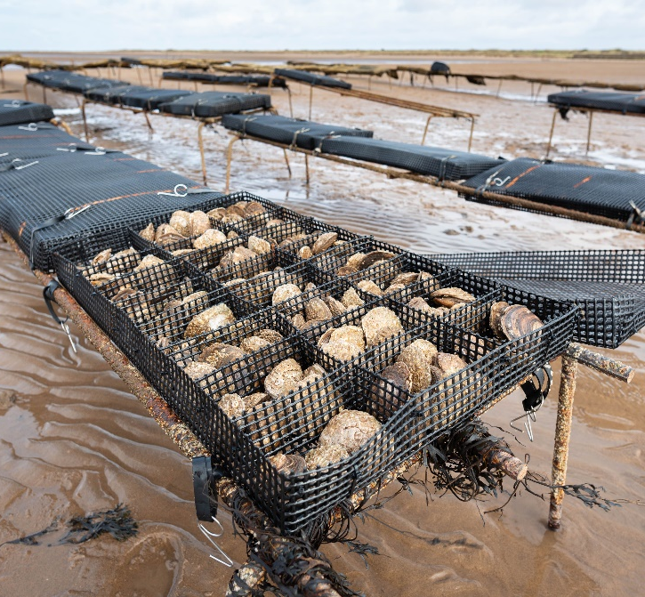
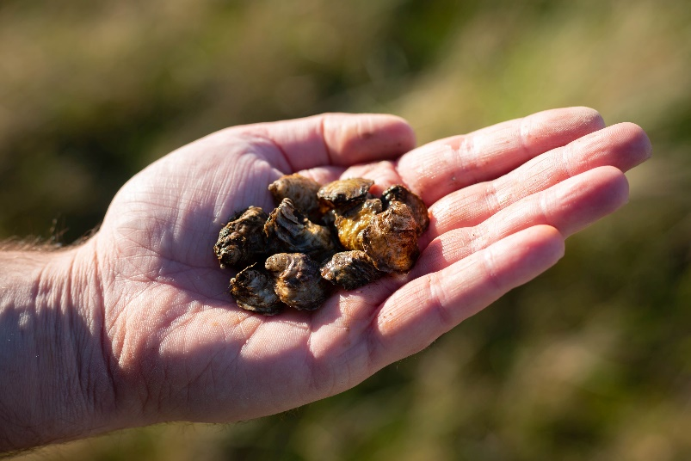
Bringing oysters back to the Humber… Explore the process below that our expert team follow to restore oyster reefs at Spurn: Step 1: 100,000 juvenile flat oysters were brought over from the west coast of England in 2021. The oysters were then cleaned and checked to make sure that they didn’t transfer any undesirable organisms or invasive species into the Humber Step 2: The oysters were quarantined in containers of UV-sterilised seawater to ensure that the water inside the oysters wasn’t harbouring anything harmful

Slide 11
Bringing oysters back to the Humber… Step 3: The oysters were placed into specially designed mesh boxes that were then strapped to trestle structures fixed into the mudflats. This is to ensure we can keep a population of oysters safe and easy to monitor Step 4: Each month, our expert team of marine biologists check the oysters’ health, weight and growth. Hopefully, one day, there will once again be a thriving flat oyster reef in the Humber estuary!

Slide 12
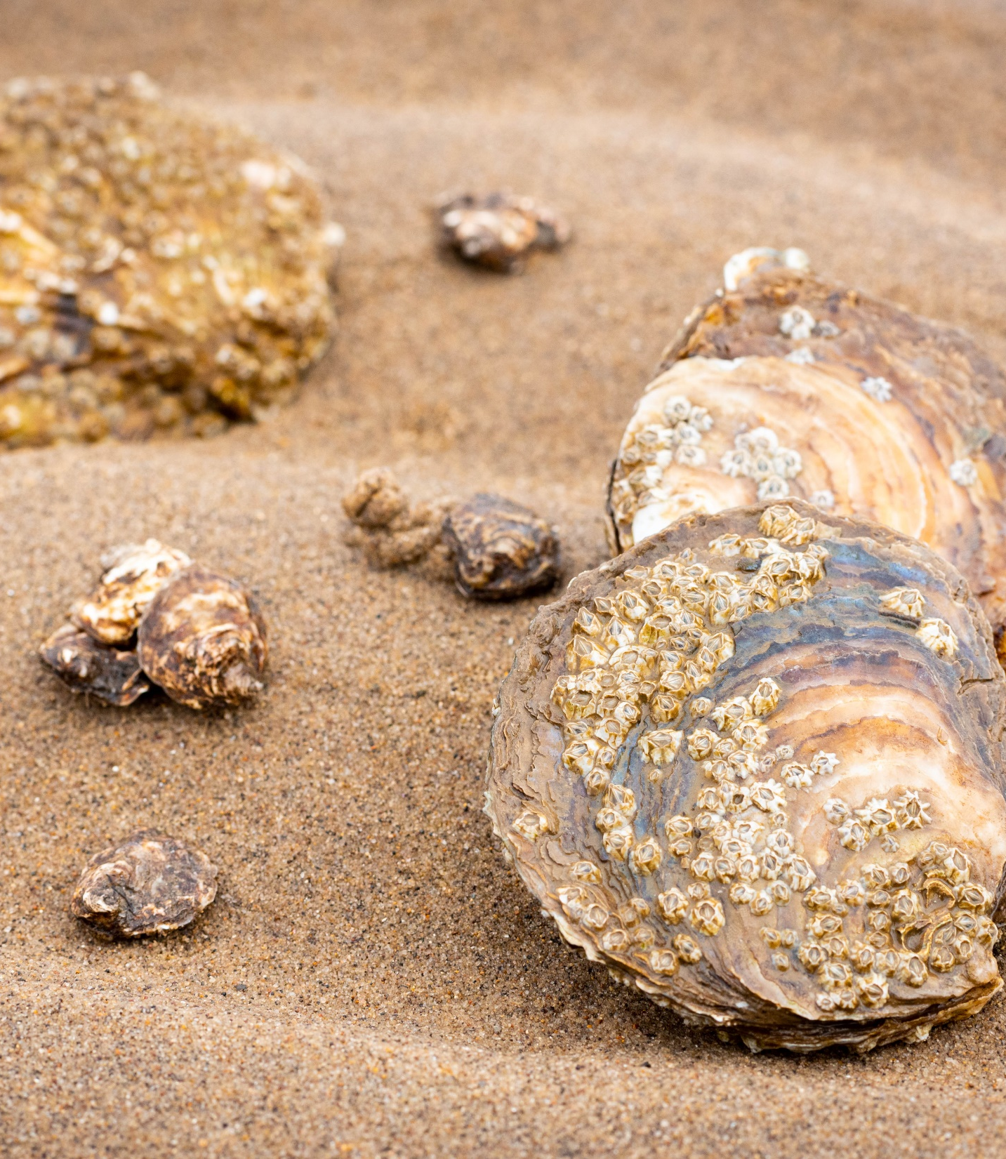
Oysters and climate change
If oysters are left undisturbed , they will join together to form an oyster reef. When oysters form a reef, carbon is stored within their shells and in the surrounding seabed.
A single adult oyster can filter 200 litres of water every day, that’s the equivalent of a bathtub of water. In its lifetime, an oyster can filter a million litres of seawater!
Oysters make the surrounding seawater clearer and healthier, improving the environment for other plants and animals to live it. Sunlight can reach deeper into the water, allowing seagrass to grow.

Slide 13
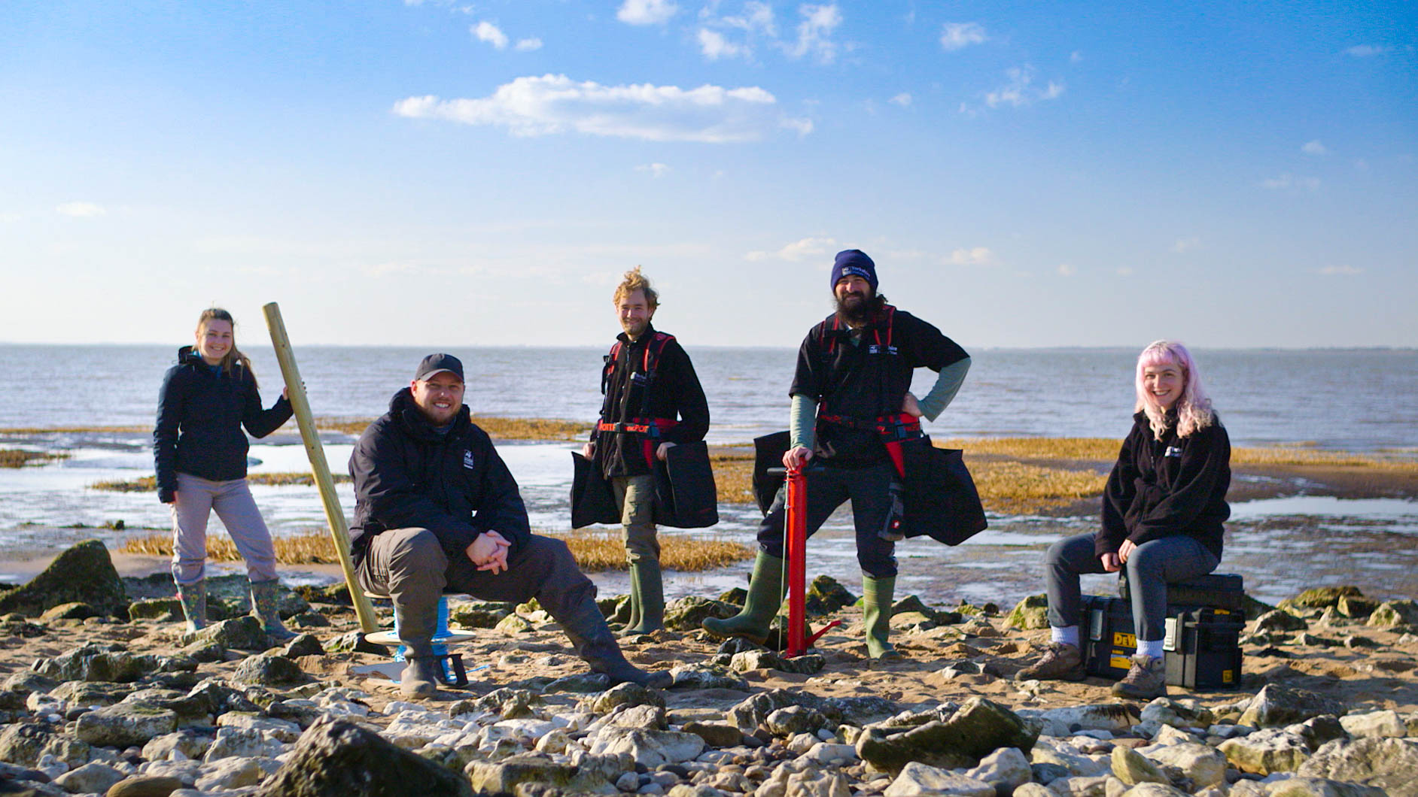
A planet saving plant! In the 1900s, there was a seagrass meadow at Spurn in East Yorkshire that stretched across 480 hectares - that’s the equivalent to more than 700 football pitches! Sadly, because of industrial and agricultural pollution running into the sea, today less than 5% of that seagrass meadow is left. But there’s good news! Our team of expert marine biologists are working tirelessly to restore Spurn’s seagrass meadow to its former glory.

Slide 14
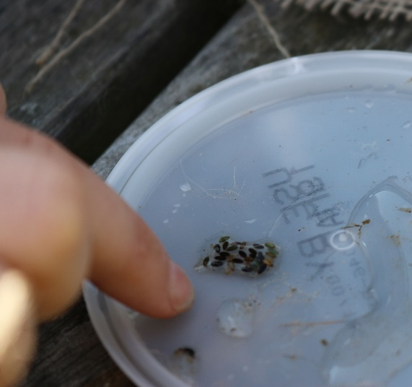
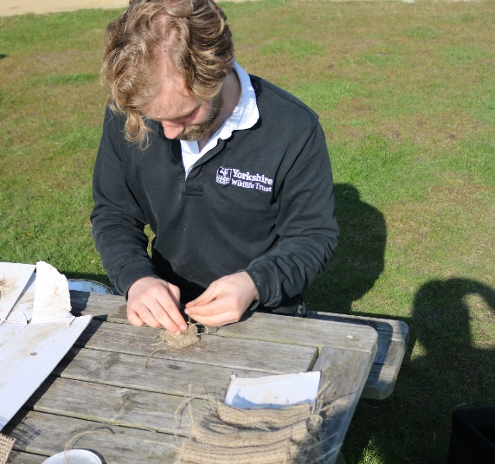
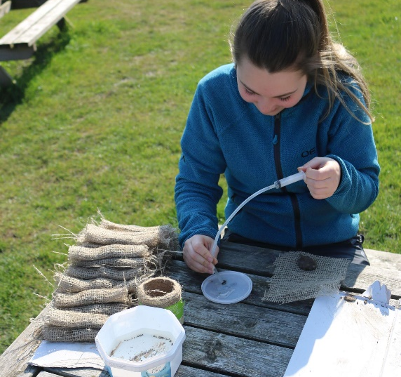
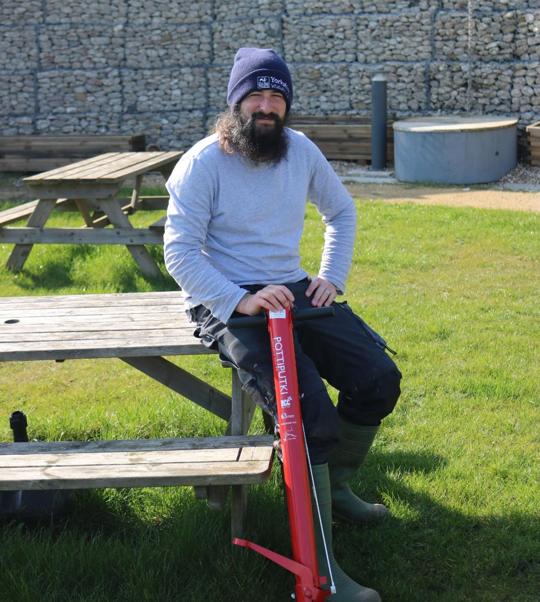
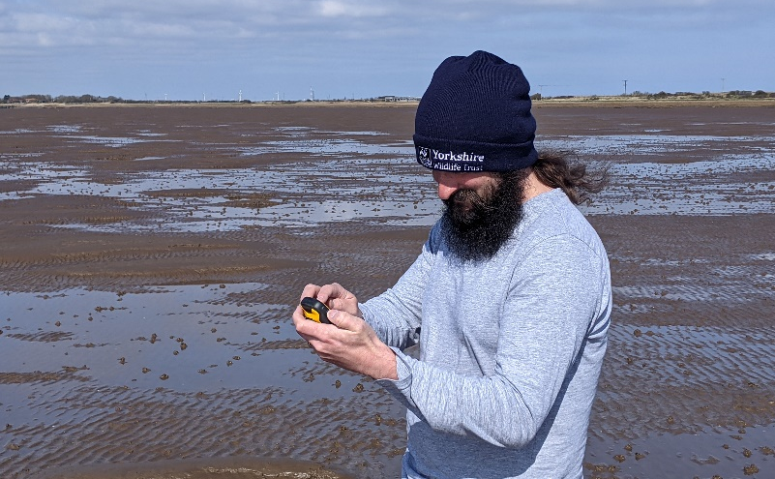
Restoring seagrass Explore the planting process below that our expert team follow to restore seagrass at Spurn: Step 1: The area for planting is marked off with posts to protect it Step 2: Seagrass seeds are carefully collected from the remaining seagrass meadow Step 3: Seeds are wrapped in biodegradable pouches so they are less likely to be swept away when planted Step 4: Seed pouches are then planted by hand in the mud using a tool called a pottiputki.

Slide 15
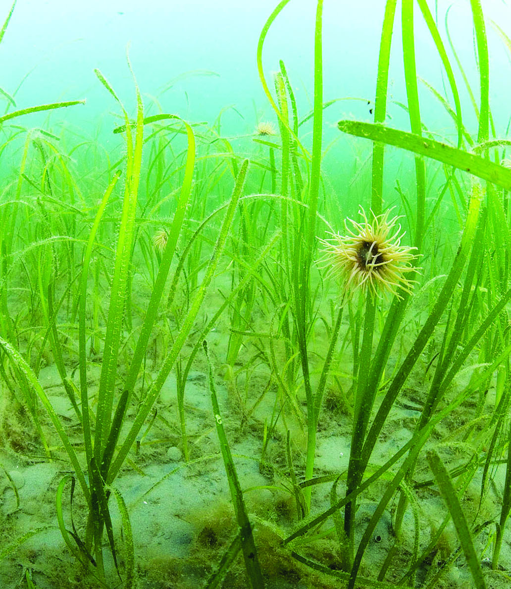
Seagrass and climate change
n Seagrass meadows stabilise coastal mud and sand flats. This helps to absorb wave energy and reduce coastal erosion.
n Seagrass is known as the lungs of the sea. It can produce 10 times more oxygen than trees! n When seagrass photosynthesises, it absorbs carbon dioxide. Seagrass meadows absorb carbon dioxide 35 times faster than tropical rainforests and are responsible for 15% of the ocean’s total carbon absorption.

Slide 16
Hopefully you’ve learnt lots about the positive and negative effects that humans have on the marine environment. Now have a go at the quiz and the practical activity!

