Slide 2
Learning Outcomes By the end of today, you should be able to: n Describe what an oyster is n Explain how an oyster reproduces n Discuss why oysters and oyster reefs are important to an ecosystem

Slide 3
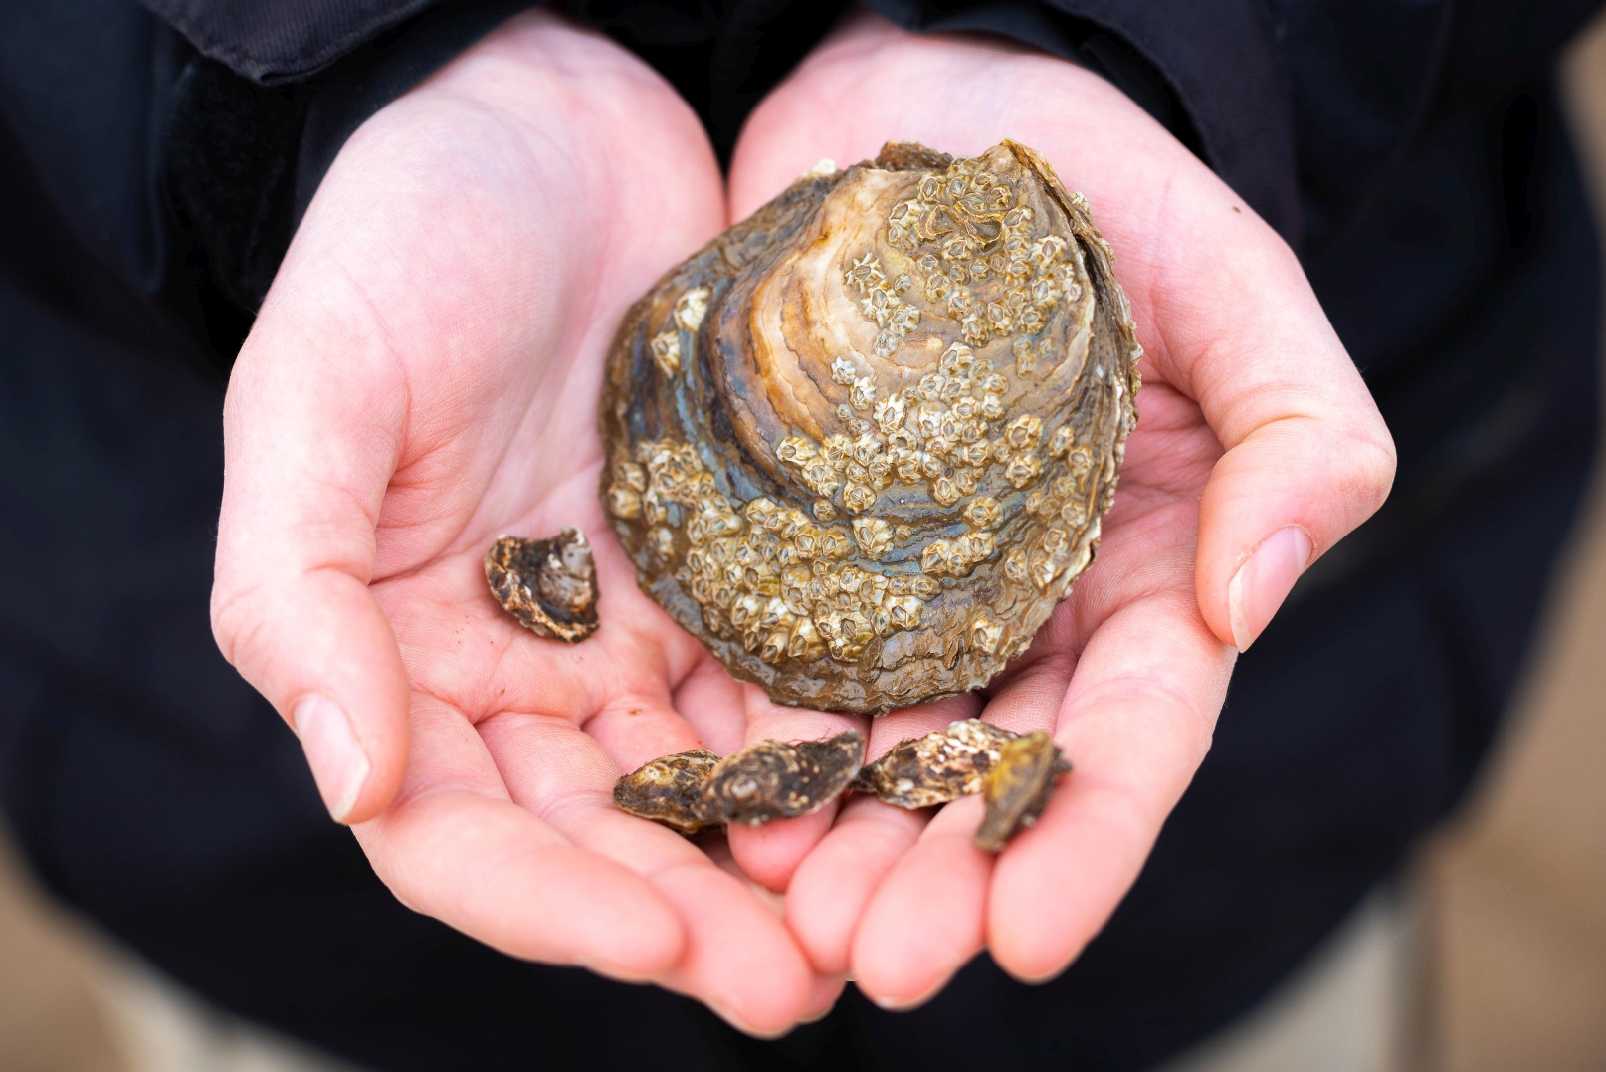
What is an oyster? n An oyster is a type of soft-bodied invertebrate, known as a mollusc n Molluscs are one of the most diverse groups in the animal kingdom and include scallops, mussels, squid, octopi and sea snails n Oysters are bivalve molluscs, which means they have two hinged shells - one shell is rounded, while the other is flat like a lid. The shells protect the fleshy oyster living inside
n The flat oyster (Ostrea edulis) is the only species of oyster native to the UK.

Slide 4
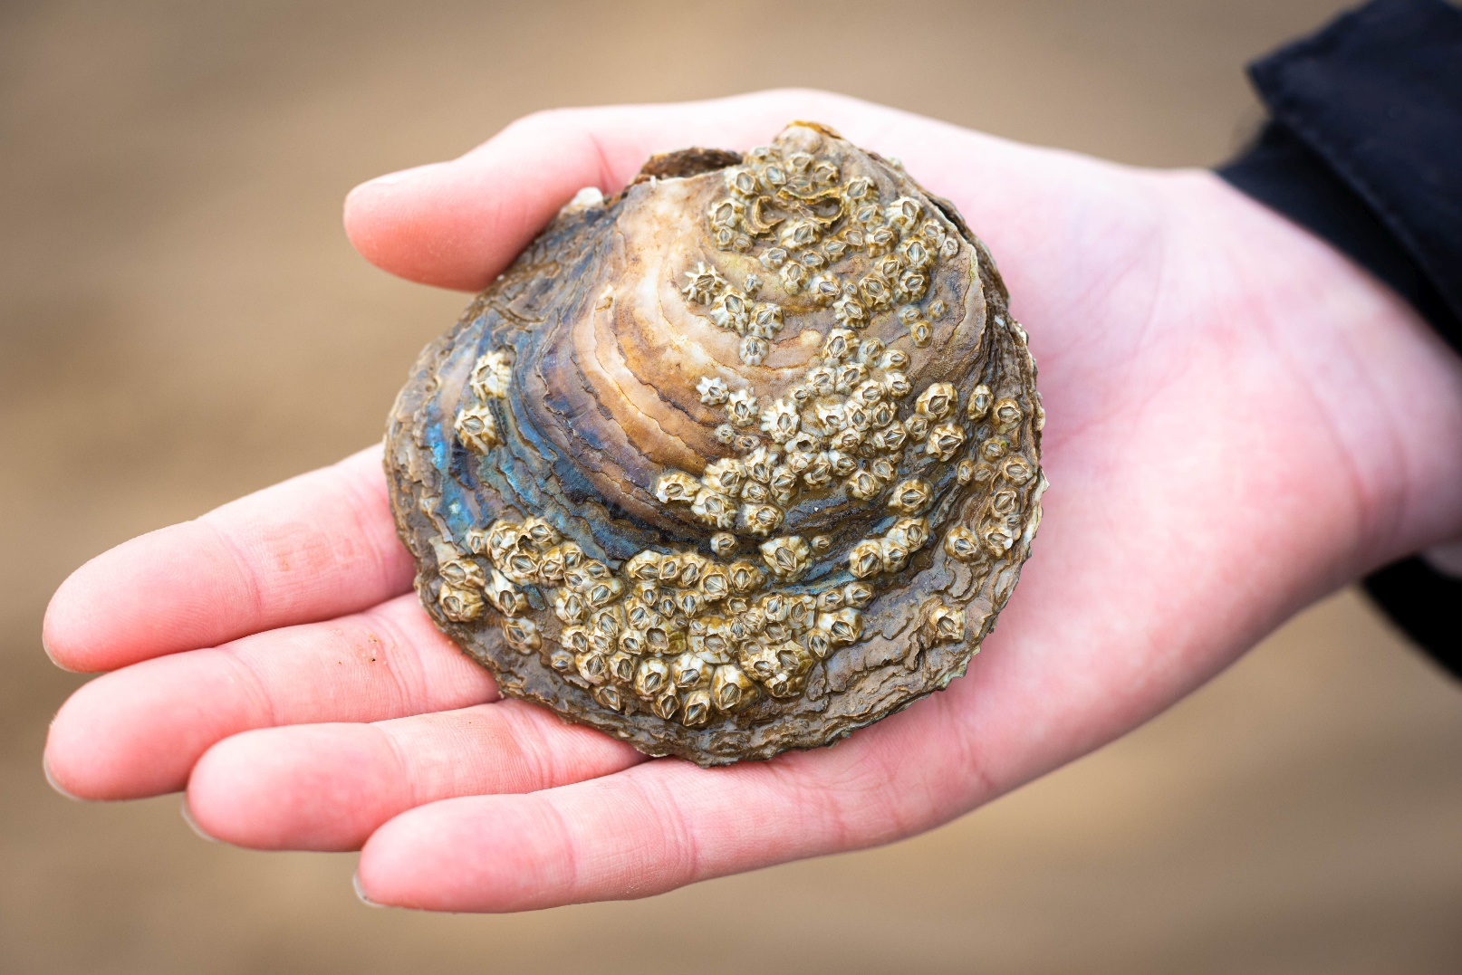
Flat oysters n Flat oysters have a rounded, flattened, rough shell that can vary in colour but is usually pale with brown or green mottling n The outside of the oyster shell has obvious growth lines, while the inside of the shell is smooth and pearly white n Flat oysters live on the seabed in shallow coastal waters and estuaries.

Slide 5
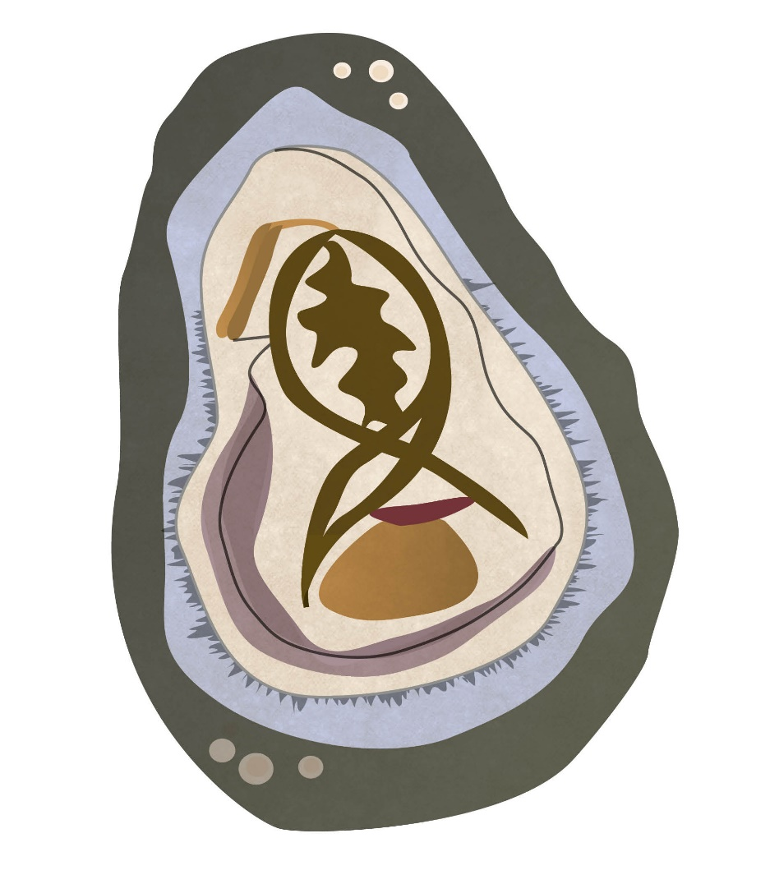
Mantle
- a membrane that surrounds the organs and filters water
Inside of an oyster
Stomach
- digests and stores food, and releases it to the intestine
Palps
- act as the oyster’s mouth and tongue
Gills
- absorb oxygen from the water
Intestine
- digests food and stores waste
Heart
- three chambers pump colourless blood around the body
Adductor muscle
- opens and closes the oyster’s shells

Slide 6
How do oysters feed? Oysters are filter feeders. They pump water over their hair-like gills and consume phytoplankton (microscopic plants that float in the sea) and other small organic particles that they filter out of the surrounding seawater.

Slide 7
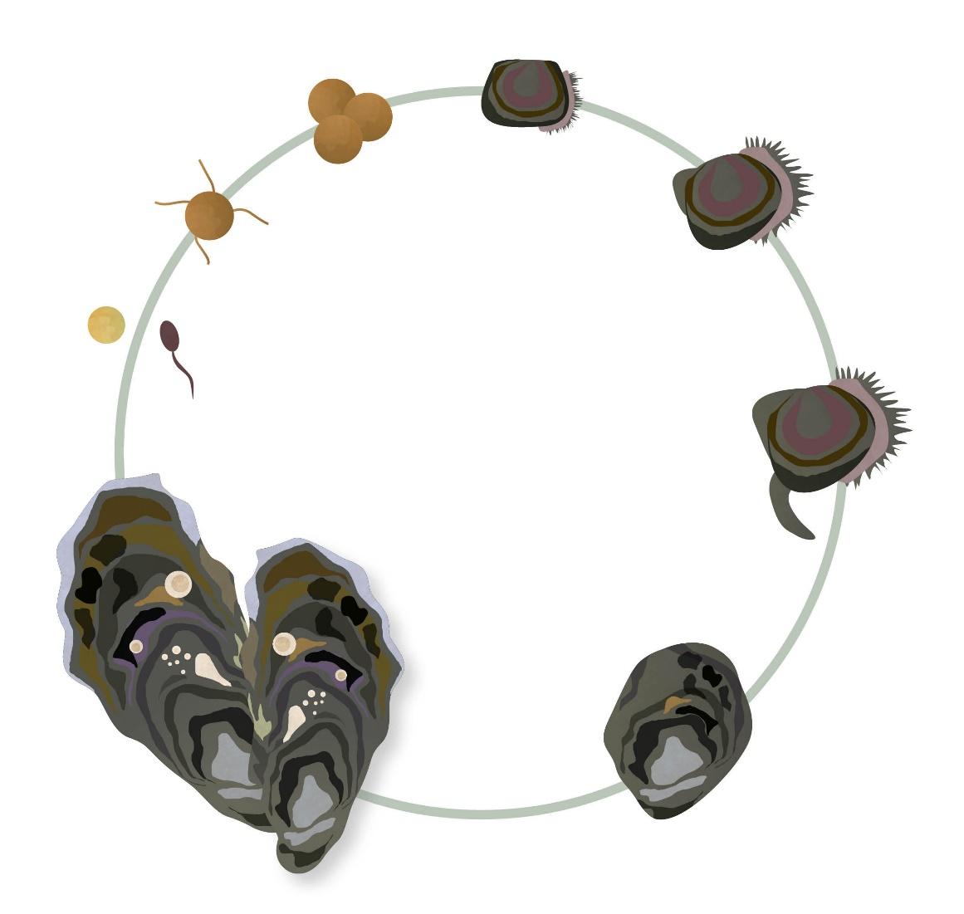
An oyster’s lifecycle
2. Fertilised eggs develop inside the female oysters and are released as swimming larvae after 7-10 days. A female oyster can produce up to 2 million larvae each time they spawn!
3. The larvae develop for a couple of weeks in the water and then attach themselves to materials on the seabed. Once attached, they are known as oyster spat.
1. Oysters reproduce sexually. Male oysters release sperm into the sea, which fertilise the eggs inside the female oyster.
4. Oyster larvae prefer to attach themselves to other live oysters or the shells of dead oysters.
5. Juvenile oysters reach sexual maturity at around 3 years of age. On average, flat oysters live for 6-7 years.

Slide 8
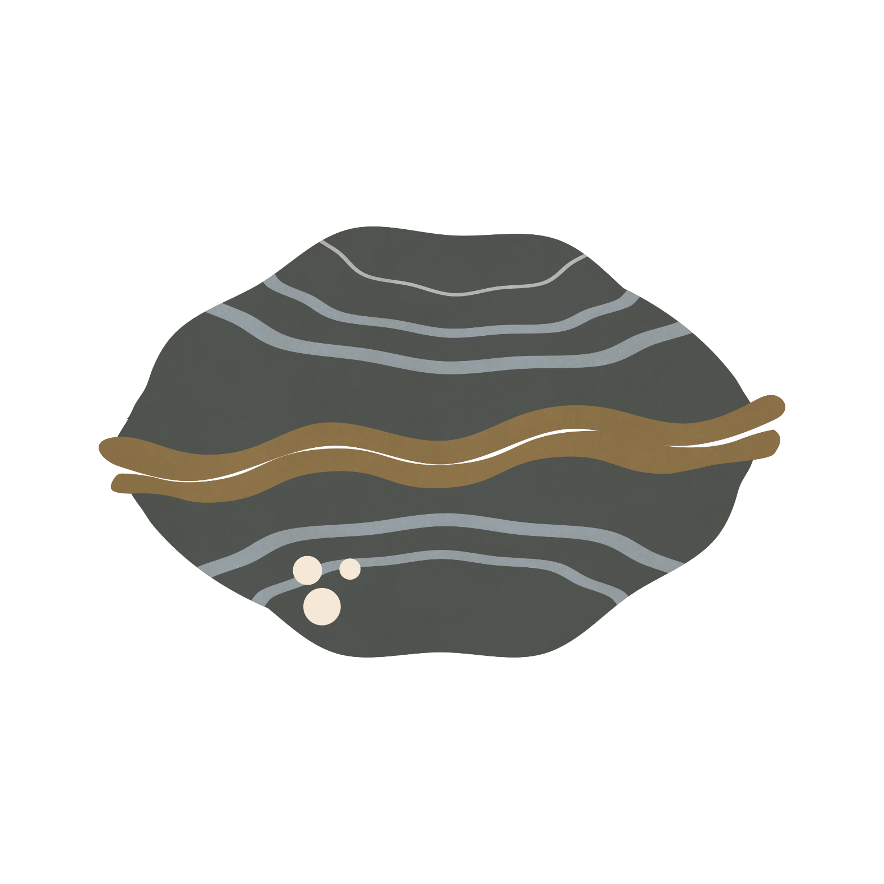
Mighty molluscs Oysters can often be overlooked. People might assume that oysters are rocks or part of the seabed. While they might not look like much from the outside, these might marine molluscs are actually very special! Although small, oysters can make big changes to the ecosystems in which they live. These ecosystem engineers not only bring great benefits to the areas in which they live but are also important for the future of our planet.
Ecosystem engineer = an organism that creates or changes habitats.

Slide 9
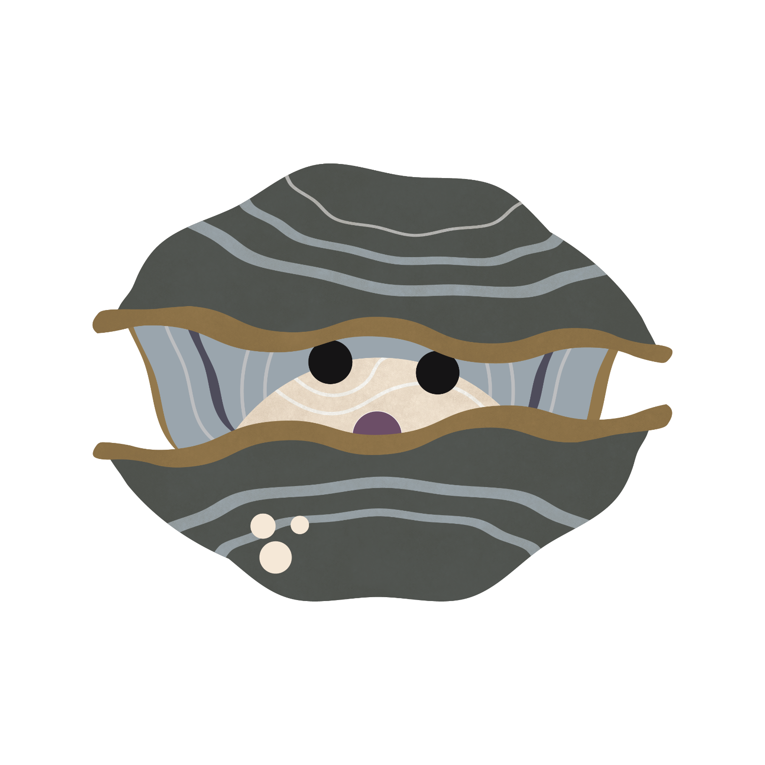
The world needs oysters Cleaning service: Oysters have an amazing ability to clean seawater, keeping the sea healthy and clear, and improving the surrounding environment for other plants and animals to live in. While feeding, oysters also remove excess nutrients from the sea, which could otherwise cause algal blooms and a lack of oxygen in the water.

Slide 10
The world needs oysters Local builders: If the conditions are right and oysters are left undisturbed for a long period of time, hundreds of thousands of oysters will fuse together to form a reef. Much like a coral reef, an oyster reef provides a fantastic habitat and shelter for lots of different animals, such as juvenile fish, crabs and sea snails.

Slide 11
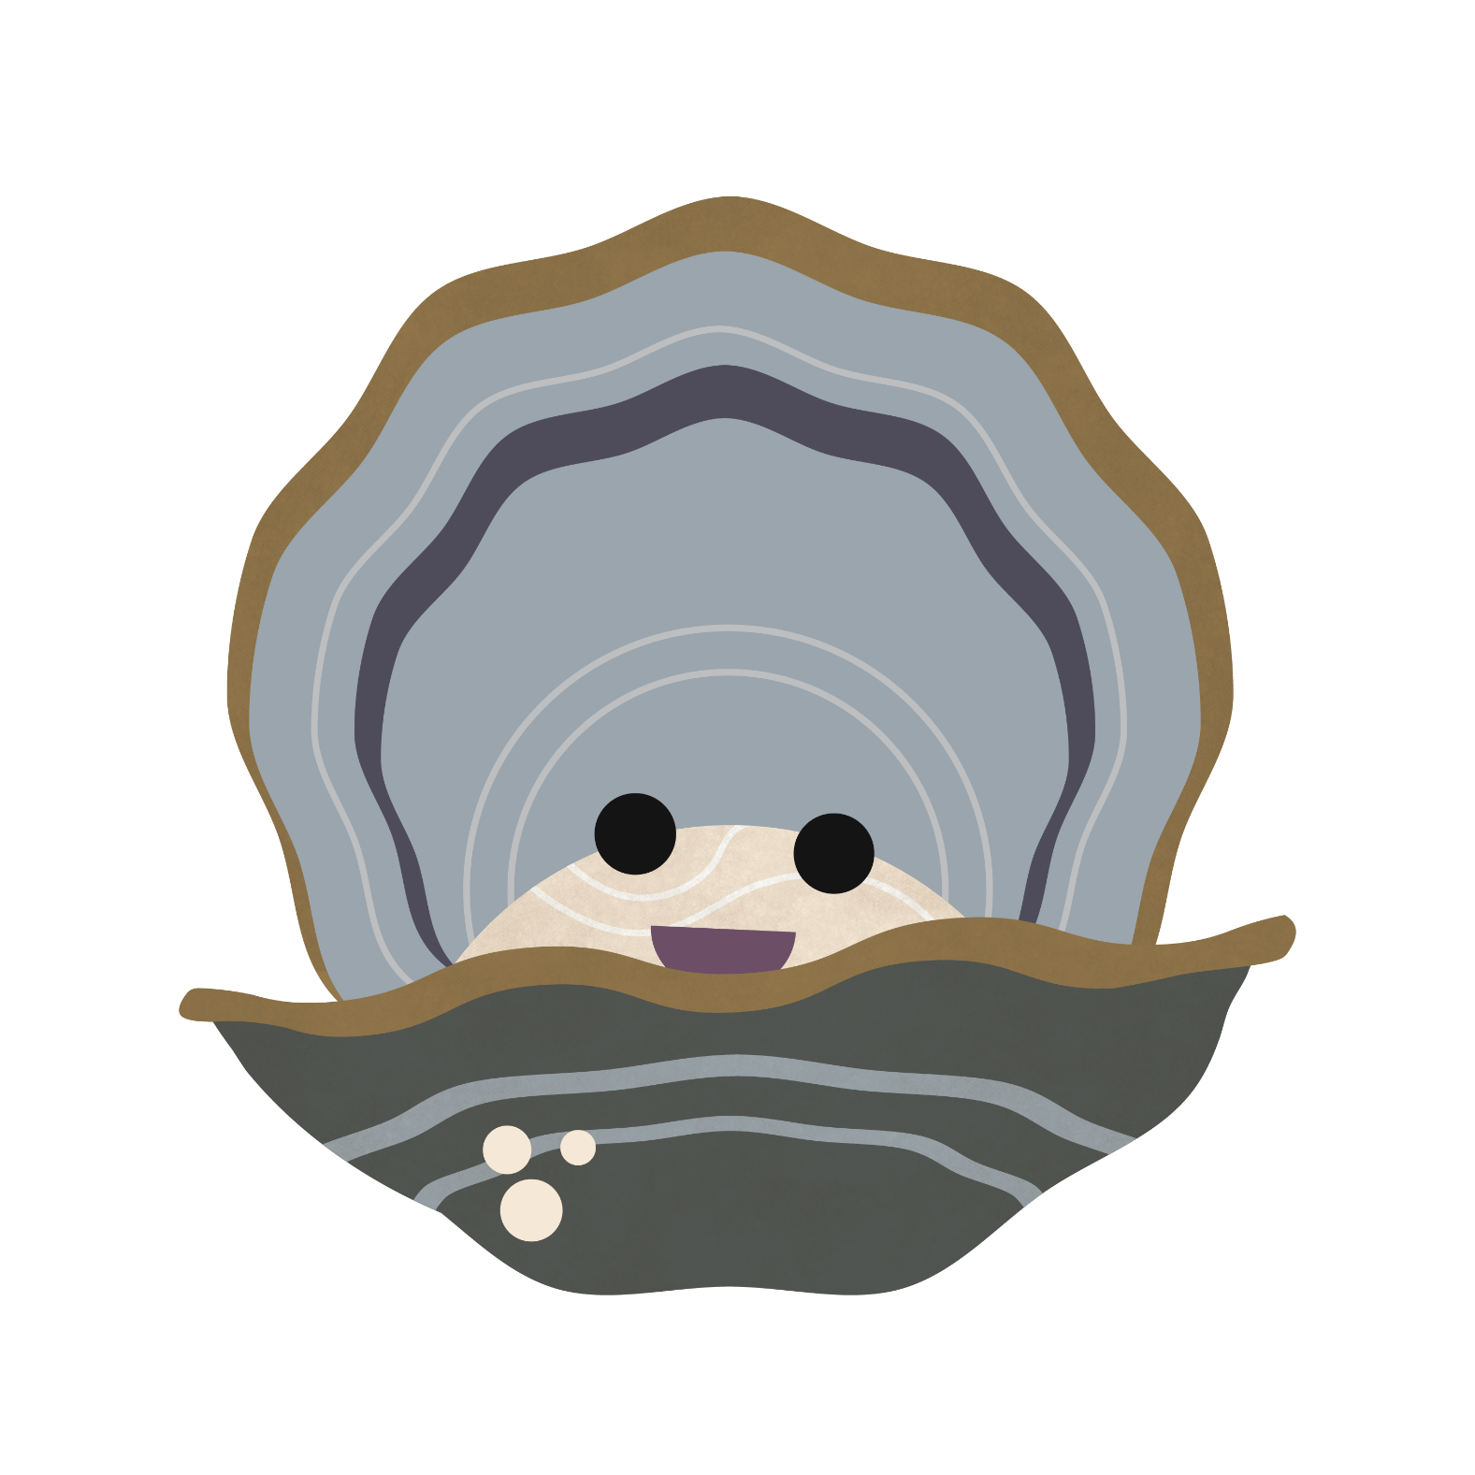
The world needs oysters Line of defence: Oyster reefs break up the energy from wave action, which protects the coast from coastal erosion and safeguards neighbouring habitats.

Slide 12
The world needs oysters Vital food source: Oysters are eaten by many different animals, including crabs, lobsters, octopi, oyster catchers, and humans. Oysters have been an important food source for millennia. There’s evidence of people in the UK gathering oysters as far back as 8700BC, and many people today still rely on oysters for their livelihood.

Slide 13
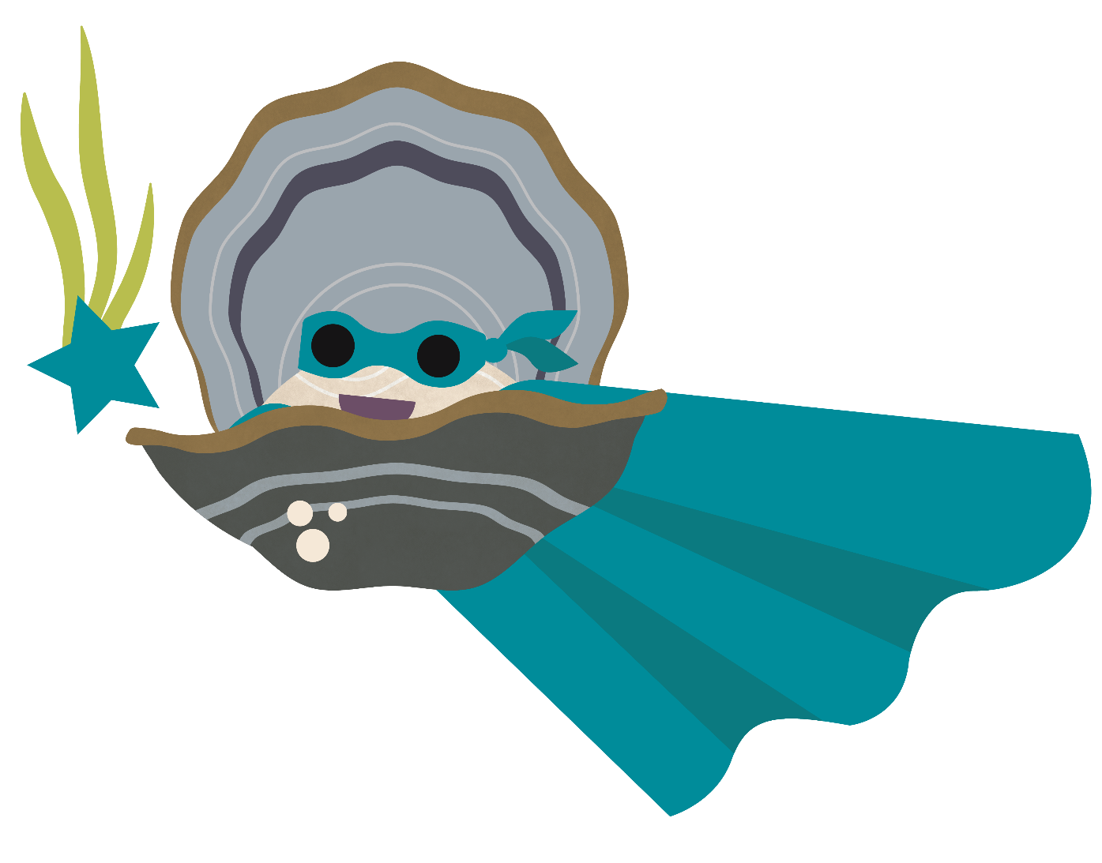
The world needs oysters Emergency service: Oysters indirectly help us to combat climate change. By filtering our seas and keeping them clear, oysters allow more sunlight to reach deeper into our seas, encouraging plants like seagrass to grow, which fight climate change by absorbing carbon dioxide and releasing oxygen.

Slide 14
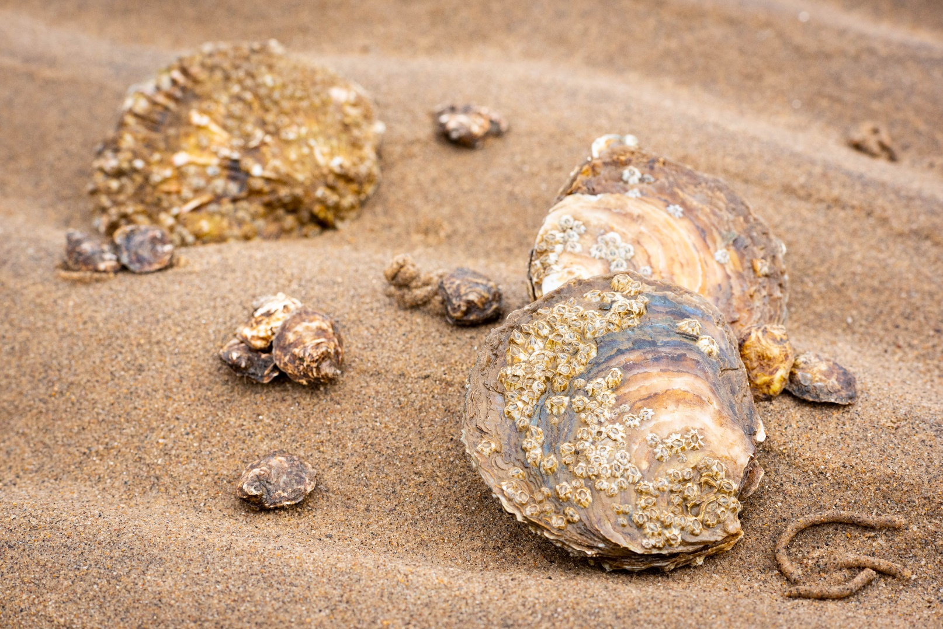
Oysters in Yorkshire There used to be a flat oyster reef so large in the Humber estuary that it stretched across the entire width of the estuary and was so big that the oysters’ hard shells were a danger to ships! Sadly, because of overfishing and pollution, that oyster reef is now a distant memory and only a few flat oysters remain.

Slide 15
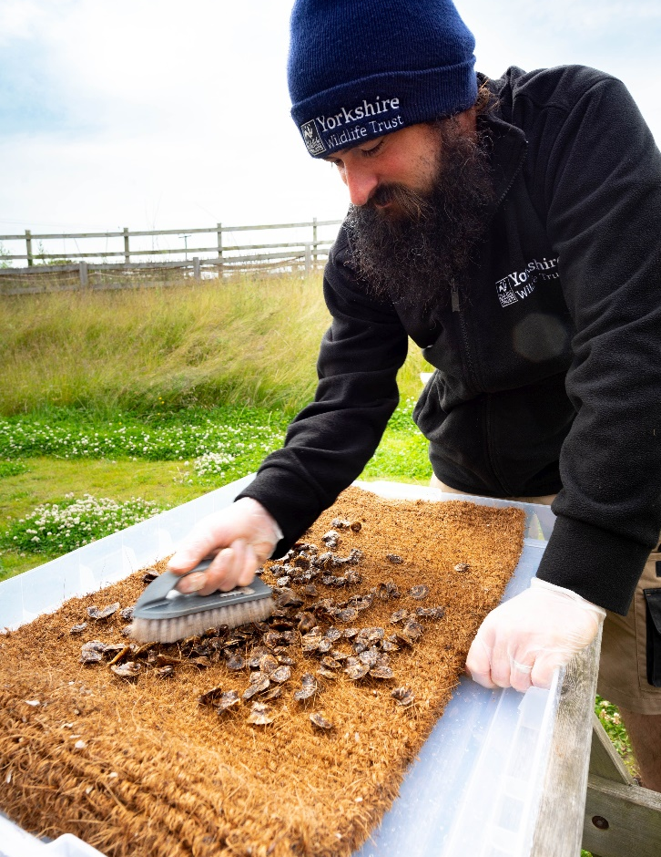
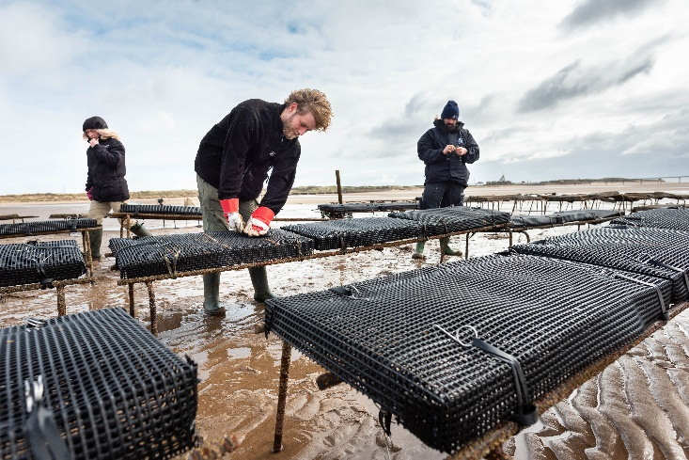
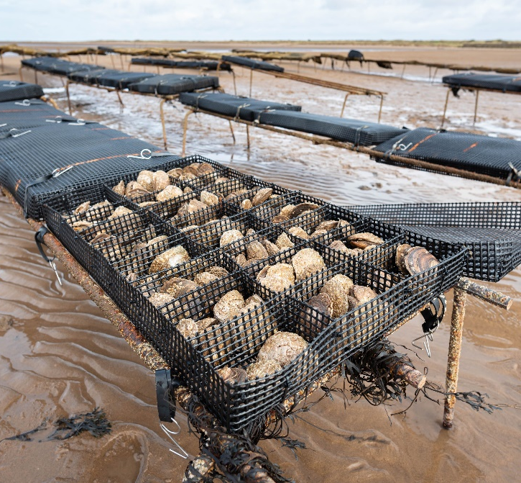
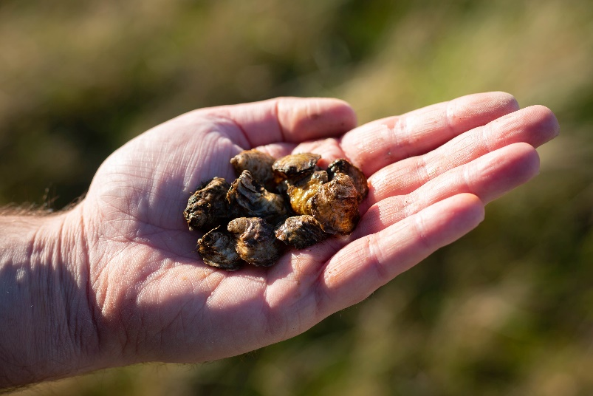
Bringing oysters back to the Humber… Yorkshire Wildlife Trust are working hard to bring flat oyster reefs back to the Humber estuary. Explore the process below that our expert team follow to restore oyster reefs at Spurn National Nature Reserve: Step 1: 100,000 juvenile flat oysters were brought over from the west coast of England in 2021 Step 2: The oysters were cleaned and checked to make sure that they didn’t transfer any undesirable organisms or invasive species into the Humber

Slide 16
Step 3: The oysters were quarantined in containers of UV-sterilised seawater to ensure that the water inside the oysters wasn’t harbouring anything harmful Step 4: The oysters were placed into specially designed mesh boxes that were then strapped to trestle structures fixed into the mudflats. This is to ensure we can keep a population of oysters safe and easy to monitor Step 5: Each month, our expert team of marine biologists check the oysters’ health, weight and growth. Hopefully, one day, there will once again be a thriving flat oyster reef in the Humber estuary!

Slide 17
Hopefully you’ve learnt lots about oysters and why they are superheroes of the sea. Now have a go at the quiz and the practical activity!

