Slide 1
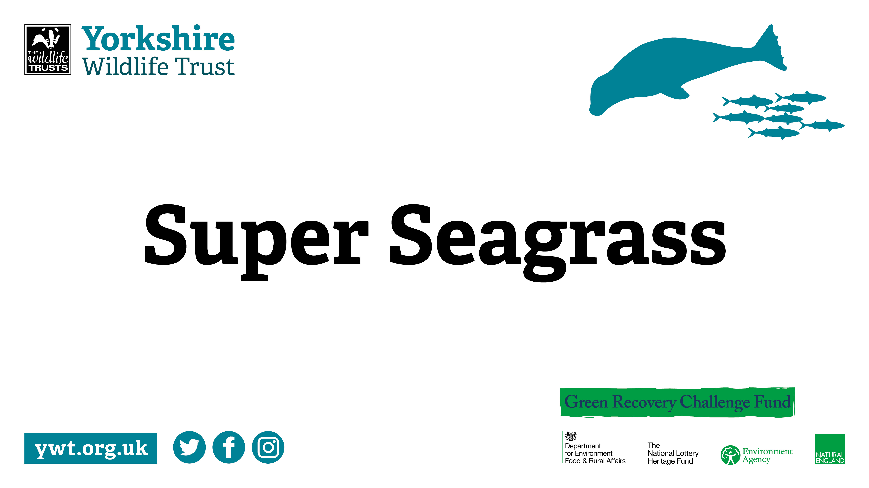

Slide 2

Learning Outcomes
By the end of today, you should be able to: n Describe what seagrass is n Describe the process of photosynthesis n Explain the function of the organs of seagrass n Discuss why seagrass is special and why it is important that we protect it

Slide 3
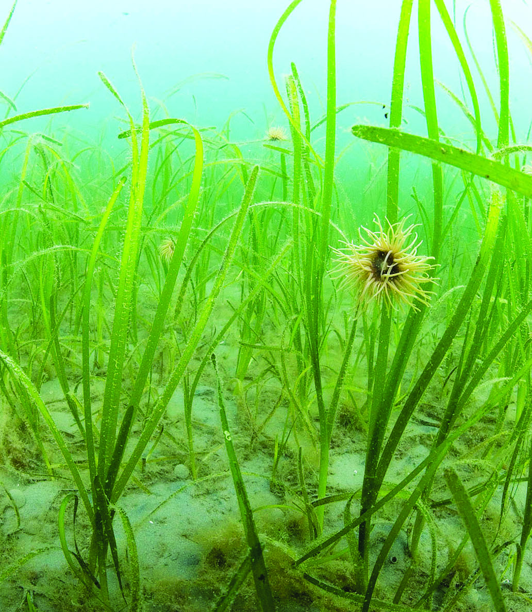
Introduction to seagrass
Seagrass is a marine flowering plant. n There are around 50 species of seagrass found around the world. In the UK, there are two species of seagrass (Zostera noltii and Zostera marina) n The only continent in the world where seagrass isn’t found is Antarctica as it’s too cold n Seagrass lives in shallow, calm coastal waters, and most species like to live in muddy or sandy habitats.

Slide 4
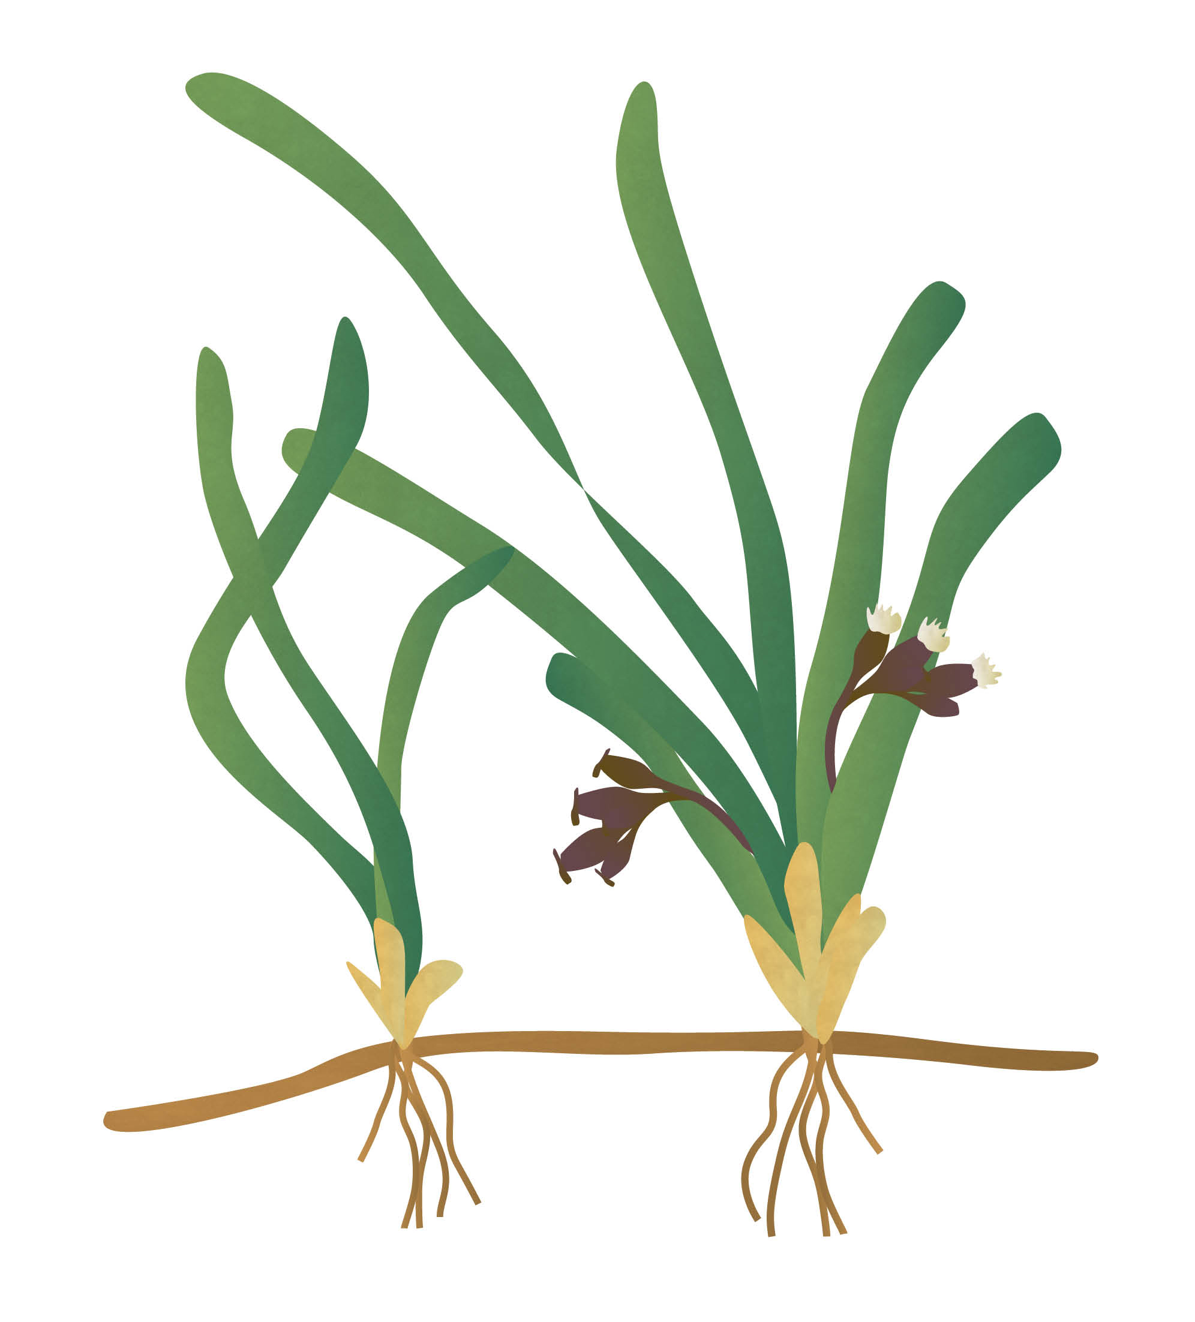
The different parts of seagrass
Seagrass is similar to flowering plants we find on land.
The fruit protect the seeds and help the plant to disperse the seeds
The fronds absorb sunlight and use light energy to make food for the plant through photosynthesis
The stem supports the fronds and flowers, and transports water and nutrients from the roots to the fronds
The flowers allow the plant to sexually reproduce
The rhizome is an underground stem that stores nutrients, and from which the roots and stems grow during asexual reproduction
The roots take up nutrients from the seabed and keep the plant upright

Slide 5
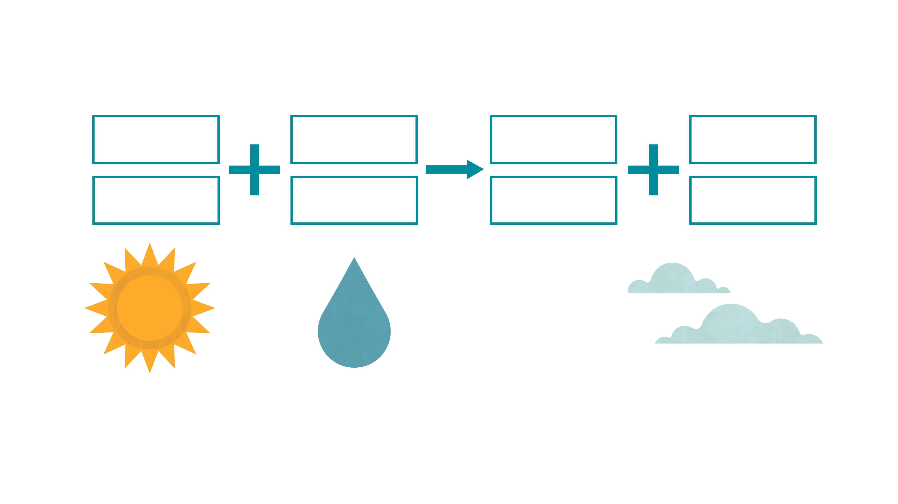

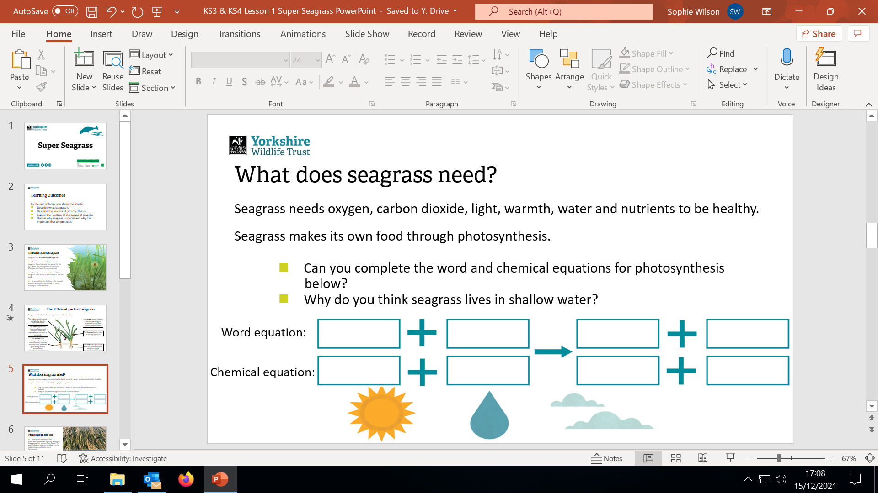
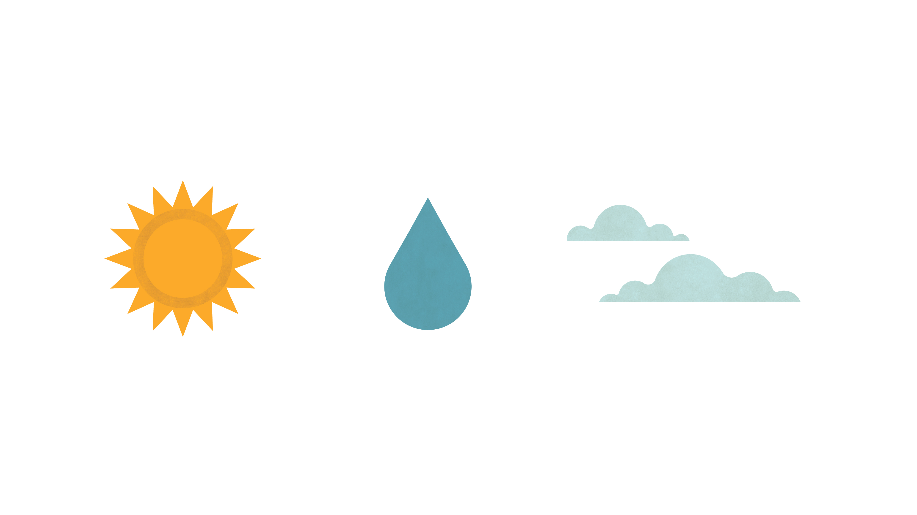





What does seagrass need?
Seagrass needs oxygen, carbon dioxide, light, warmth, water and nutrients to be healthy.
Seagrass makes its own food through photosynthesis.
n Can you complete the word and chemical equations for photosynthesis below?
n Why do you think seagrass lives in shallow water?
Word equation:
Chemical equation:
Notes:
Word equation: Carbon dioxide + Water -> Glucose + Oxygen
Chemical equation: 6CO2 + 6H2O -> C6H12O6 + 6O2
Seagrass lives in shallow water as it needs sunlight to photosynthesise to make its own food.

Slide 6
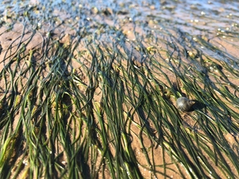
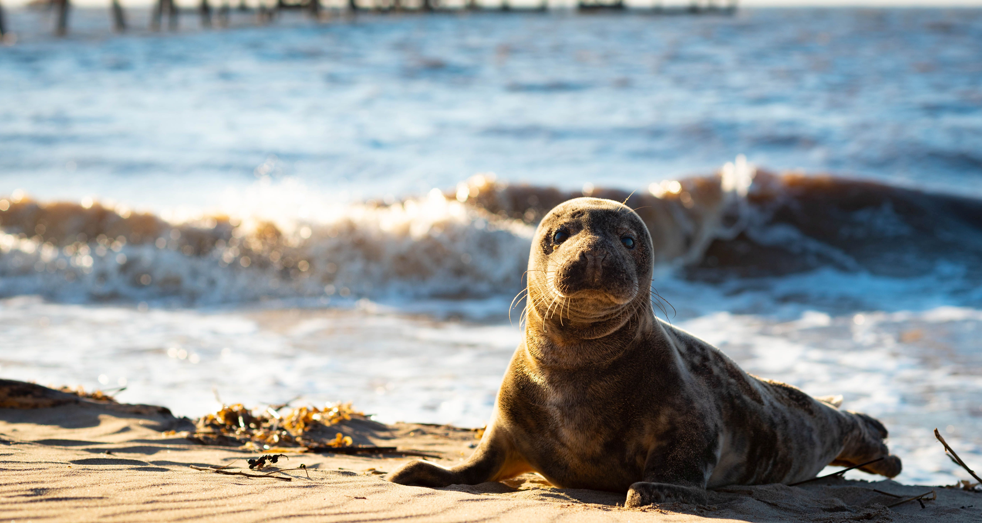
Meadows in the sea n Seagrasses can create lush underwater meadows, some of which are large enough to be seen from Space! The world’s largest seagrass meadow is in the Indian Ocean and is the size of Switzerland! n Seagrass meadows provide shelter and food for a huge variety of animals, including crabs, sea snails, fish, seabirds and marine mammals n Seagrass meadows provide a fantastic habitat that can support up to 30 times more animals than in nearby areas of bare sand.

Slide 7
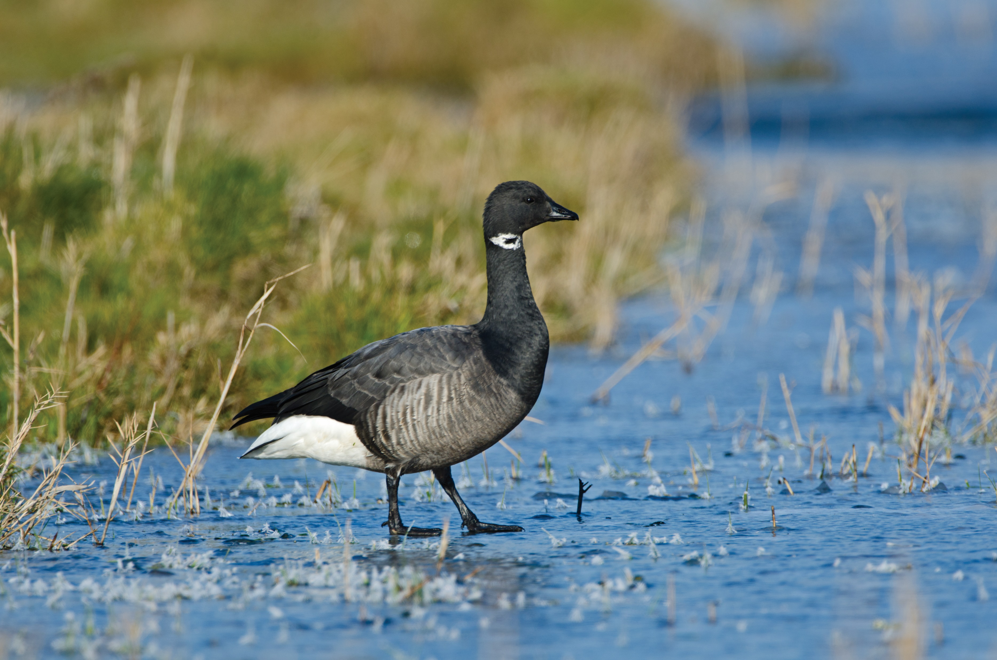
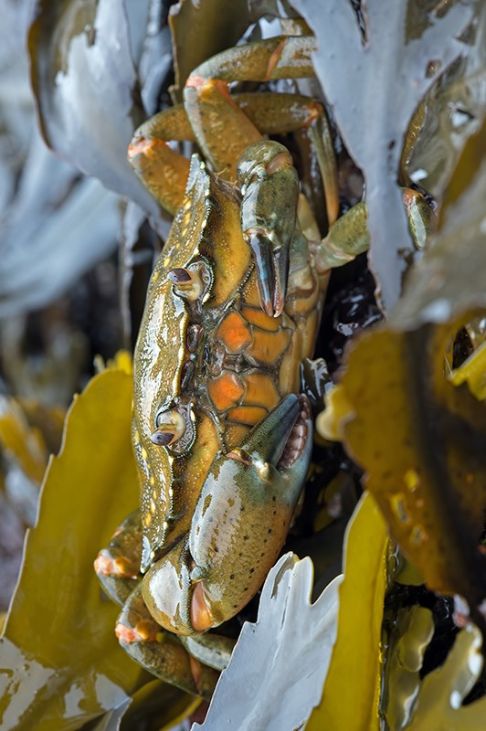
Who uses seagrass meadows? n Seahorses attach themselves to seagrass fronds n Sharks, rays and fish such as seabass use seagrass meadows as shallow water hunting grounds n Brent geese feed on seagrass during the winter n The sheltered conditions of the seagrass meadow make for a perfect nursery for juvenile fish. It’s thought that seagrass meadows support a fifth of all commercial fisheries around the world!

Slide 8
Seagrass and the environment
n Seagrass meadows stabilise coastal mud and sand flats. This helps to absorb wave energy and reduce coastal erosion
n Seagrass is known as the lungs of the sea. It can produce 10 times more oxygen than trees!
n When seagrass photosynthesises, it absorbs carbon dioxide. Seagrass meadows absorb carbon dioxide 35 times faster than tropical rainforests and are responsible for 15% of the ocean’s total carbon absorption.

Slide 9
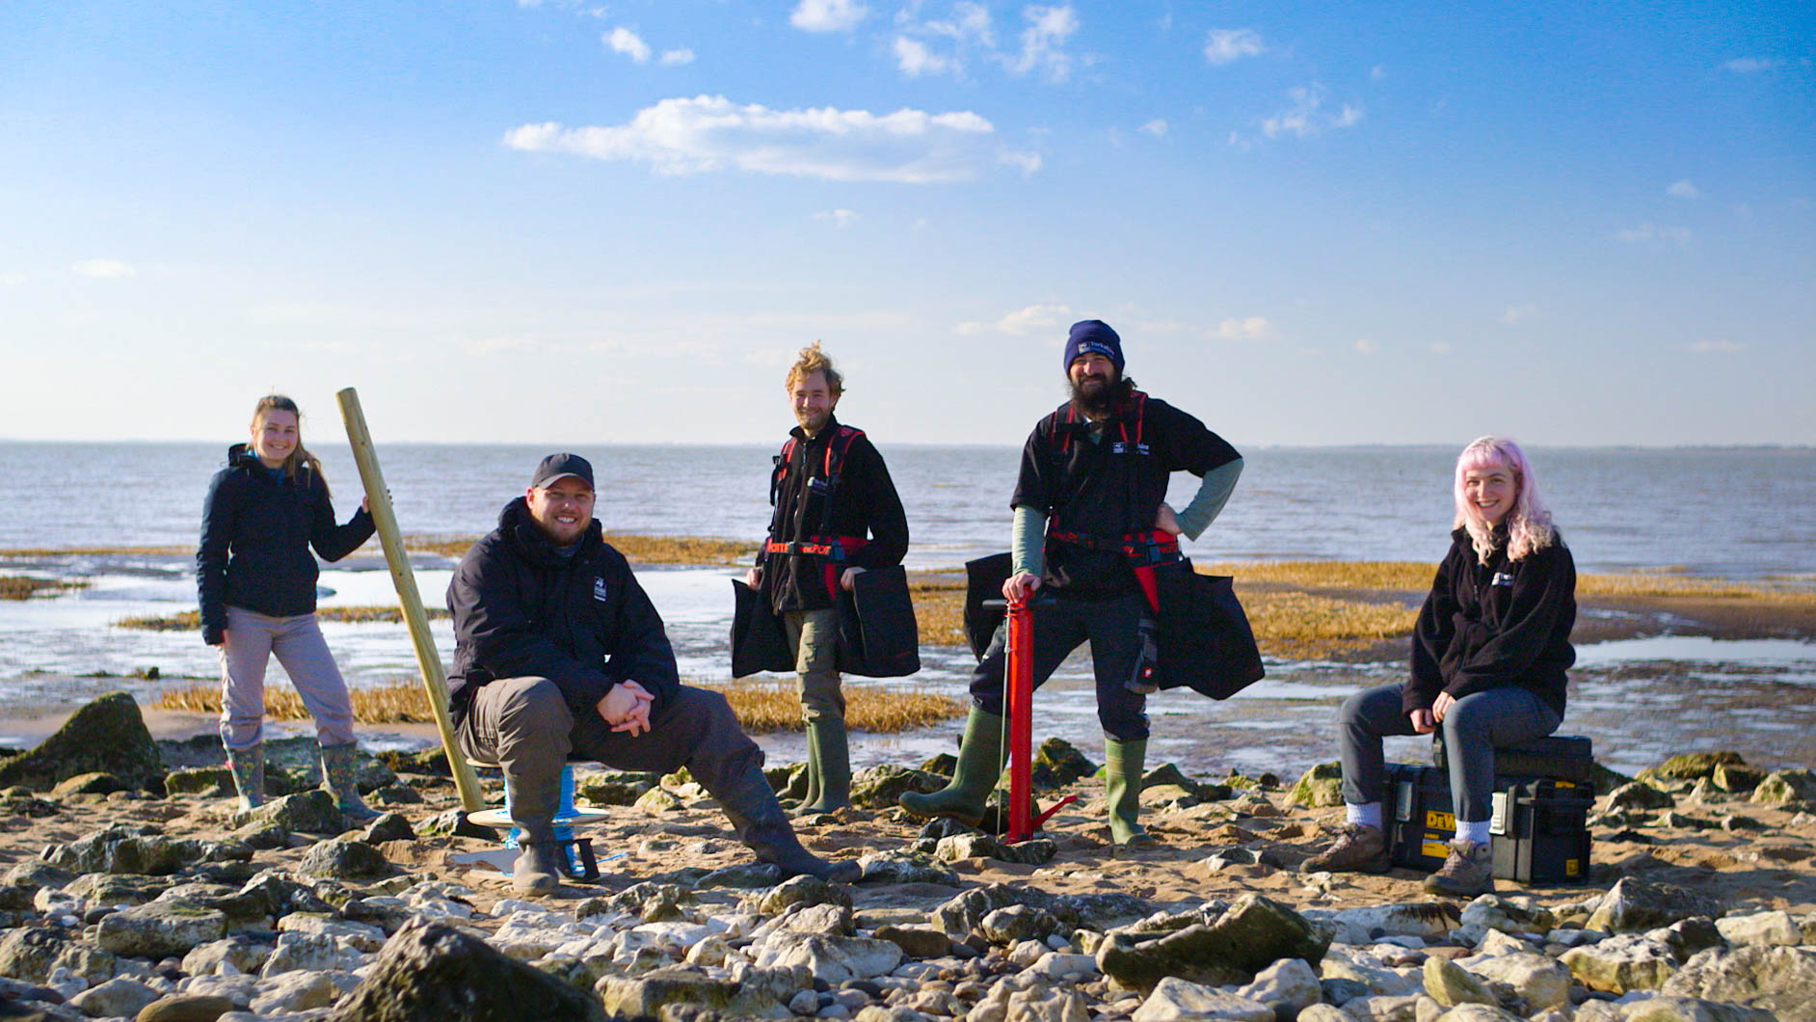
A planet saving plant!
In the 1900s, there was a seagrass meadow at Spurn National Nature Reserve in East Yorkshire that stretched across 480 hectares - that’s the equivalent to more than 700 football pitches! Sadly, today less than 5% of that seagrass meadow is left.
But there’s good news! Our team of expert marine biologists are working tirelessly to restore Spurn’s seagrass meadow to its former glory, which will help the planet in the fight against climate change.

Slide 10
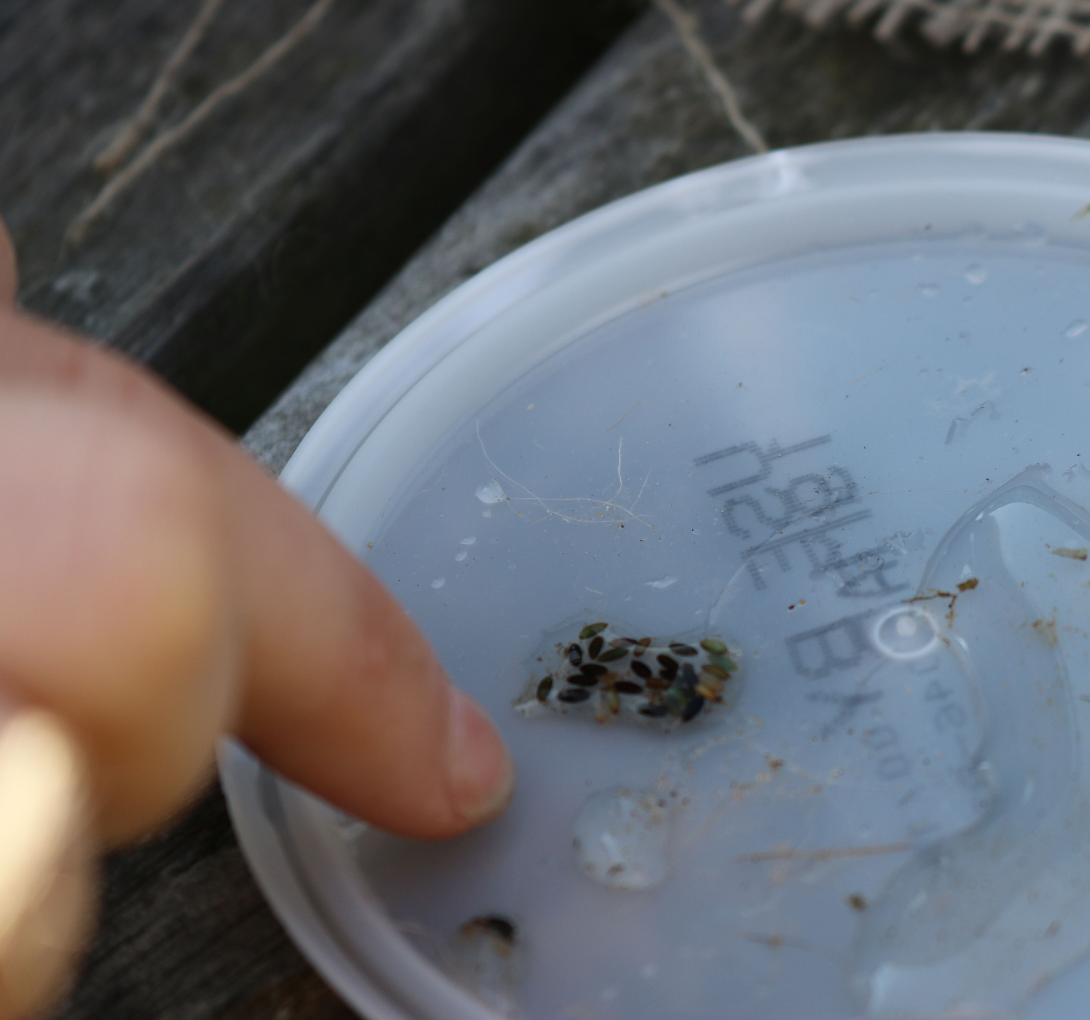
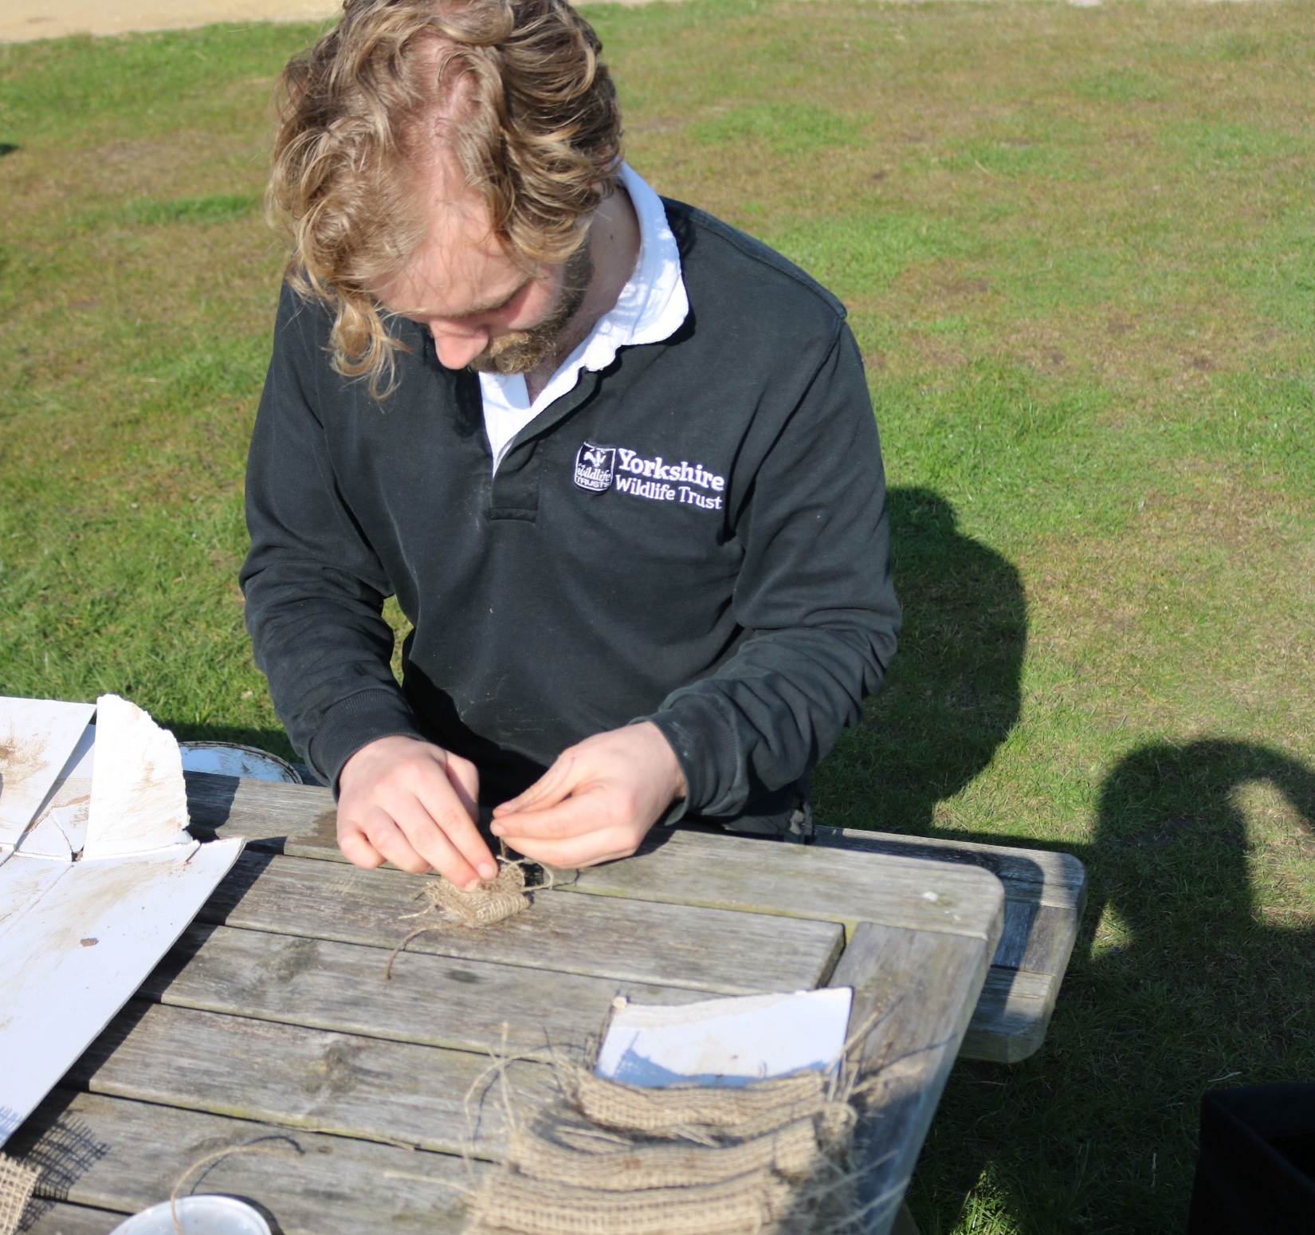
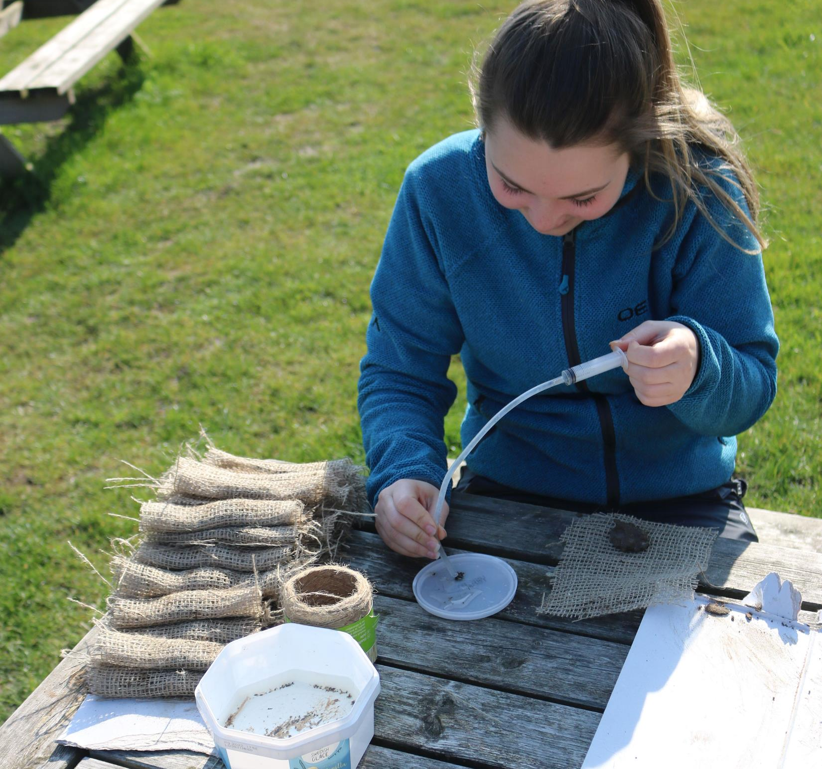
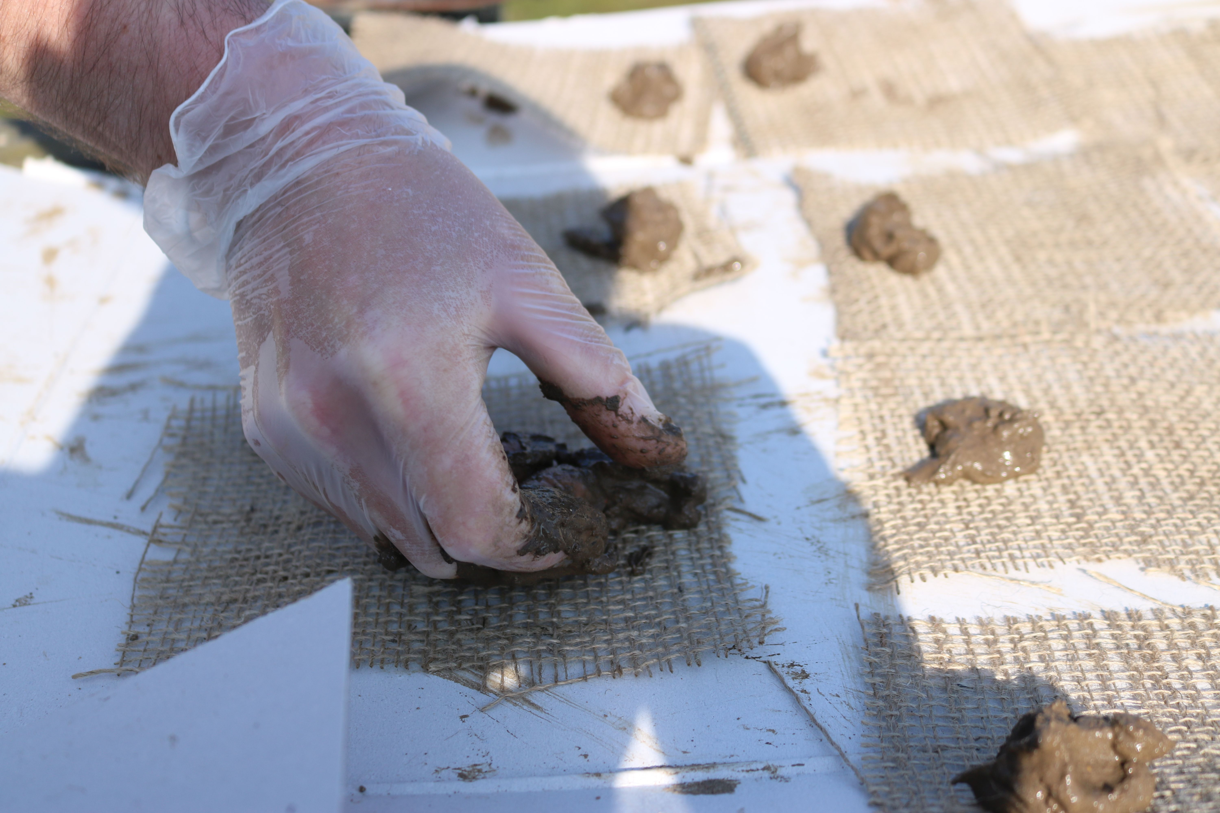
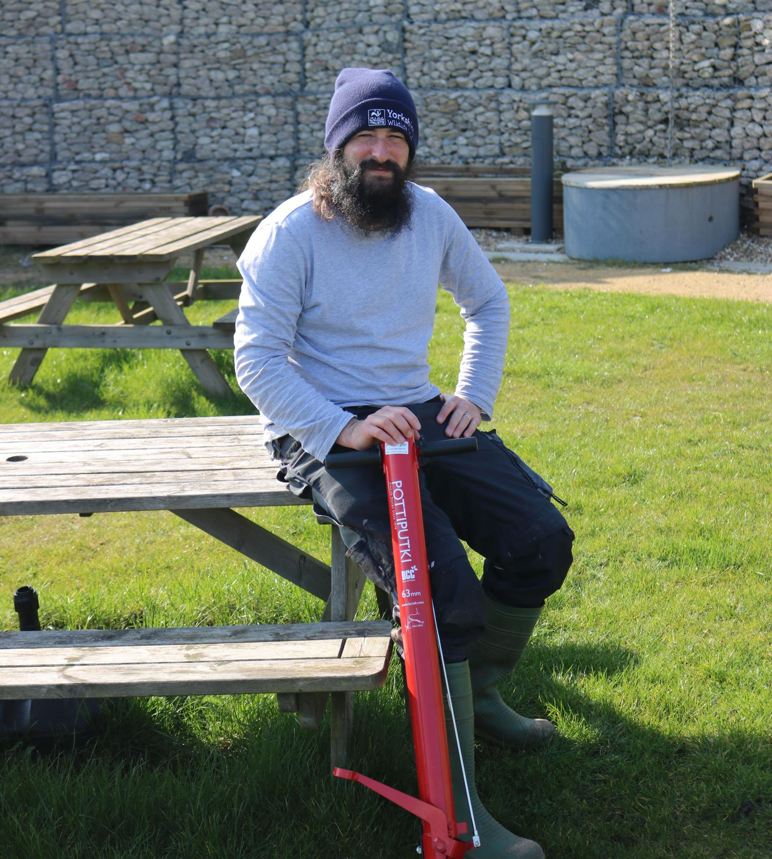
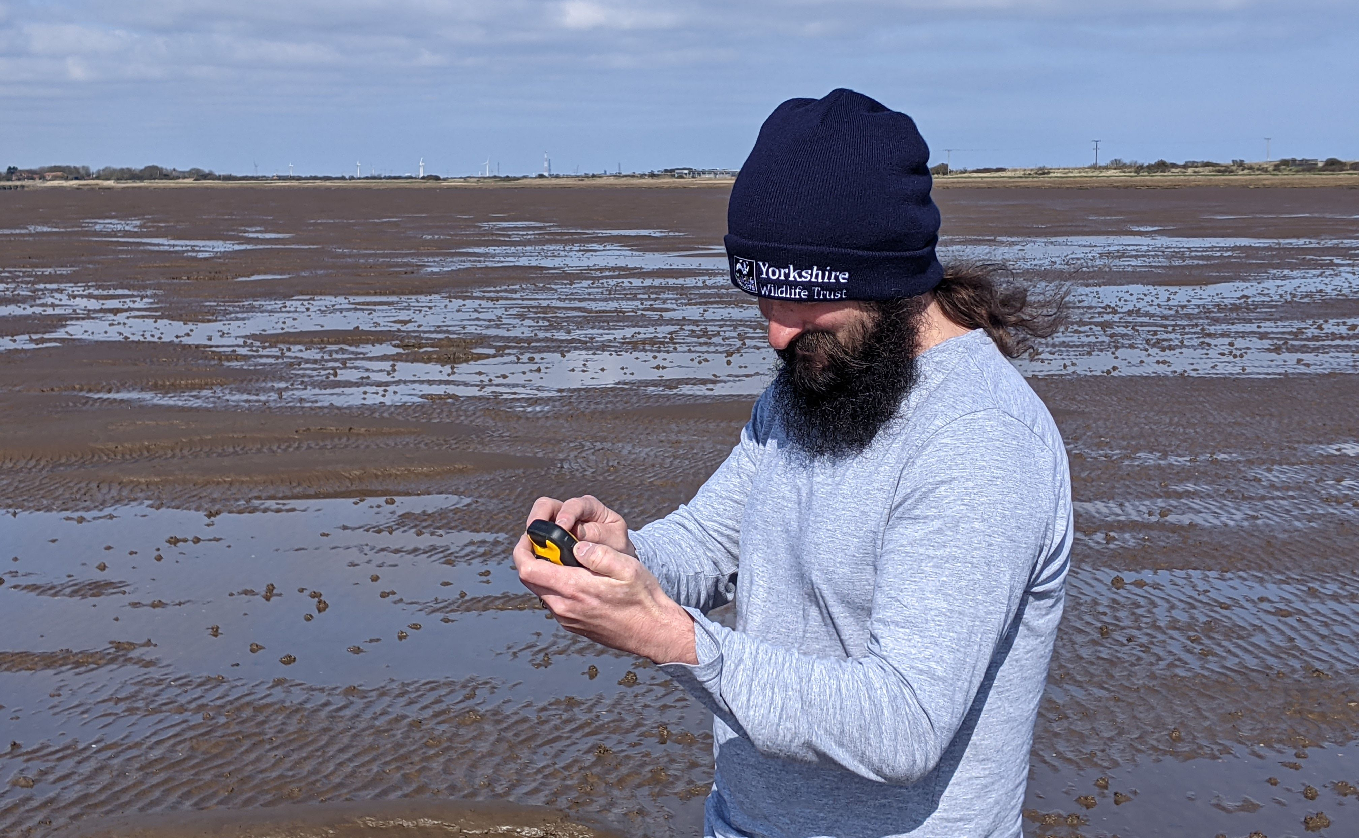
Restoring seagrass
Explore the planting process below that our team follow to restore seagrass at Spurn National Nature Reserve:
Step 1: The area for planting is marked off with posts to protect it
Step 2: Seagrass seeds are carefully collected from the remaining seagrass meadow
Step 3: Seeds are wrapped in biodegradable pouches so they are less likely to be swept away when planted
Step 4: Seed pouches are then planted by hand in the mud using a tool called a pottiputki.

Slide 11

Hopefully you’ve learnt lots about seagrass and why it’s such a super species. Now have a go at the quiz and the practical activity!

