Slide 1
Food Chains

Slide 2
Learning Outcomes By the end of today, you should be able to: n Describe what a food chain is n Explain the role of different organisms in a food chain n Explore how Ollie the oyster fits into the food chain

Slide 3
Some key definitions
An organism is a living thing.
A habitat is the place where an organism lives.
A community is all the different animals, plants and microorganisms that live together in a habitat.
A community of animals, plants and microorganisms, together with their habitat is called an ecosystem.

Slide 4
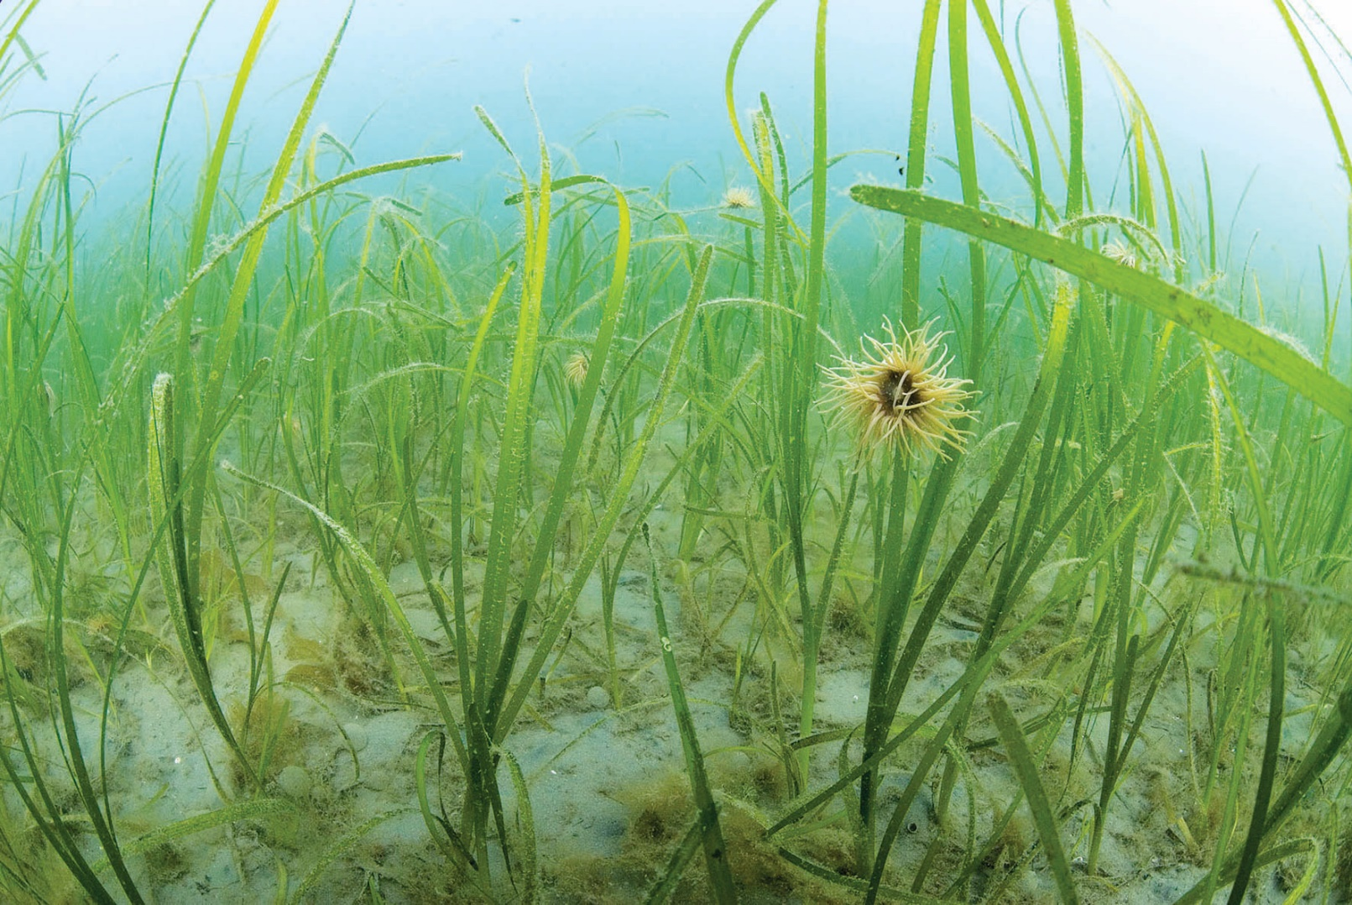
What is a food chain? n A food chain shows how plants and animals get their energy n A food chain always starts with a producer n A producer is an organism that makes its own food. Most food chains start with a green plant, because plants make their food through photosynthesis.
Seagrass is an example of a producer!

Slide 5
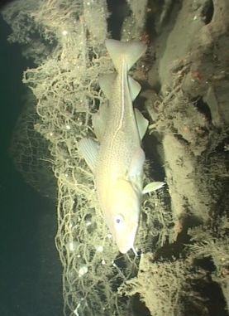
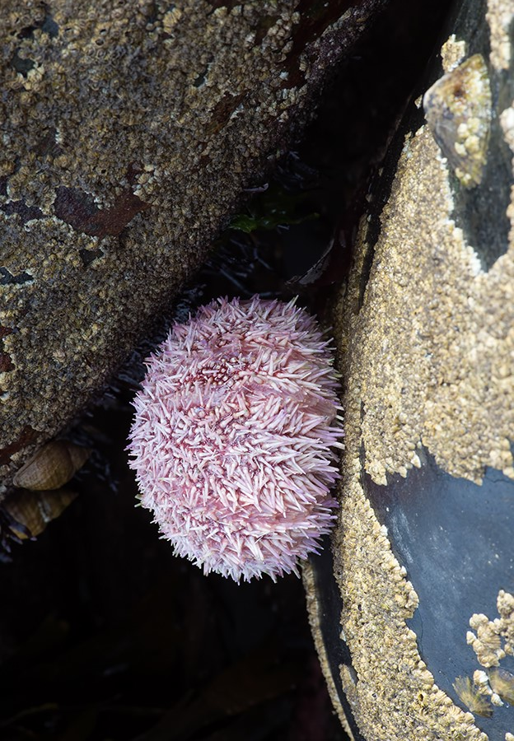
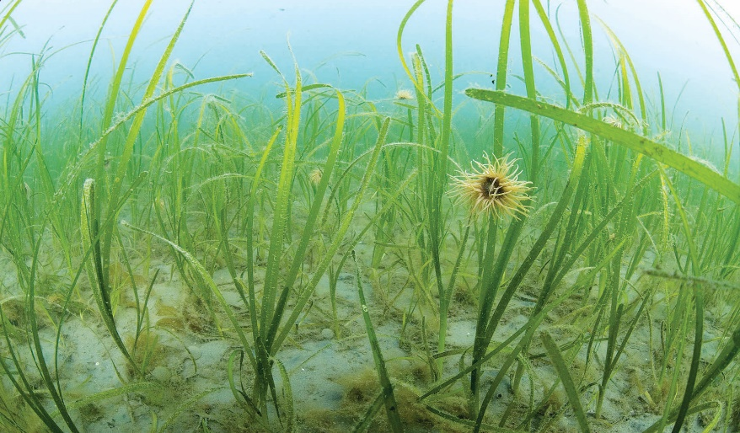
Cod
(Consumer)
What is a consumer?
n An organism that eats other plants and animals is called a consumer
n The arrows show us who eats who and the flow of energy in the food chain.
Urchin
(Consumer)
Seagrass
(Producer)

Slide 6
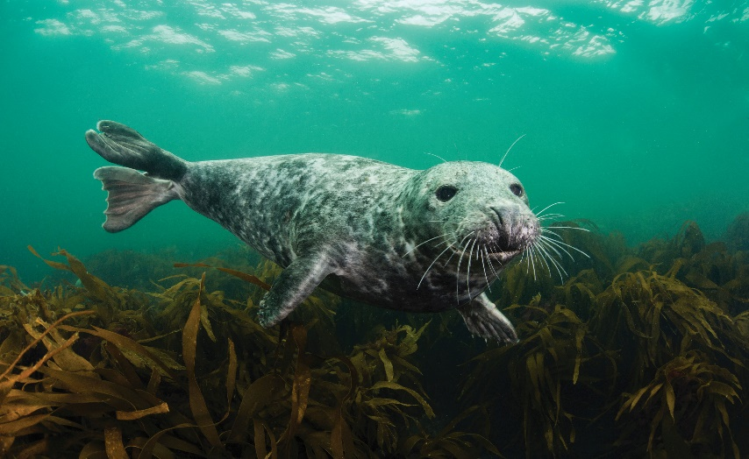
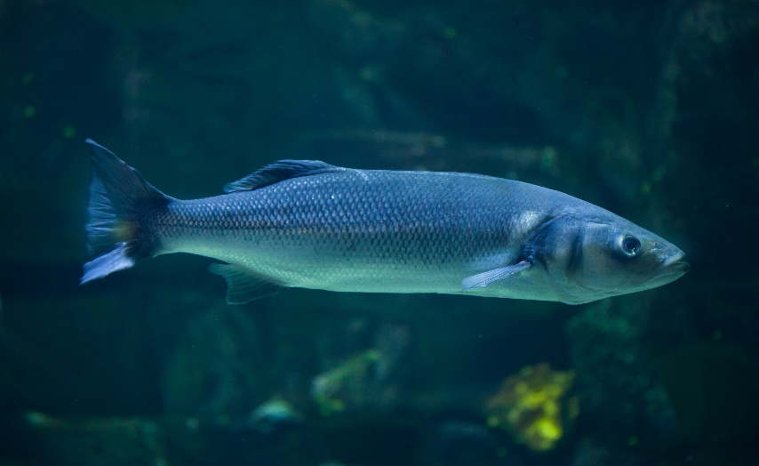
Predator vs. prey A predator is an animal that eats other animals.
The animals that predators eat are called prey.
Predators are found at the top of a food chain.
n Who is the predator and who is the prey with the animals below?
Grey seal
Seabass
Notes:
The grey seal is the predator and the seabass is the prey.

Slide 7
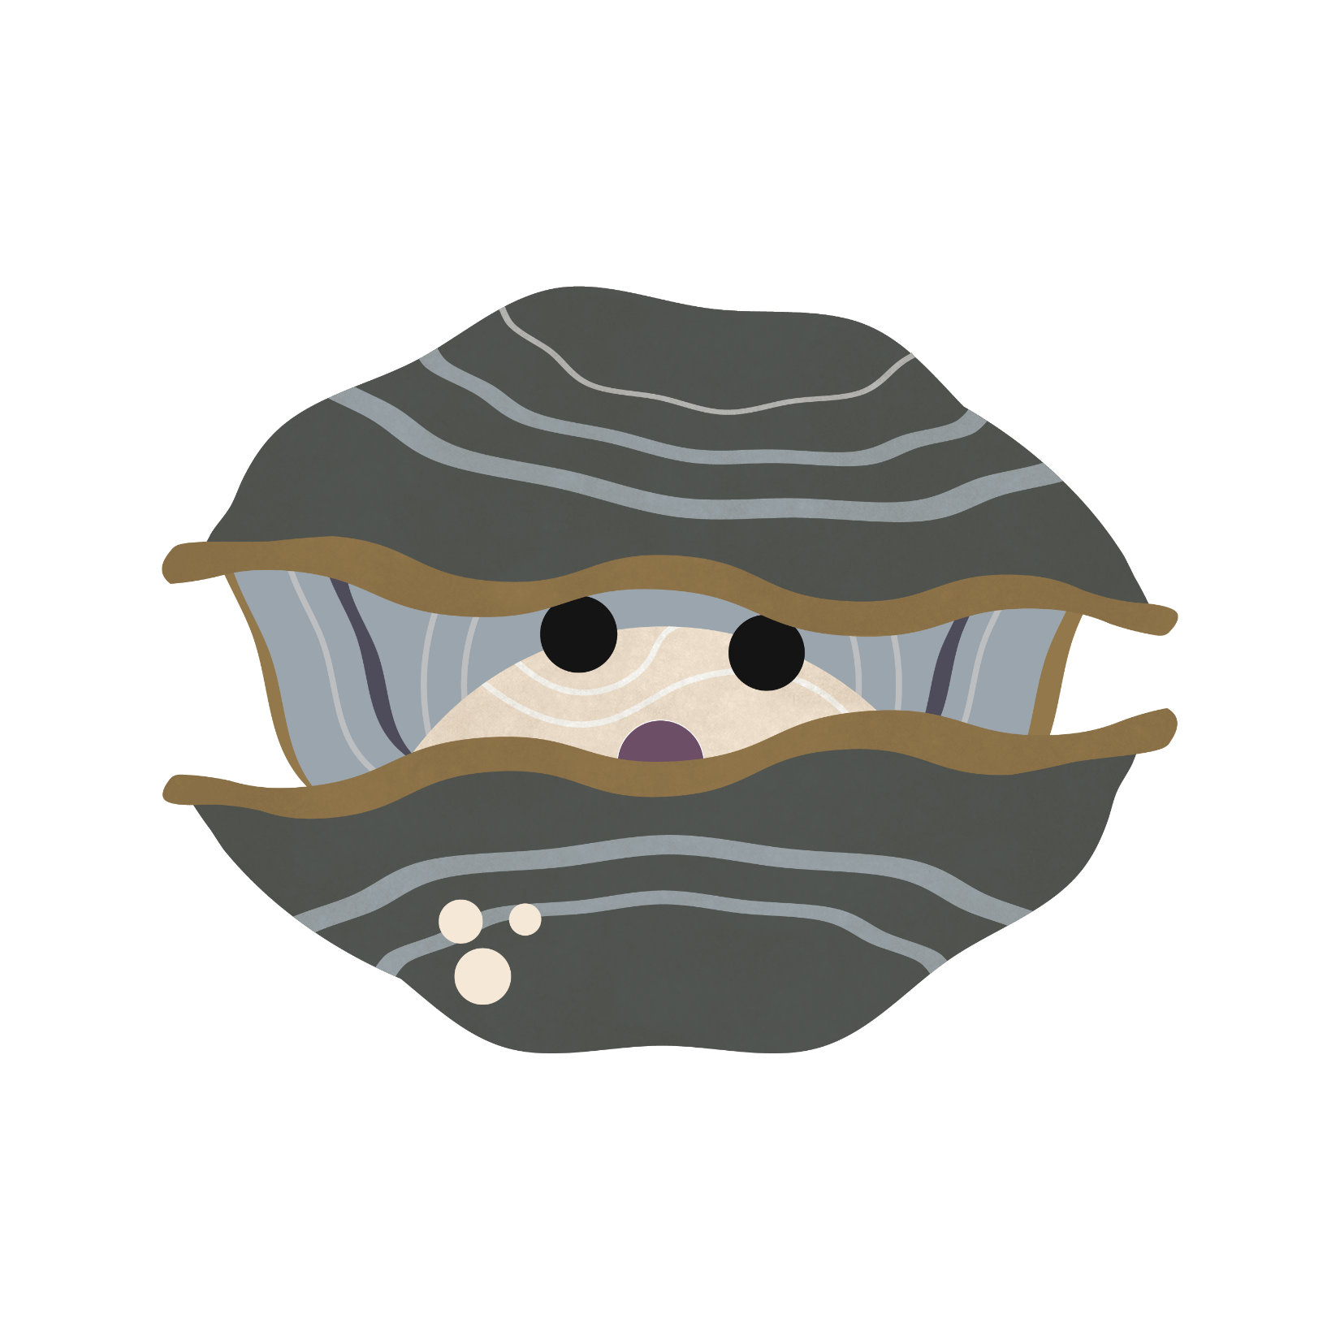
Where does Ollie fit in the food chain?
n Ollie is a flat oyster that lives at Spurn
n Ollie can’t make his own food so Ollie isn’t a producer
n Ollie eats tiny plants that float in the seawater, called phytoplankton
n If Ollie eats the producer, what do you think his role in the food chain is?

Slide 8
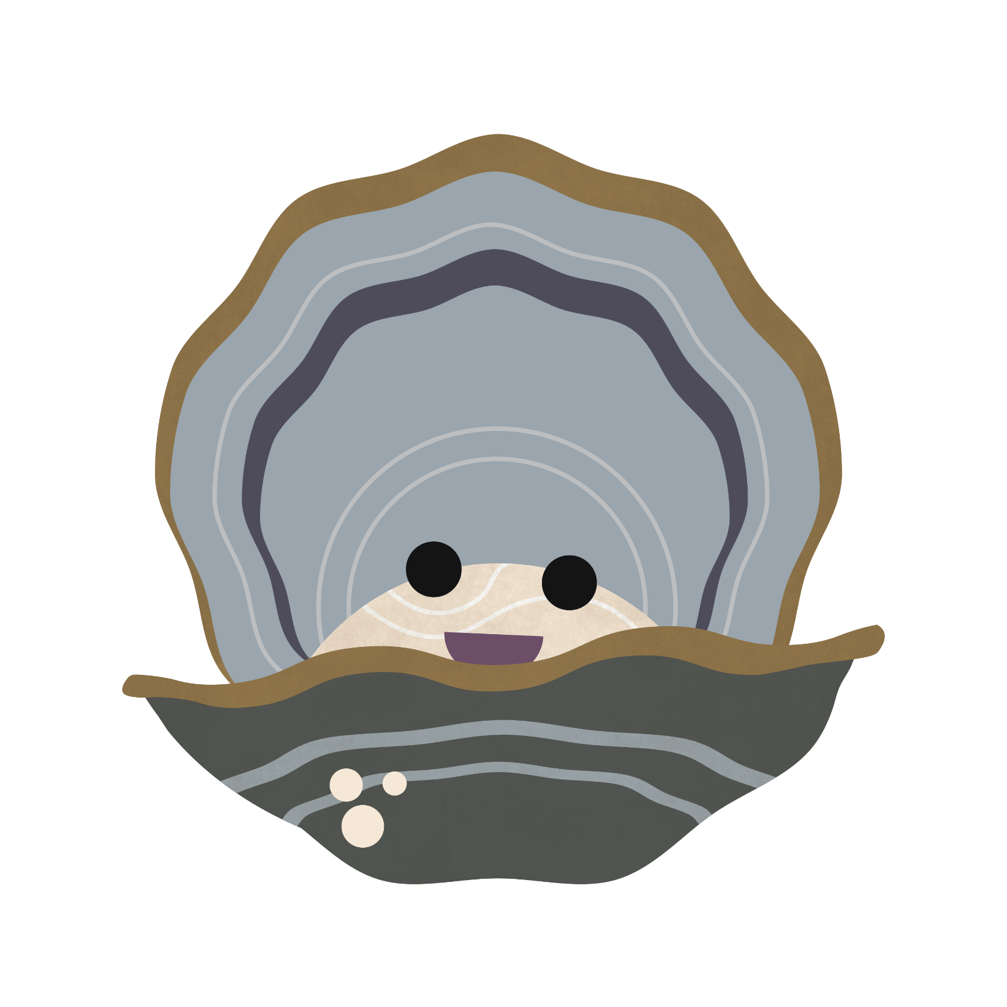
Where does Ollie fit in the food chain?
n Ollie is a consumer!
n Flat oysters like Ollie are food for other animals, like seabirds called oystercatchers
n If Ollie is food for other animals, is he the prey or the predator?
Answer: Flat oysters are the prey!

Slide 9
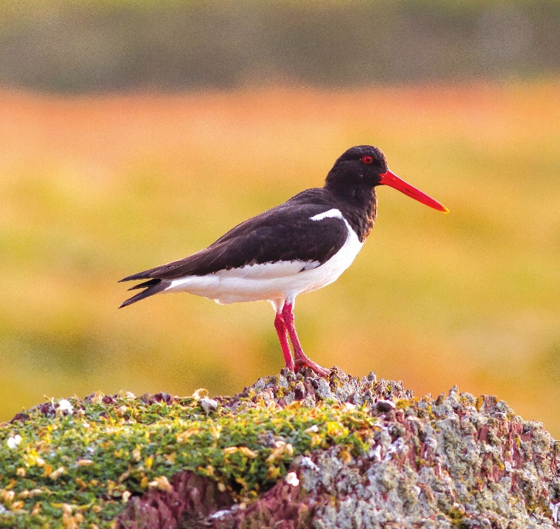
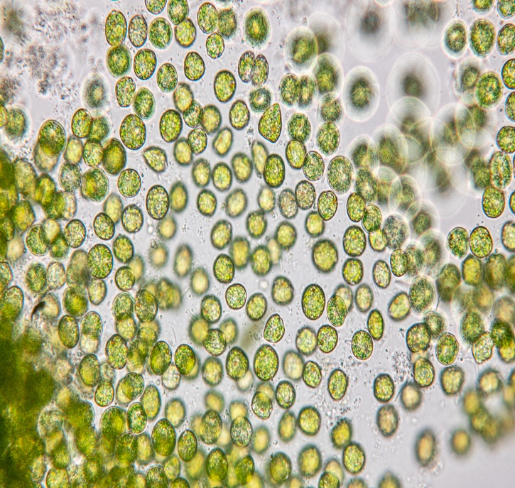
Can you rearrange the food chain?
n Can you put this food chain in order, starting with the producer?
n Who is the producer and who are the consumers?
Oyster catcher
Phytoplankton
Flat oyster
Notes:
Phytoplankton (producer) -> Flat oyster (consumer) -> Oyster catcher (consumer)

Slide 10
Hopefully you’ve learnt lots about food chains and the different roles organisms play. Now have a go at the quiz and the practical activity!

