Slide 2
Learning Outcomes By the end of today, you should be able to: n Describe what seagrass is n Explain the function of the organs of seagrass n Discuss why seagrass is special and why it is important that we protect it

Slide 3
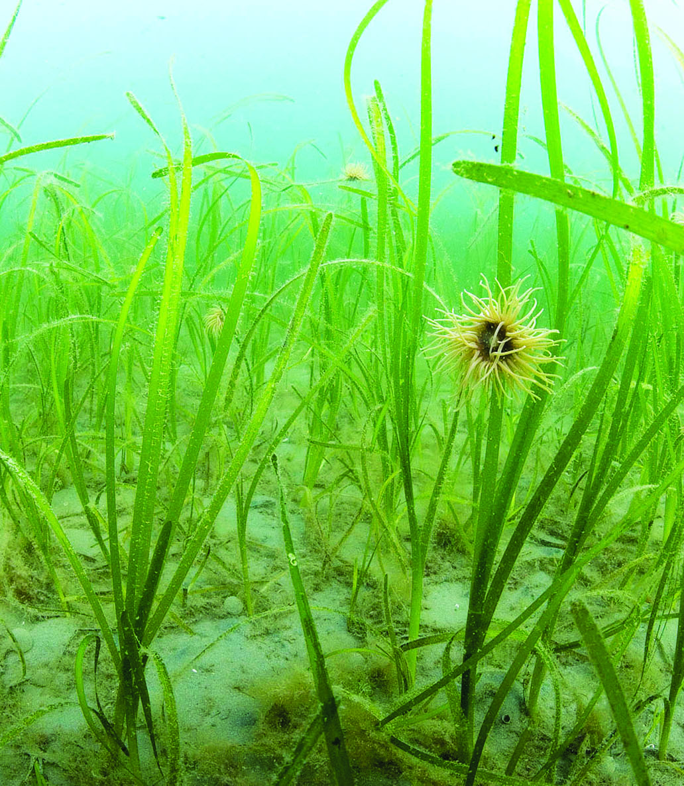
Introduction to seagrass n Seagrass is a flowering plant that lives in the sea n There are around 50 types of seagrasses found around the world. In the UK, we have two types of seagrass n The only continent in the world where seagrass isn’t found is Antarctica as it’s too cold n Seagrass lives in shallow, calm coastal waters, and most types like to live in mud or sand.

Slide 4
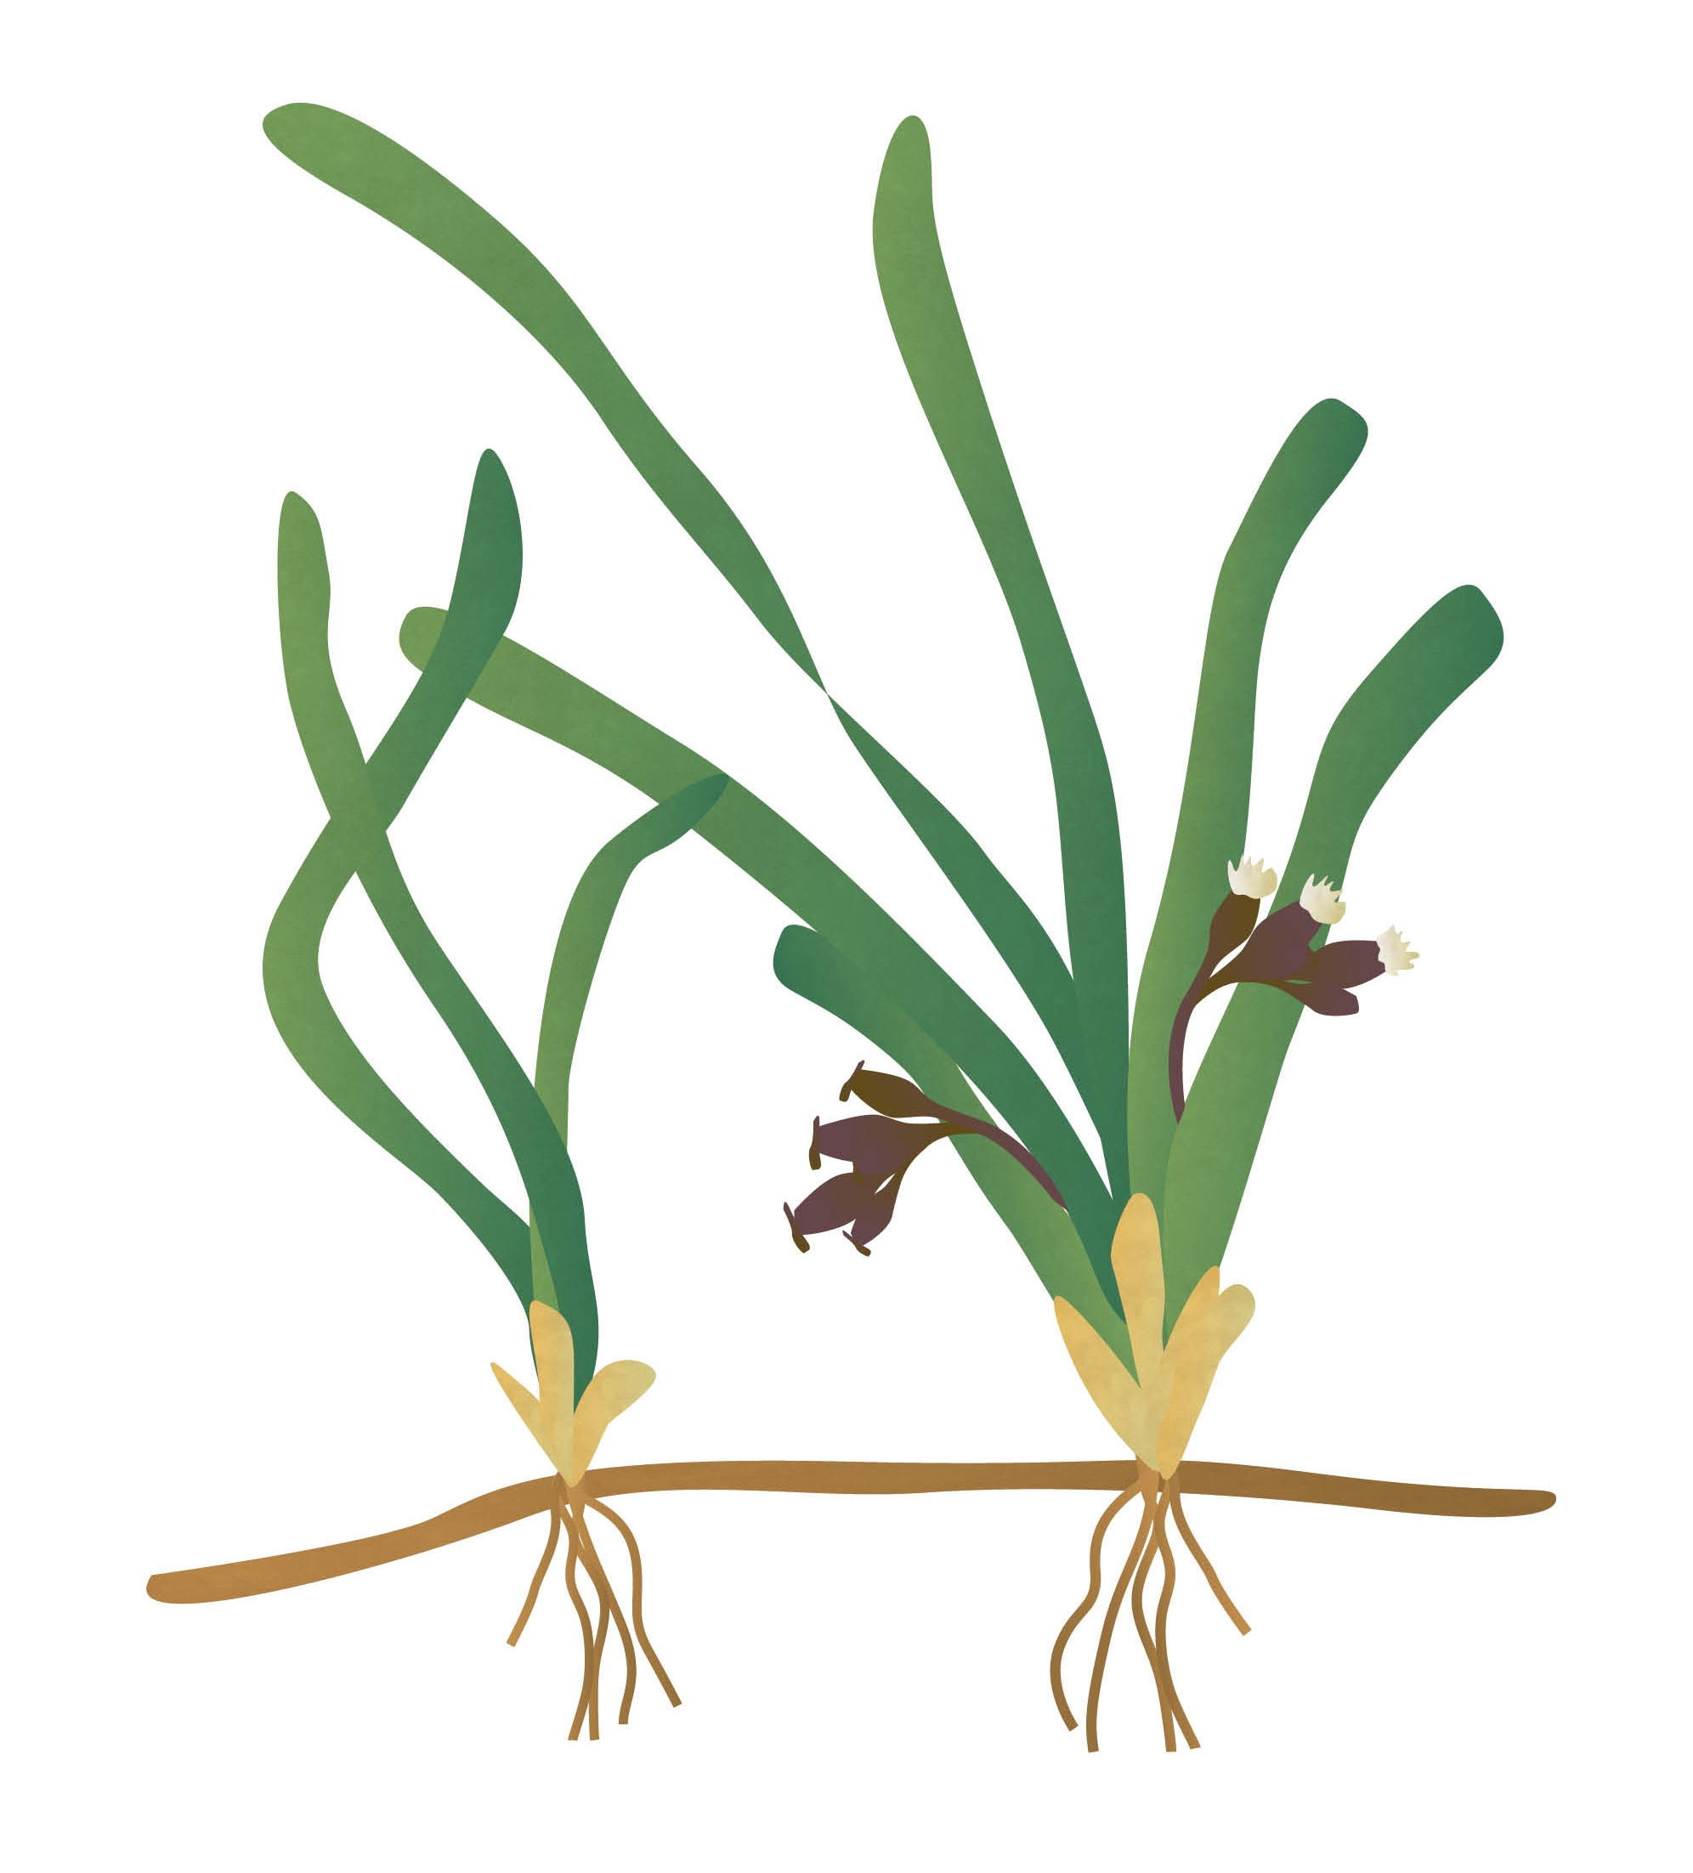
The different parts of seagrass
Seagrass is similar to flowering plants we find on land!
The fruit protect the seeds and then help the plant to disperse the seeds.
The fronds absorb sunlight and use it to make food for the plant through photosynthesis.
The stem supports the fronds and flowers, and transports water and nutrients from the roots to the fronds.
The flowers allow the plant to reproduce and produce seeds from which new plants grow.
The rhizome is an underground stem that stores nutrients, and from which the roots and fronds grow.
The roots take up nutrients from the seabed and keep the plant upright.

Slide 5
What does seagrass need?
Seagrass needs oxygen, carbon dioxide, light, warmth, water and nutrients to be healthy.
Seagrass makes its own food through photosynthesis.
n Why do you think seagrass lives in shallow water?
Notes:
Seagrass lives in shallow water as it needs lots of sunlight to photosynthesise to make its own food.

Slide 6
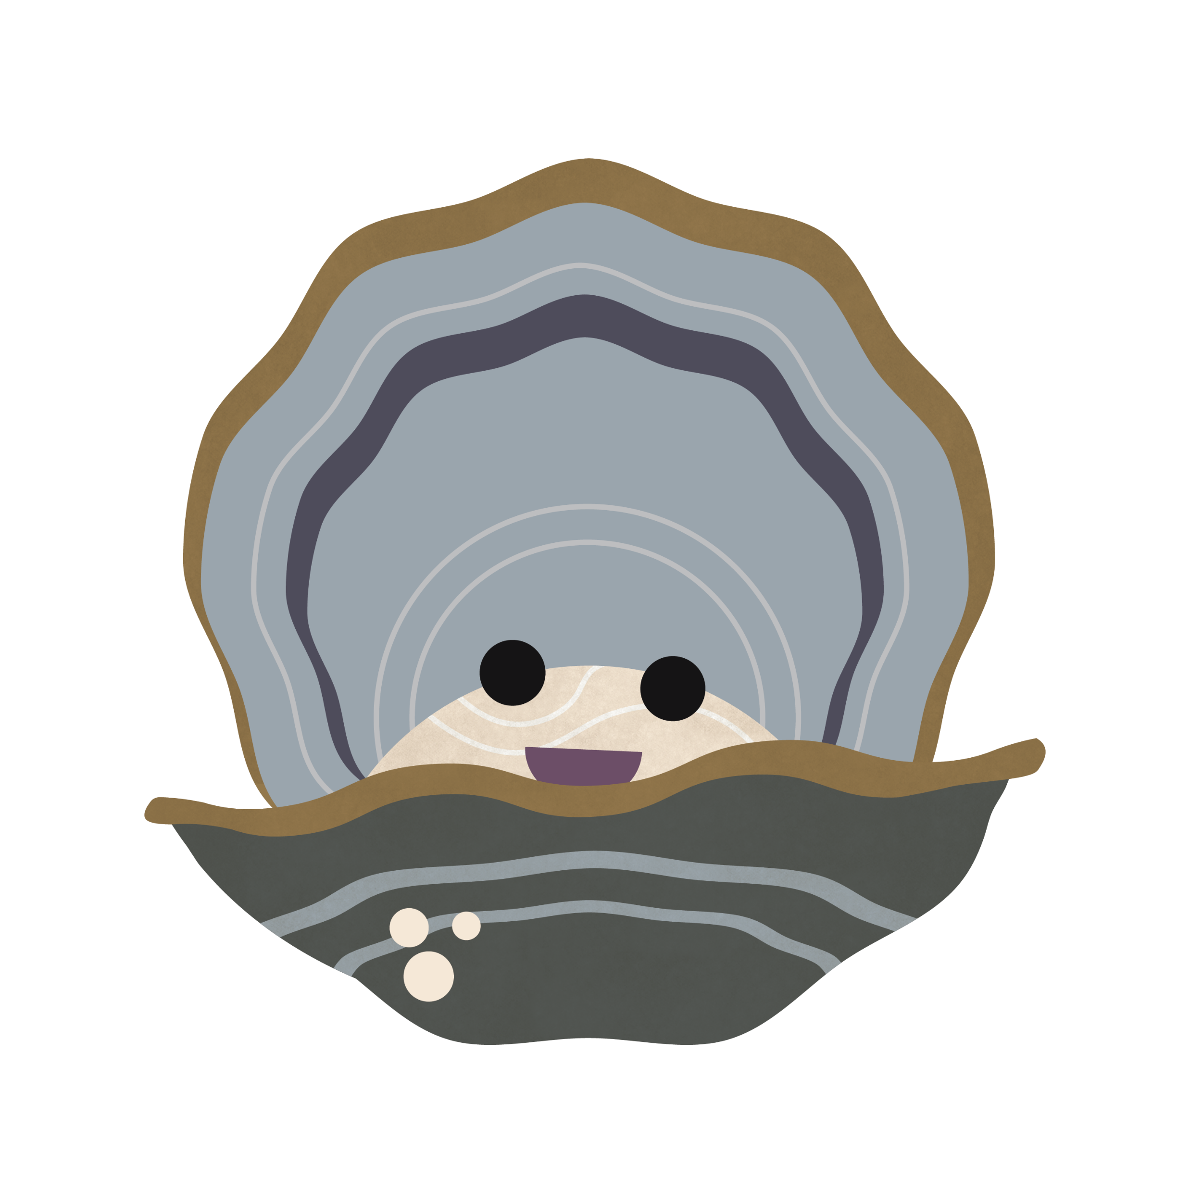
Ollie and seagrass
Flat oysters, like Ollie, have an amazing ability to clean seawater. Clearer seawater allows sunlight to reach deeper into the water, meaning that more sunlight is available for seagrass to use to make its own food through photosynthesis.

Slide 7
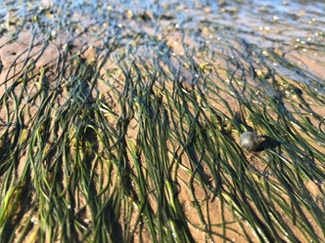
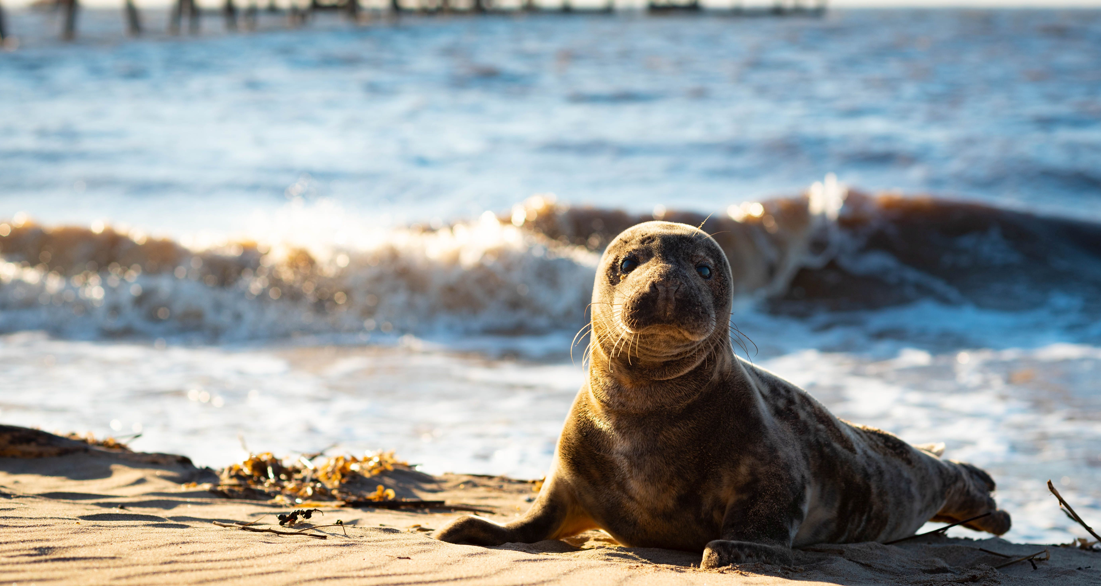
Meadows in the sea Seagrasses can create lush underwater meadows, some of which are large enough to be seen from Space! The world’s largest seagrass meadow is in the Indian Ocean and is the size of Switzerland! Seagrasses provide shelter and food for a huge variety of animals, including crabs, sea snails, fish, seabirds and marine mammals.

Slide 8
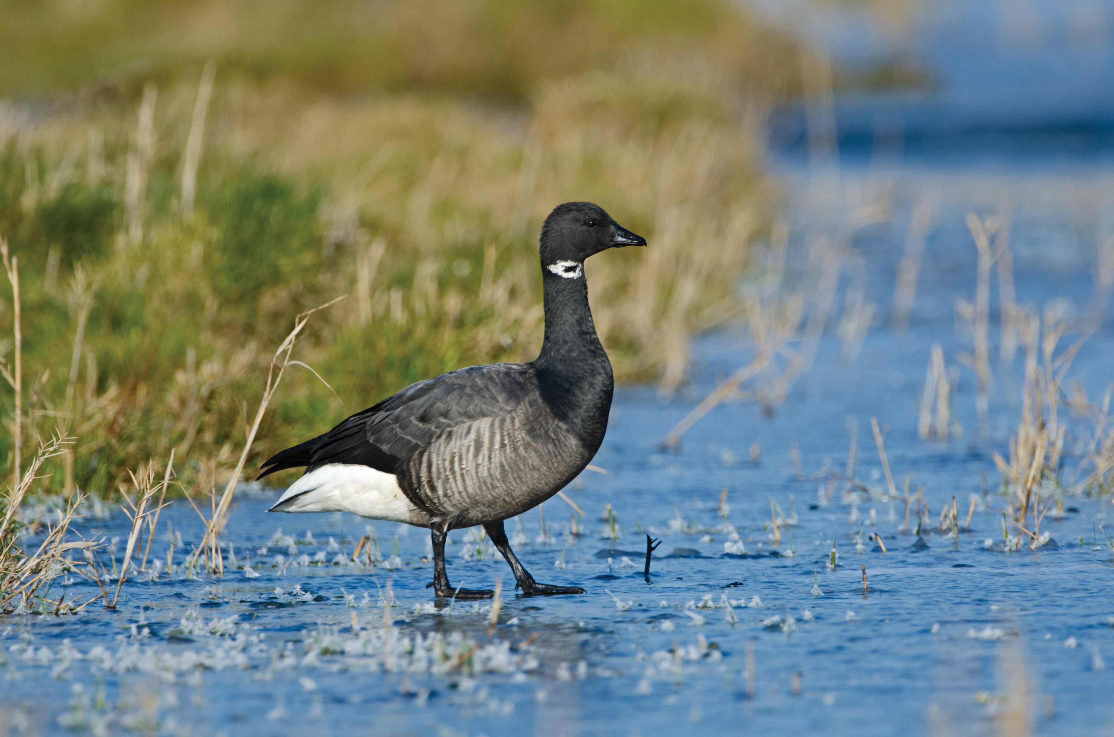
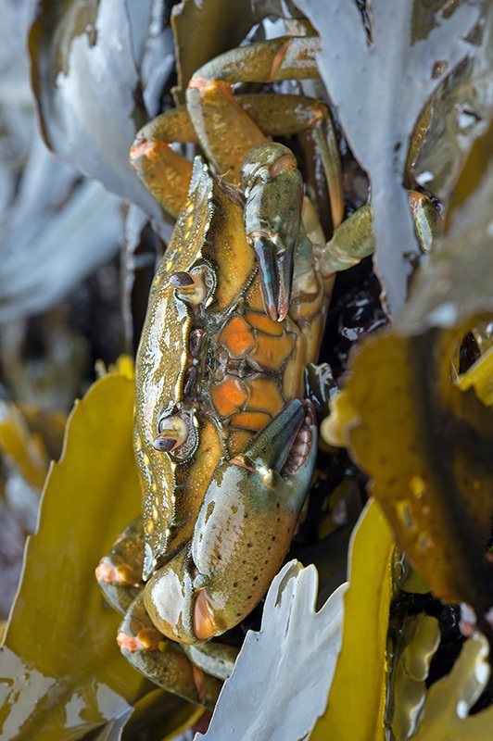
Who uses seagrass meadows? n Seahorses attach themselves to seagrass fronds n Sharks, rays and fish such as seabass use seagrass meadows as shallow water hunting grounds n Brent geese feed on seagrass during the winter n The sheltered conditions of the seagrass meadow make for a perfect nursery for young fish.

Slide 9
Seagrass and the environment n Seagrass is known as the lungs of the sea. It can produce 10 times more oxygen than trees n When seagrass photosynthesises, it stores carbon dioxide. Seagrass meadows store carbon dioxide 35 times faster than tropical rainforests!

Slide 10
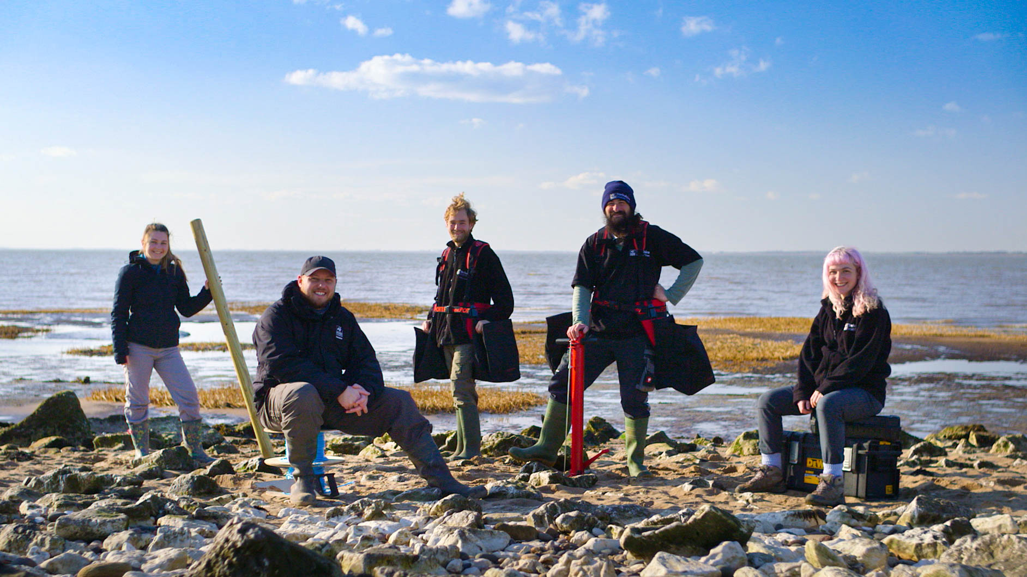
A planet saving plant! In the 1900s, there was a seagrass meadow at Spurn National Nature Reserve in East Yorkshire that stretched across 480 hectares - that’s the equivalent to more than 700 football pitches! Sadly, today less than 5% of that seagrass meadow is left. But there’s good news! Our team of expert marine biologists are working tirelessly to restore the seagrass meadow to its former glory, which will help the planet in the fight against climate change.

Slide 11
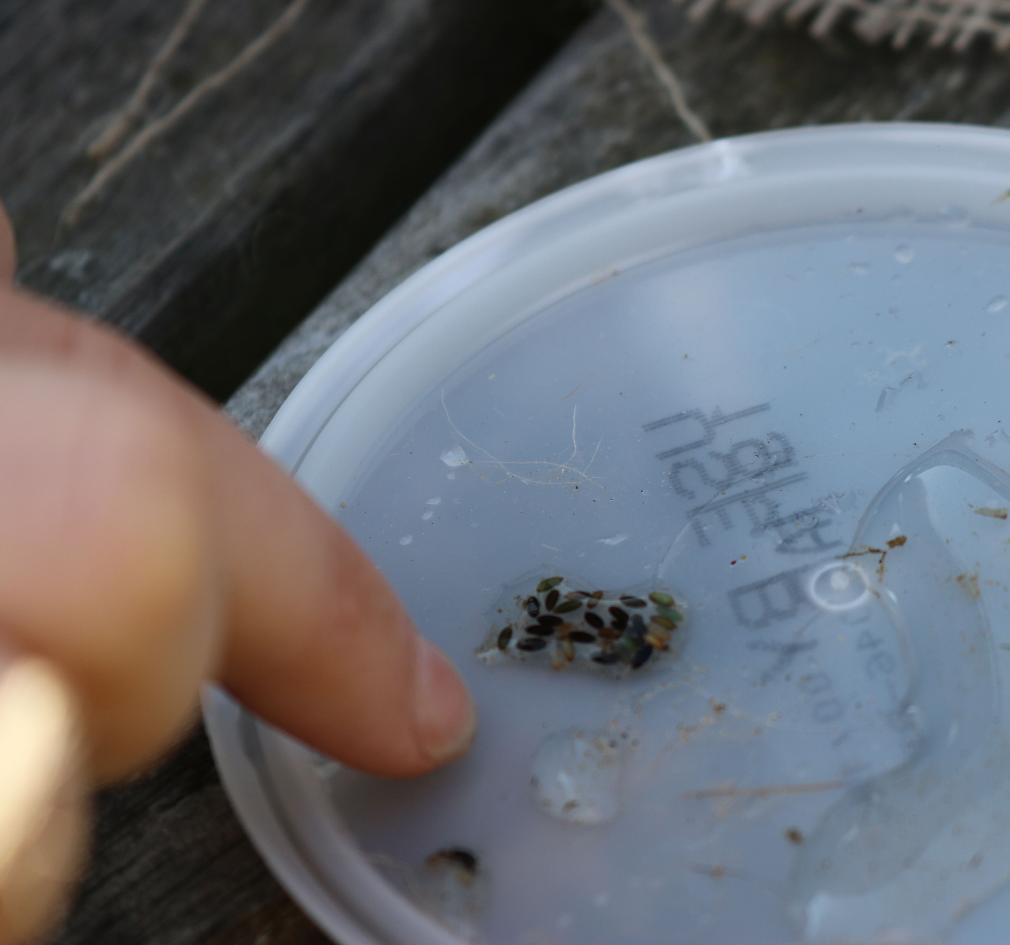
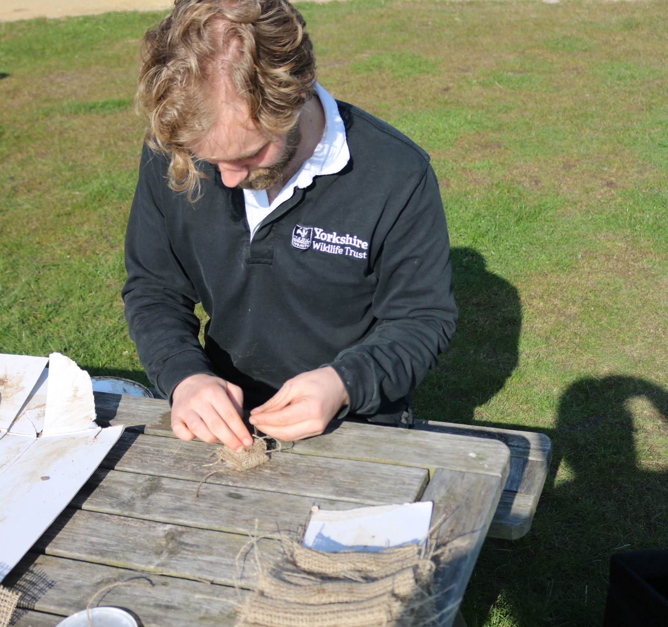
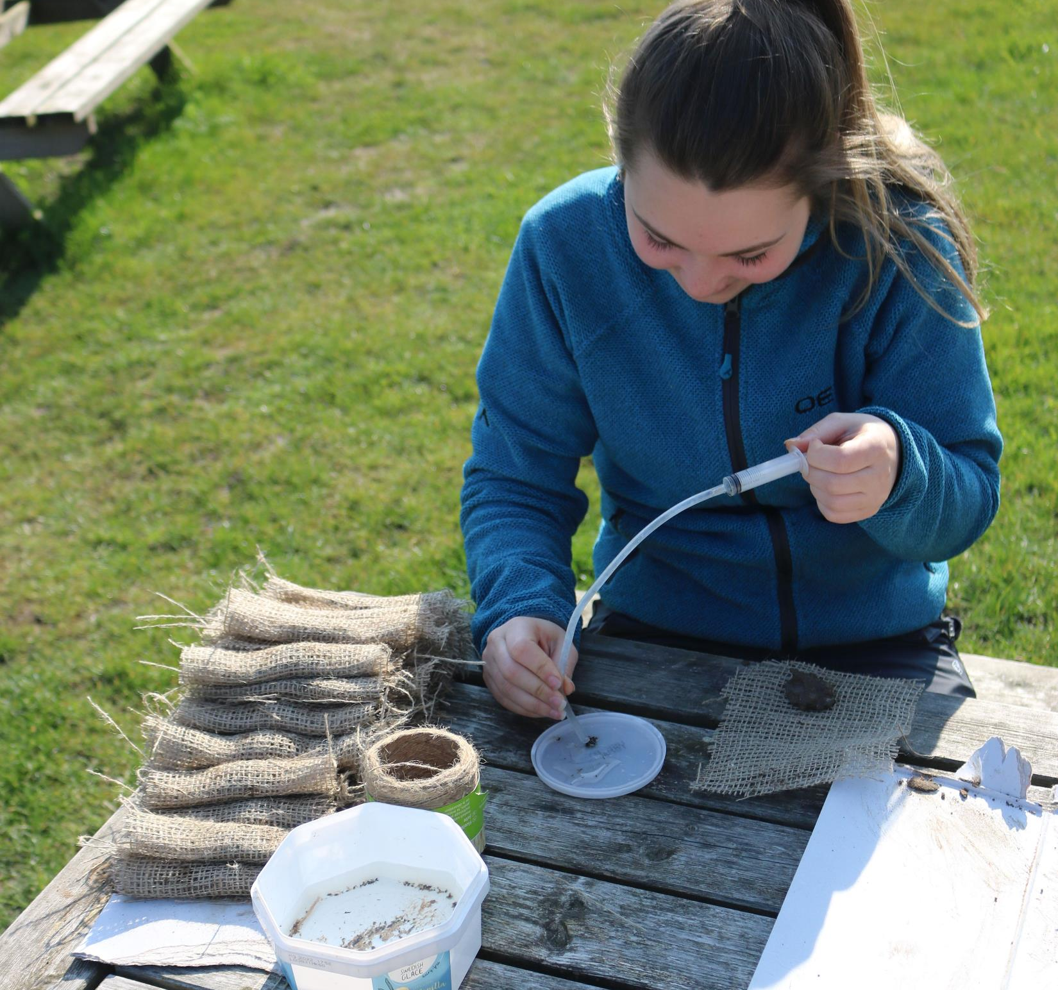
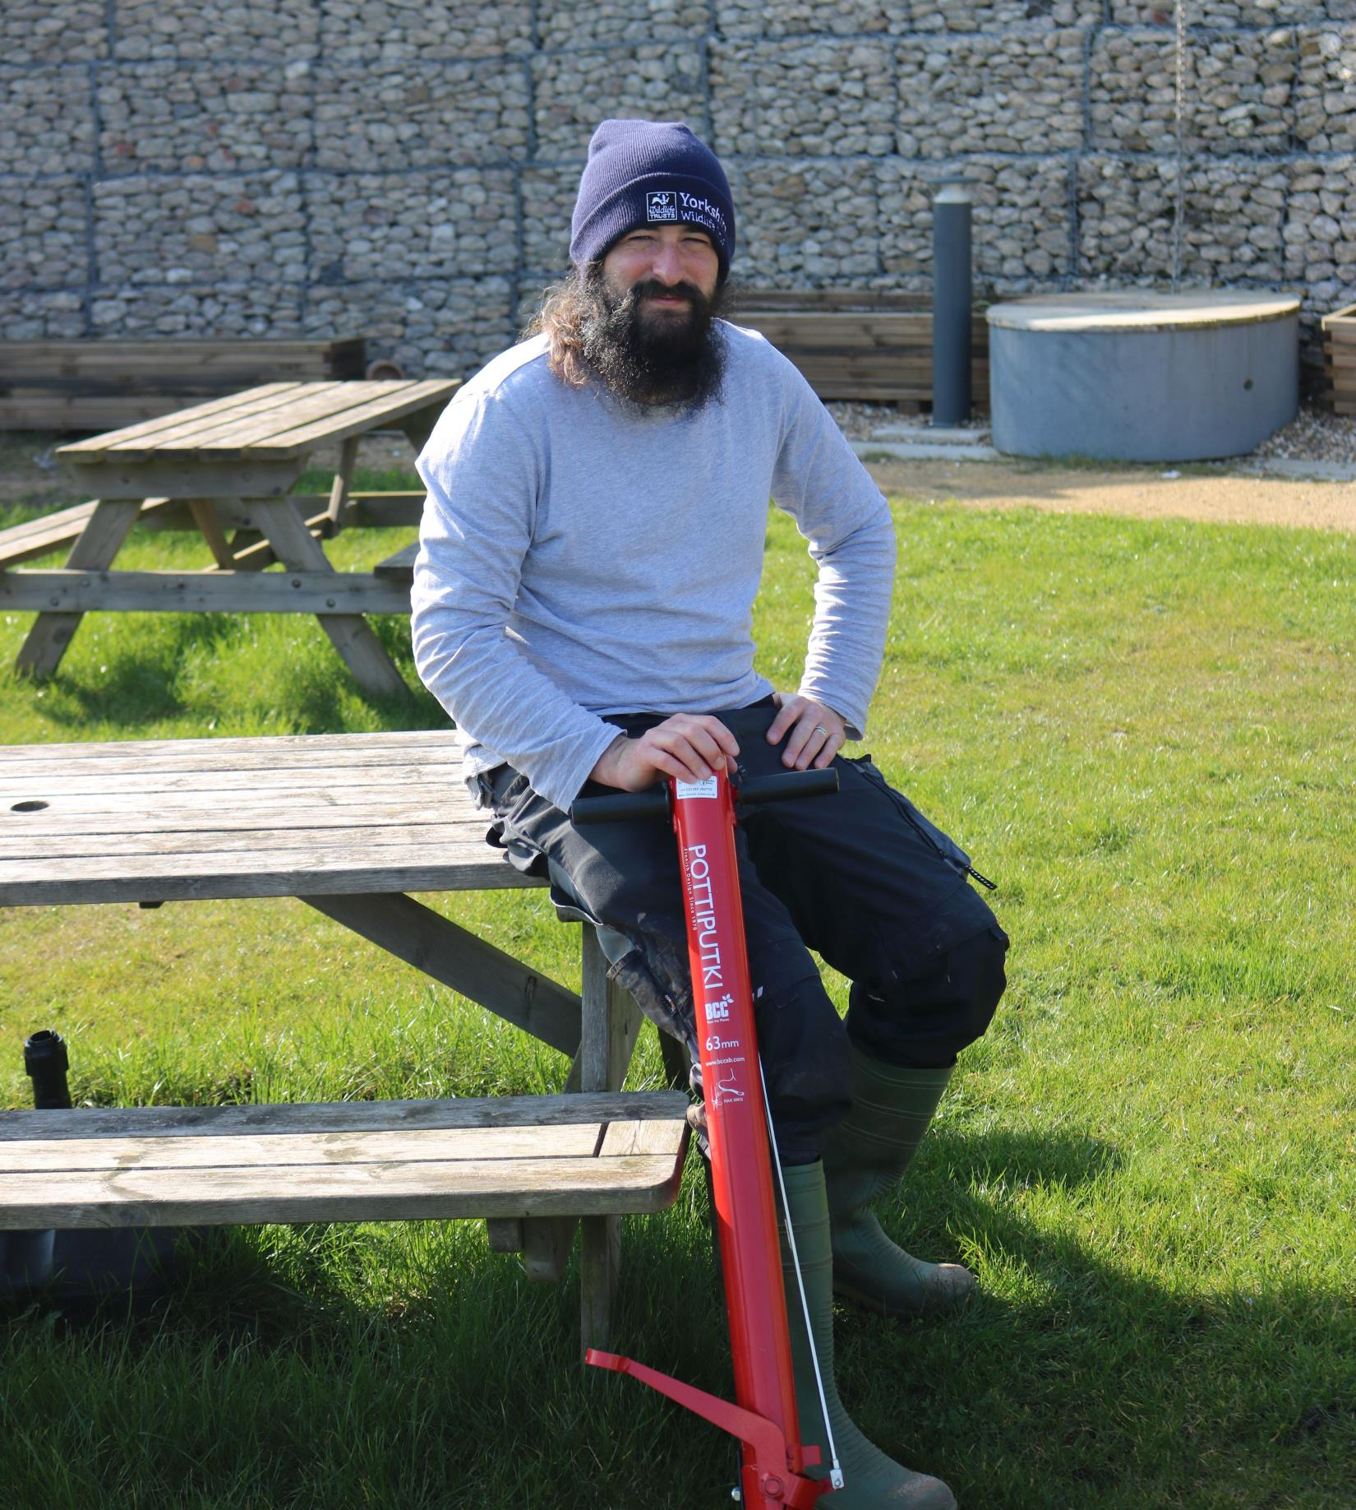
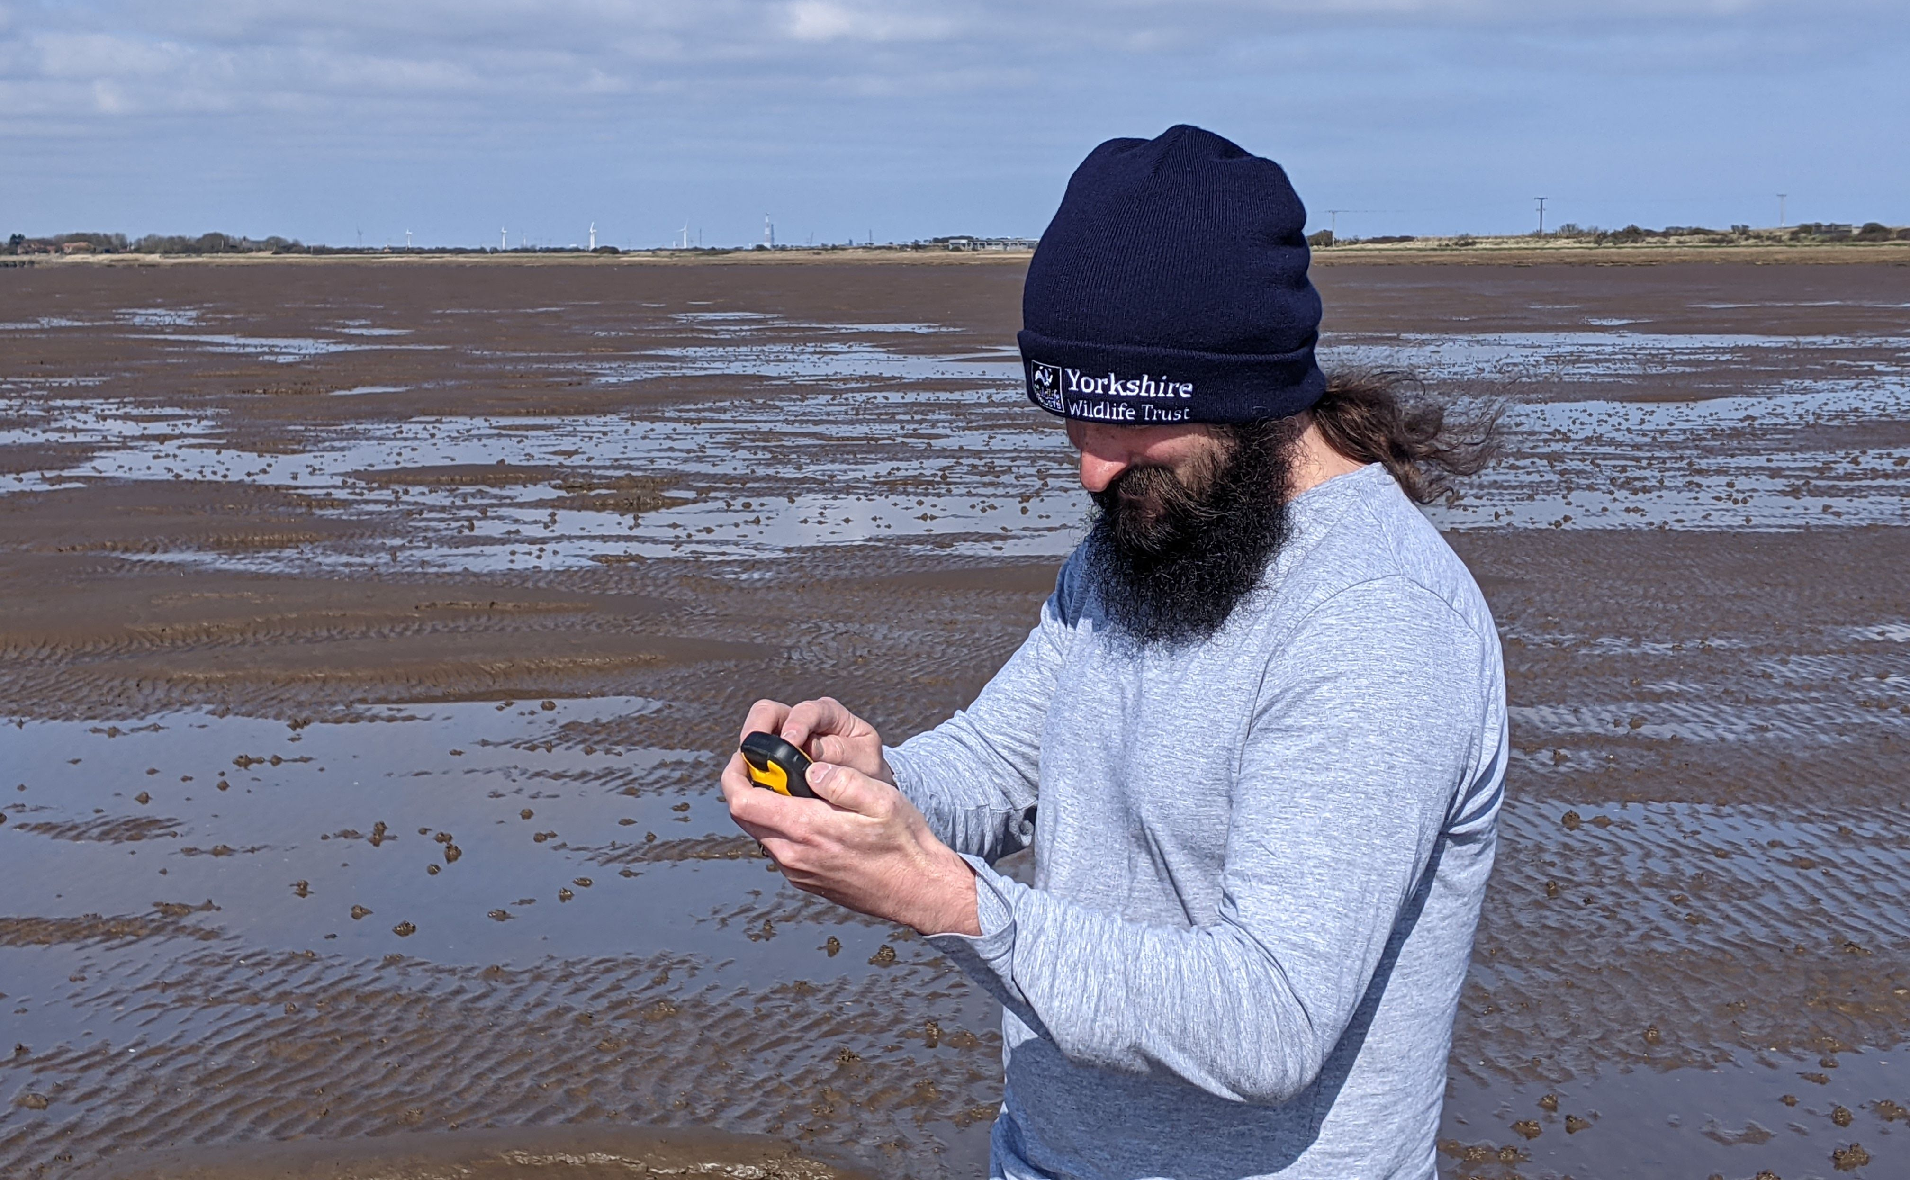
Restoring seagrass Explore the planting process below that our expert team follow to restore seagrass at Spurn National Nature Reserve: Step 1: The area for planting is marked off with posts to protect it Step 2: Seagrass seeds are carefully collected from the remaining seagrass meadow Step 3: Seeds are wrapped in biodegradable pouches so they are less likely to be swept away when planted Step 4: Seed pouches are then planted by hand in the mud using a tool called a pottiputki.

Slide 12
Hopefully you’ve learnt lots about seagrass and why it’s such a super species. Now have a go at the quiz and the practical activity!

