Slide 2
Learning Outcomes By the end of today, you should be able to: n Describe what an oyster is n Explain how an oyster reproduces n Discuss why oysters and oyster reefs are important to an ecosystem

Slide 3
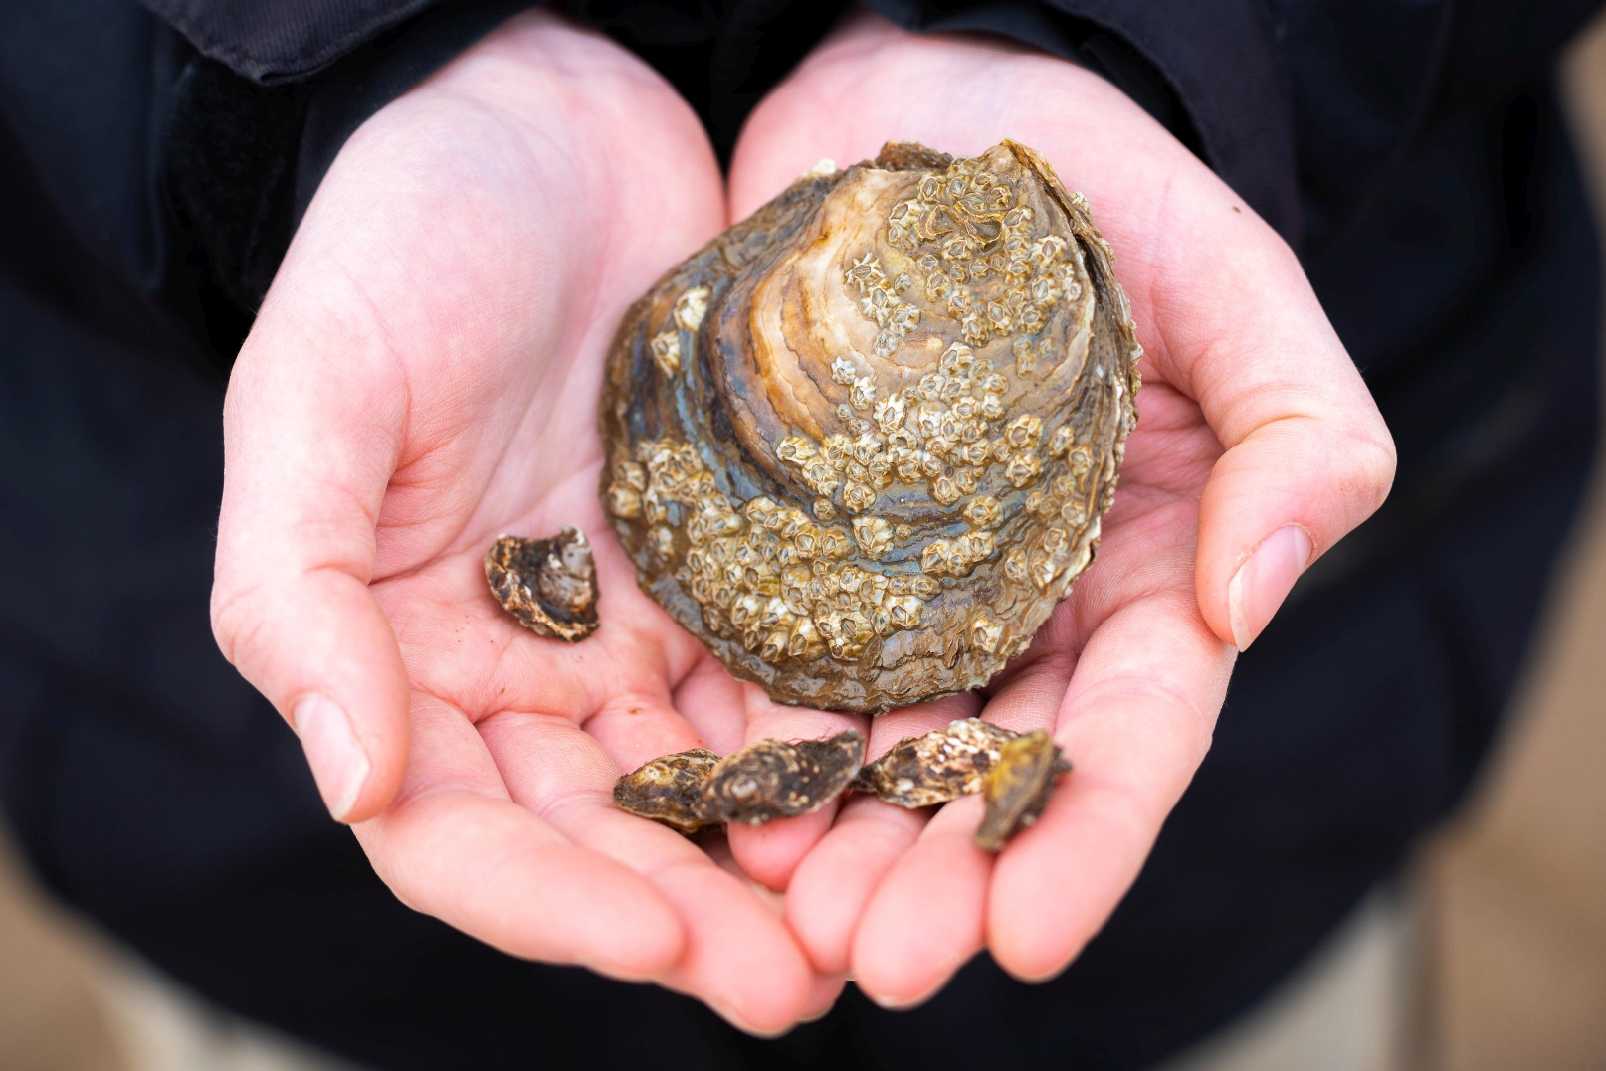
What is an oyster? n An oyster is a type of soft-bodied invertebrate, known as a mollusc. This means that oysters don’t have a backbone n Some other animals classed as molluscs are mussels, squid, octopuses and sea snails n Oysters have two shells. One shell is rounded, while the other is flat like a lid. The shells protect the fleshy oyster living inside.

Slide 4
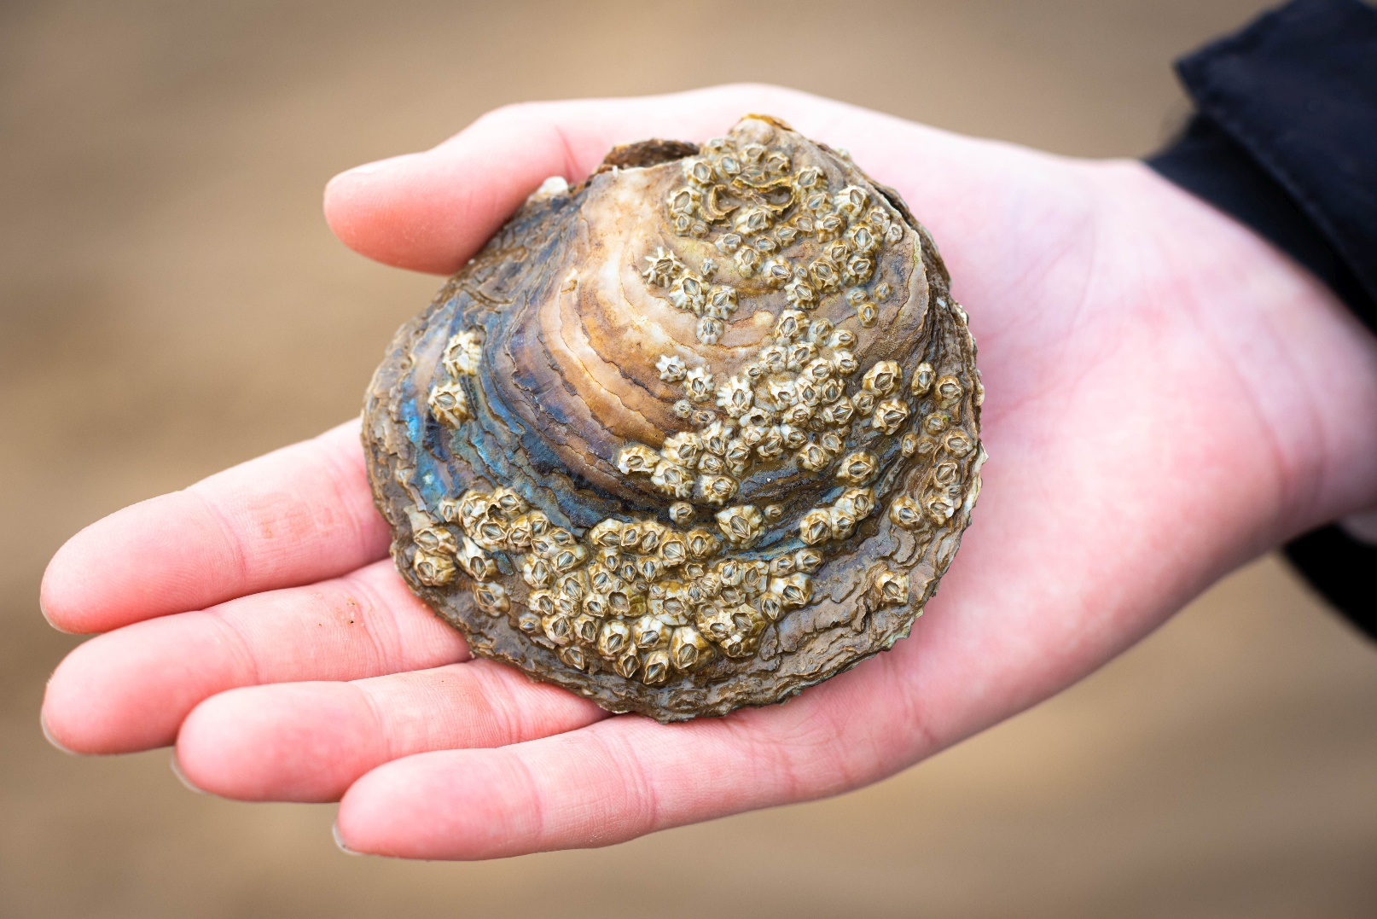
Flat oysters n The flat oyster is the only species of oyster native to the UK n Flat oysters have a rounded, flattened, rough shell that can vary in colour but are usually pale with brown or green mottling n The outside of the oyster shell has growth lines, while the inside of the shell is smooth and pearly white n They live on the seabed in shallow seawater and estuaries.

Slide 5
How do oysters feed? Oysters pump water over their gills and eat tiny plants (called phytoplankton) that they filter out of the seawater. This is called filter feeding.

Slide 6
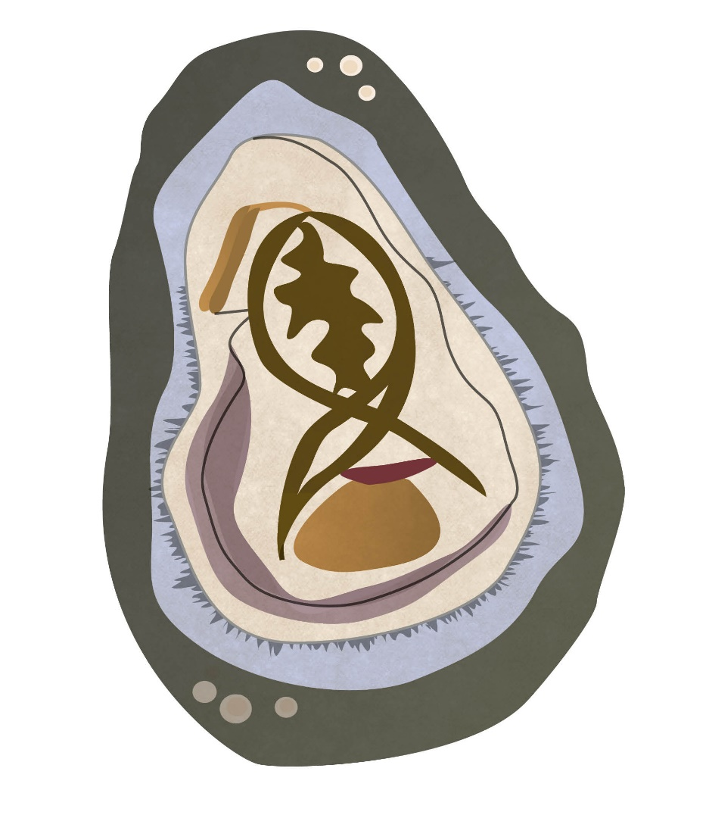
Inside of an oyster
Stomach
- digests and stores food
Intestines
- digest food and store waste
Heart
- pumps colourless blood around the body
Gills
- absorb oxygen from the water

Slide 7
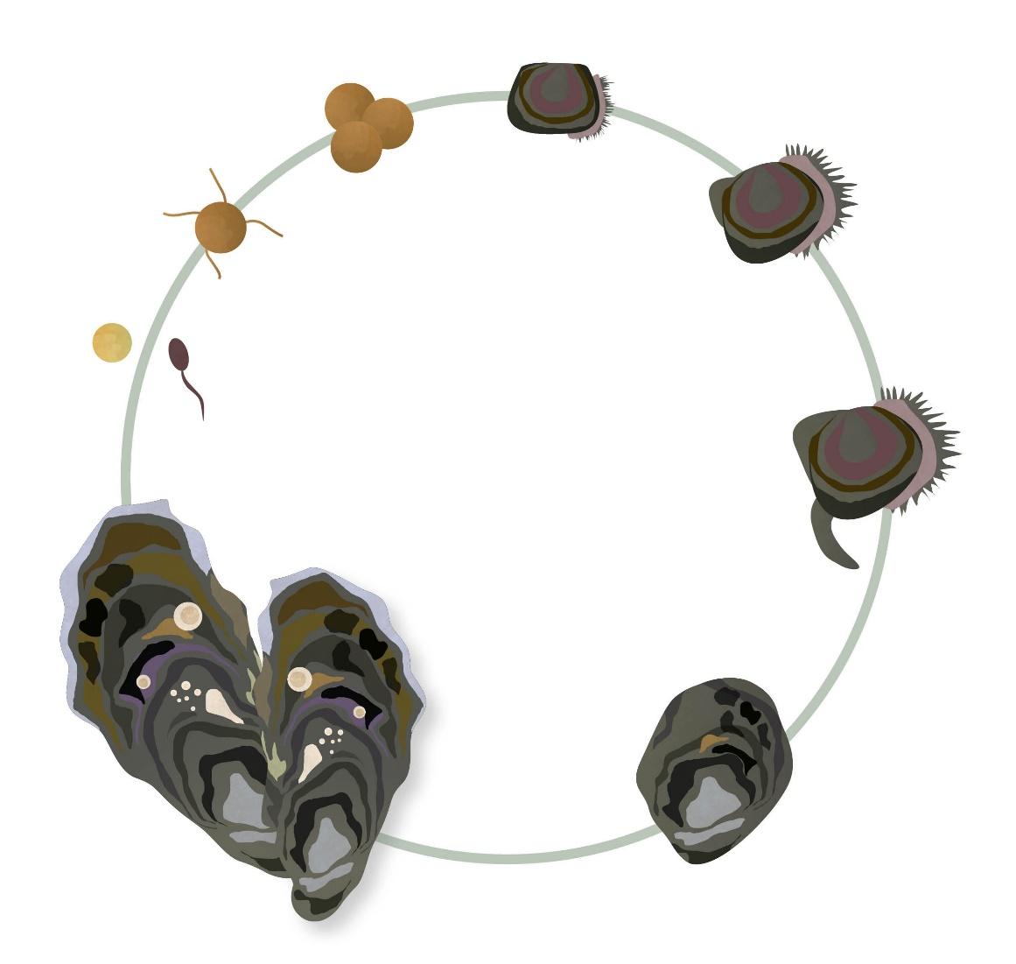
An oyster’s lifecycle All animals are born, they get older and bigger and some will have children. In the end, all animals die. This is called a lifecycle. Male oysters release sperm into the sea, which fertilises the eggs inside female oysters. The babies develop inside the female oyster and are then released as swimming baby oysters, or offspring.

Slide 8
An oyster’s lifecycle After a couple of weeks, the baby oysters stop swimming and settle onto the seabed. Flat oysters can produce as many as 2 million babies each time they reproduce! Flat oysters usually live for 6 to 7 years. At the end of their lives, oysters leave their shells behind on the seafloor. This is the perfect material for young oysters to settle onto.

Slide 9
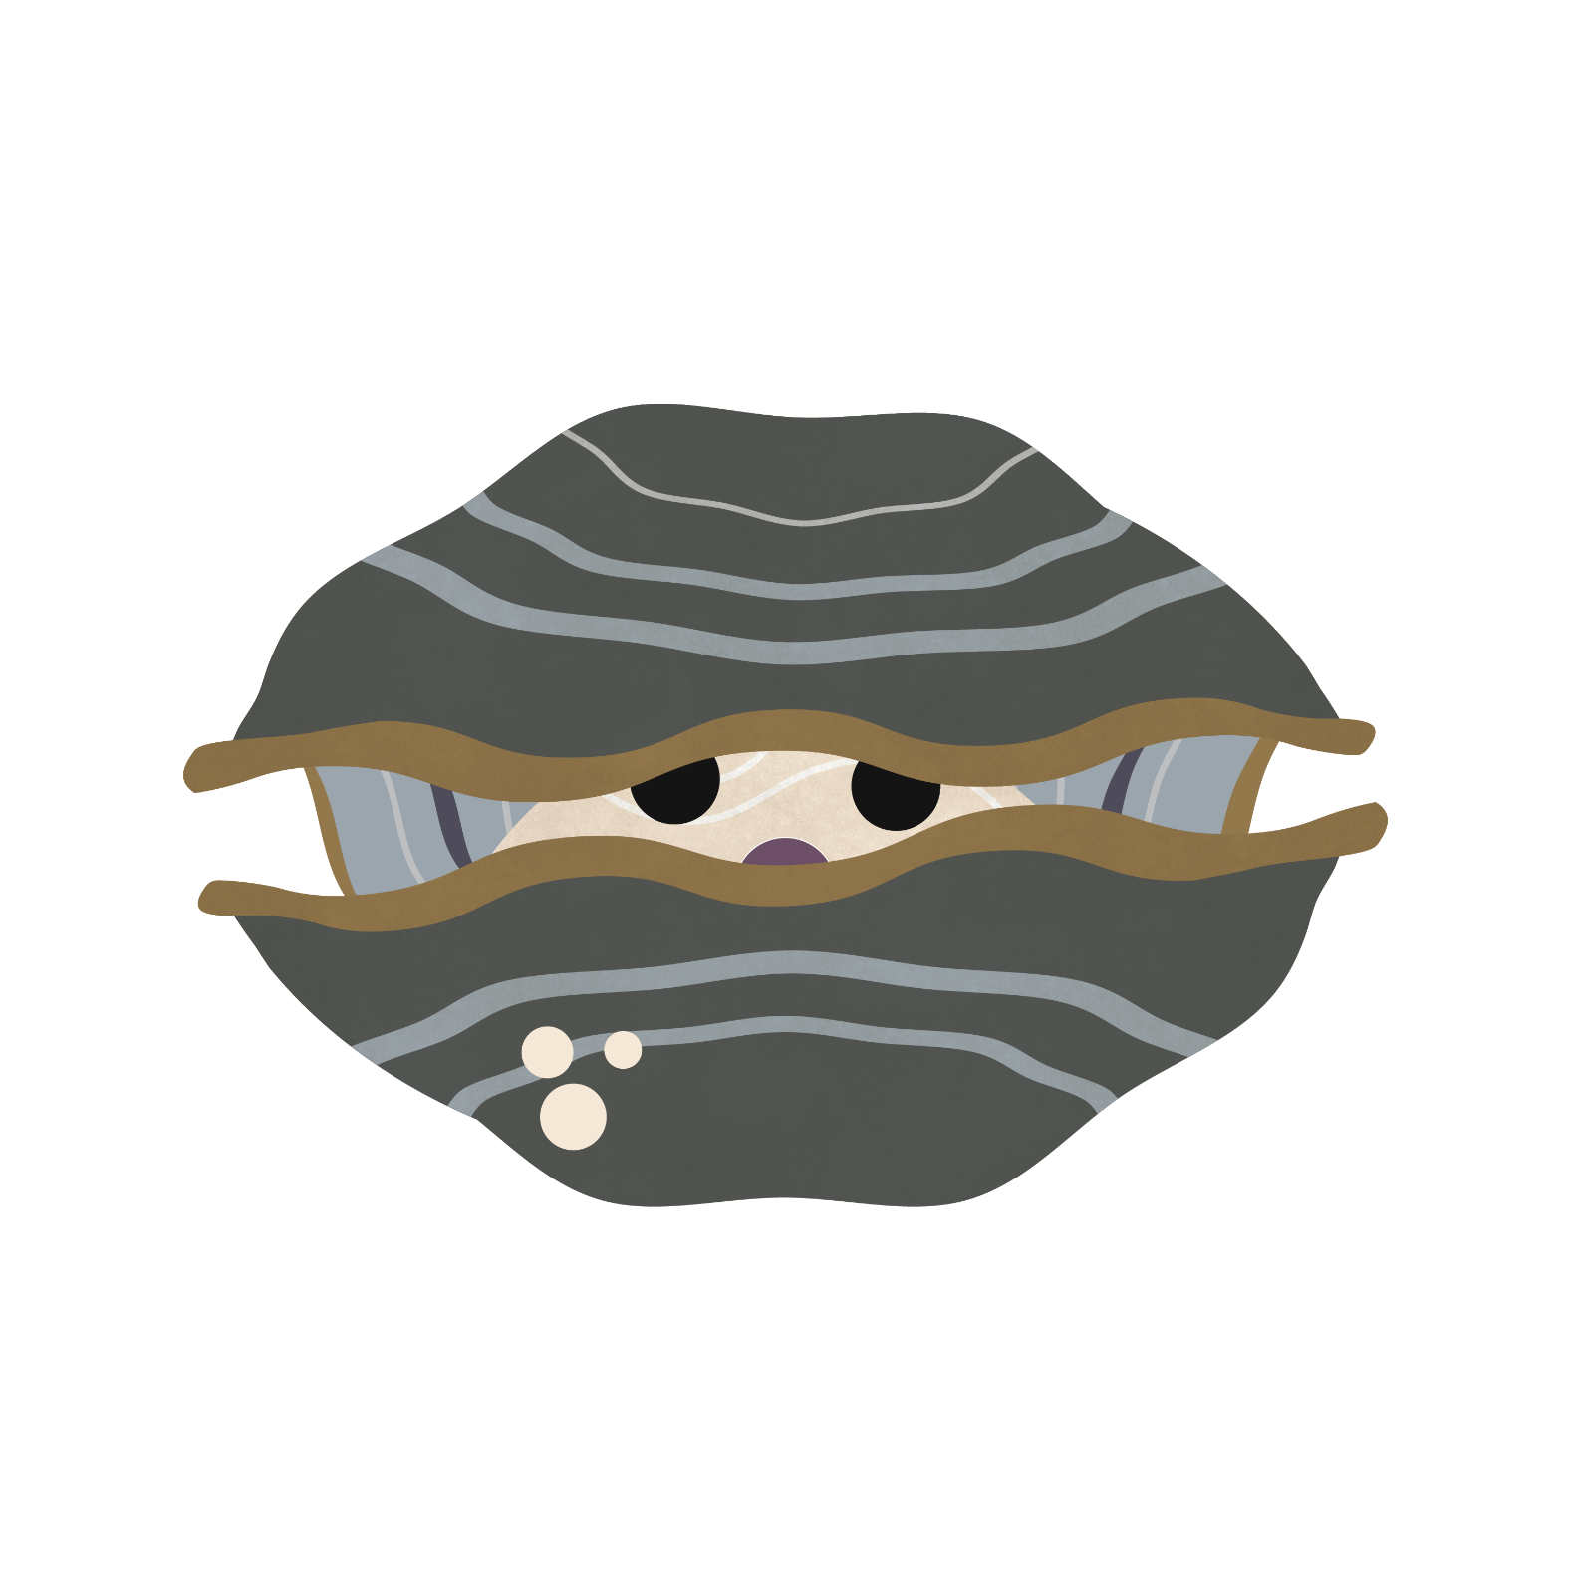
Meet Ollie! This is Ollie, he’s a flat oyster and sometimes Ollie can feel overlooked. People often assume that Ollie is a rock or part of the seabed. He might not look like much from the outside, but Ollie is actually very special!

Slide 10
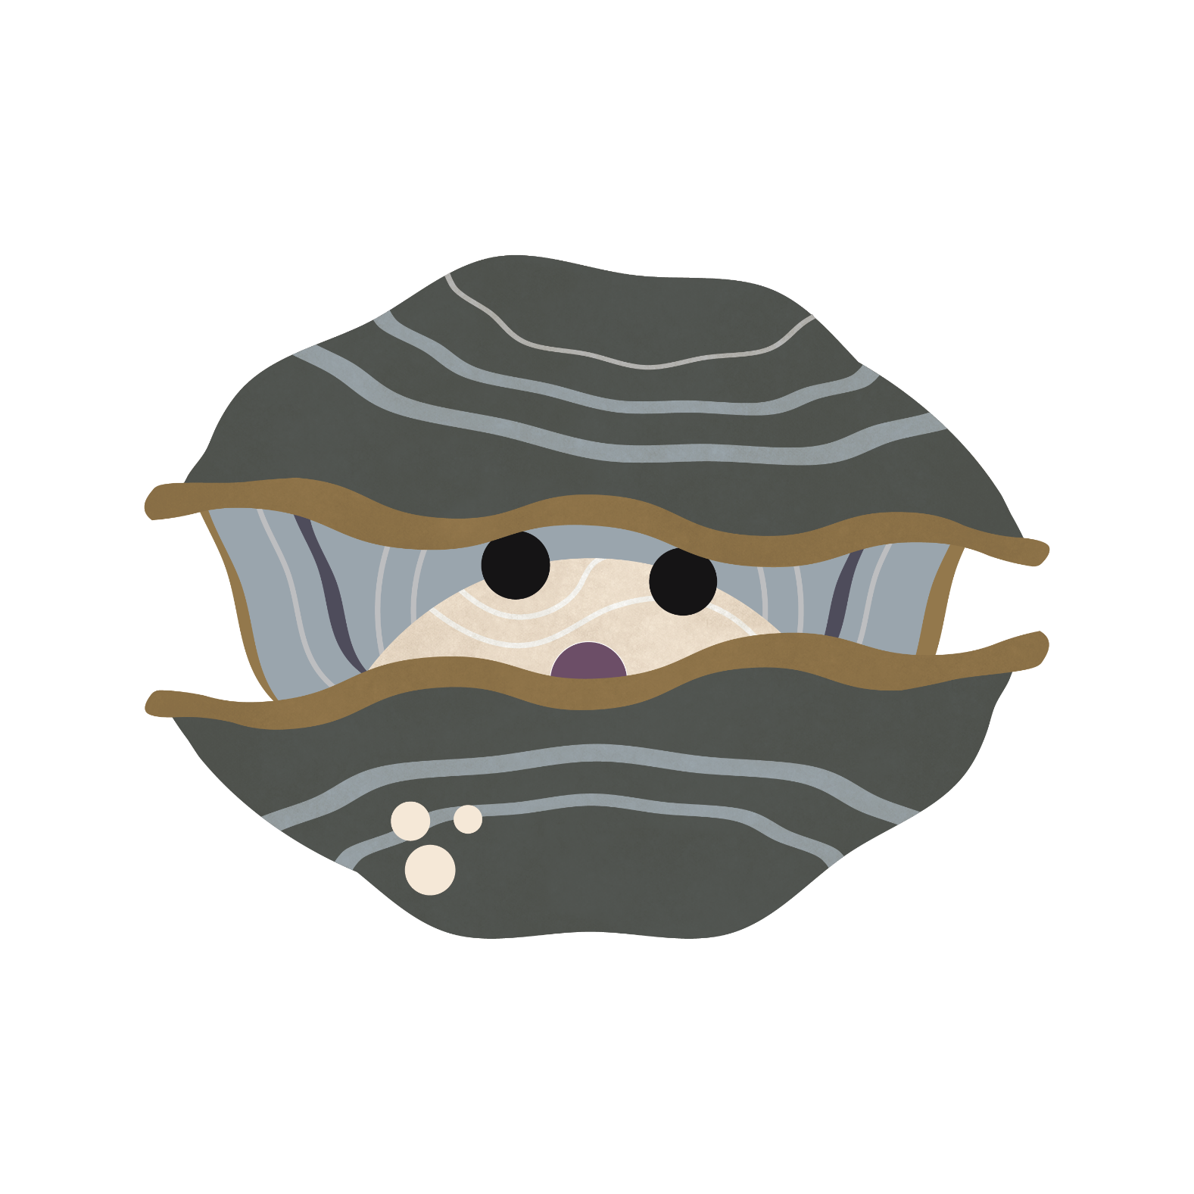
Oysters like Ollie have an amazing ability to clean seawater, improving the environment for other plants and animals that live nearby. A single oyster can clean 200 litres of seawater everyday – that’s the same as a bathtub of water. In its lifetime, an oyster can clean one million litres of seawater!

Slide 11
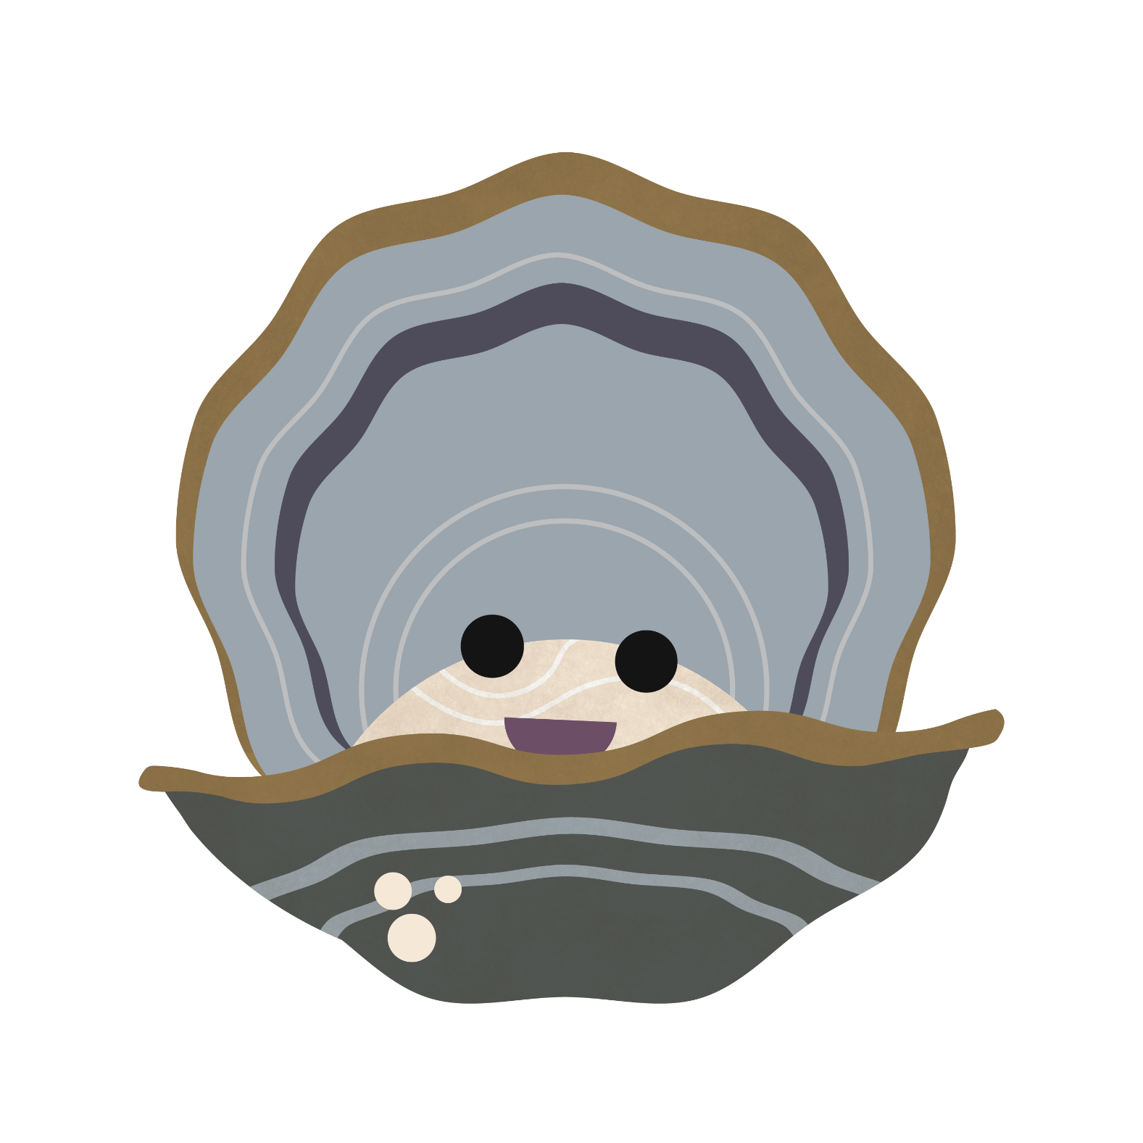
If oysters are left undisturbed for a long time, they will join together to form a reef. An oyster reef provides a fantastic habitat and shelter for lots of different animals, such as young fish, crabs and sea snails. Oyster reefs also protect the coast and other nearby habitats from strong waves.

Slide 12
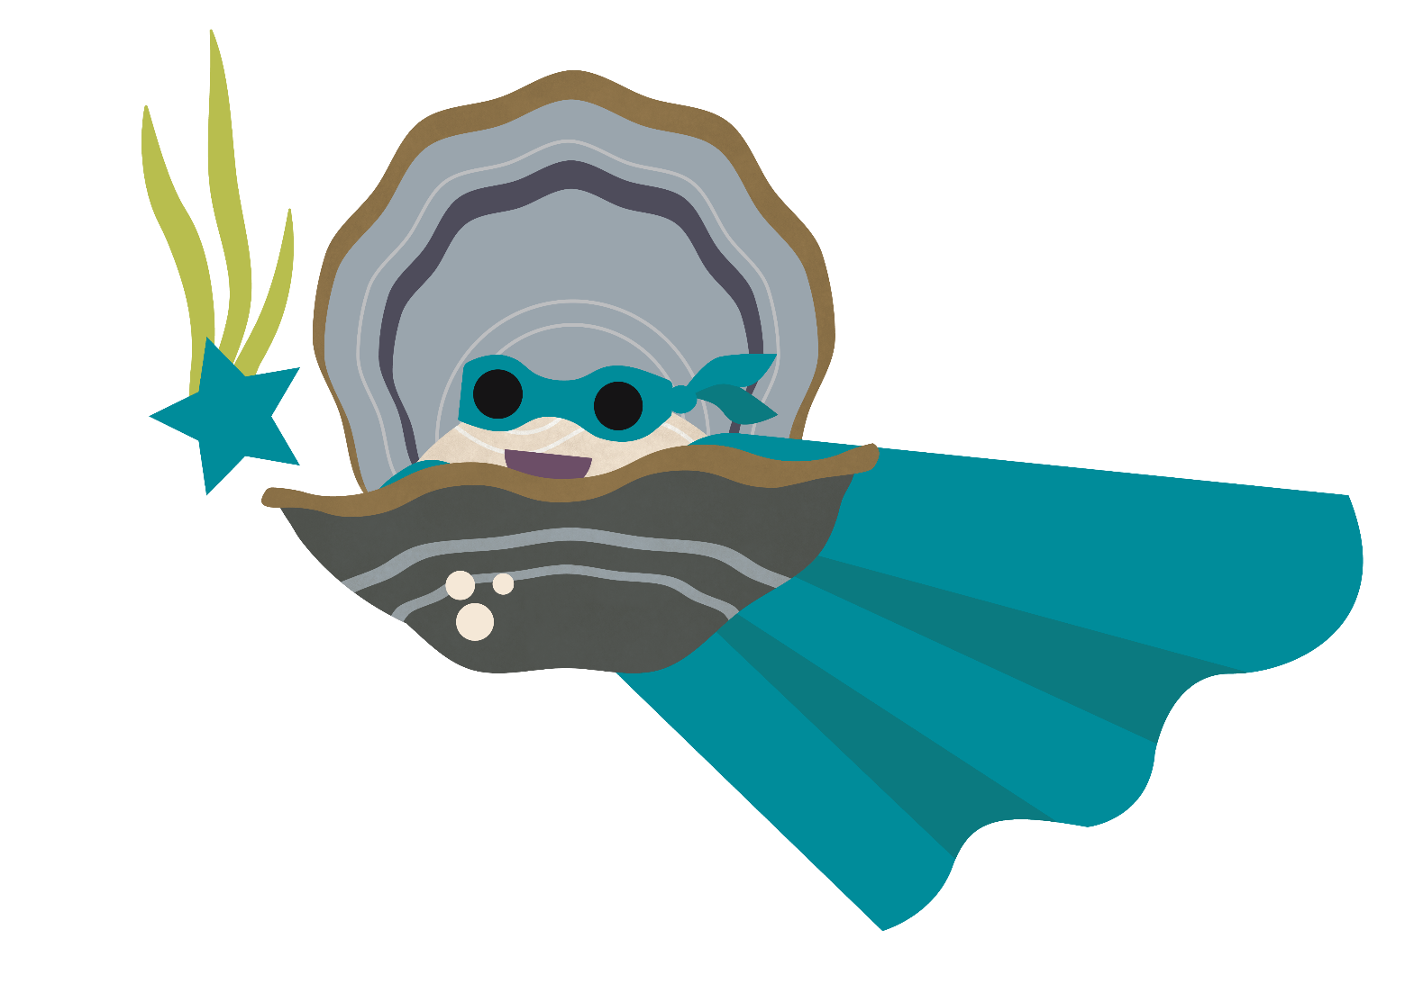
Don’t tell Ollie but oysters are an important food source and are eaten by many different animals, including crabs, lobsters, octopi, oystercatchers and humans. For something so small, these mighty marine molluscs can have a big impact on the marine environment. Ollie, you’re a superhero of the sea!

Slide 13
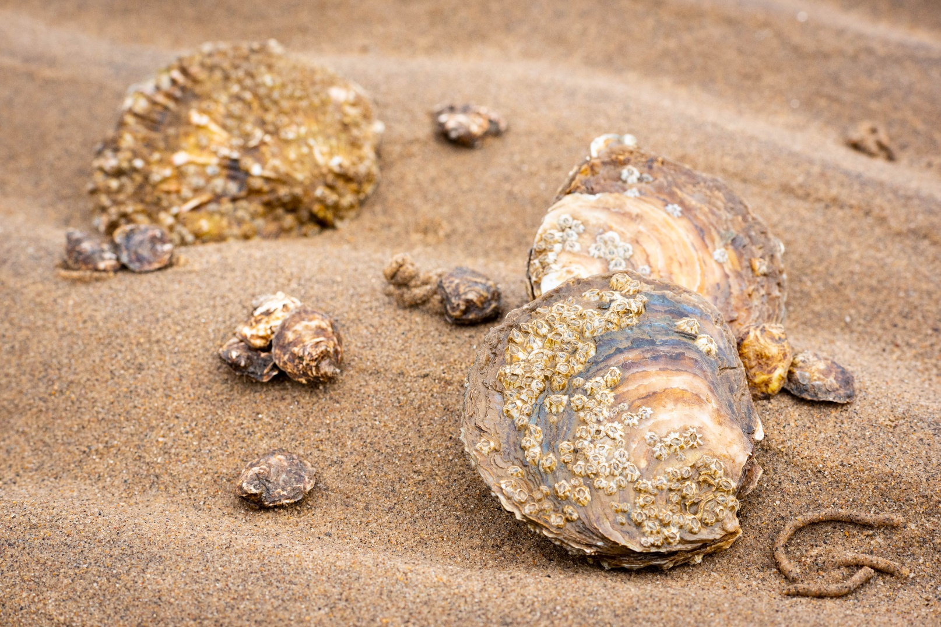
Oysters in Yorkshire There used to be a flat oyster reef in the Humber so large that it stretched across the entire width of the estuary and was so big that the oysters’ hard shells were a danger to ships! Sadly, because of overfishing and pollution, that oyster reef is now a distant memory and only a few flat oysters remain.

Slide 14
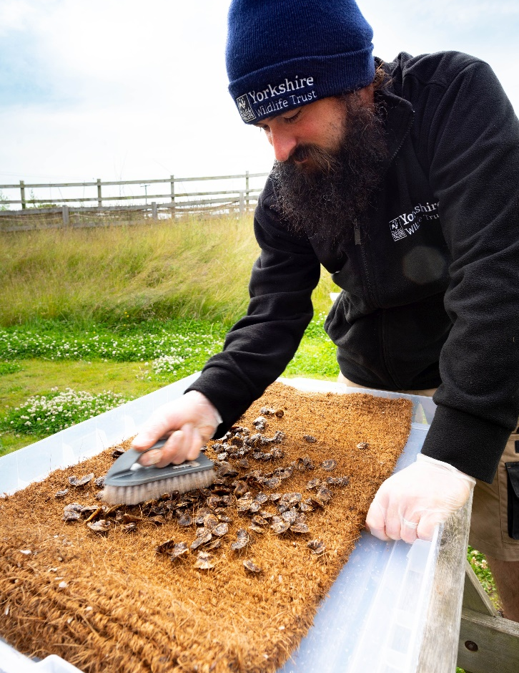
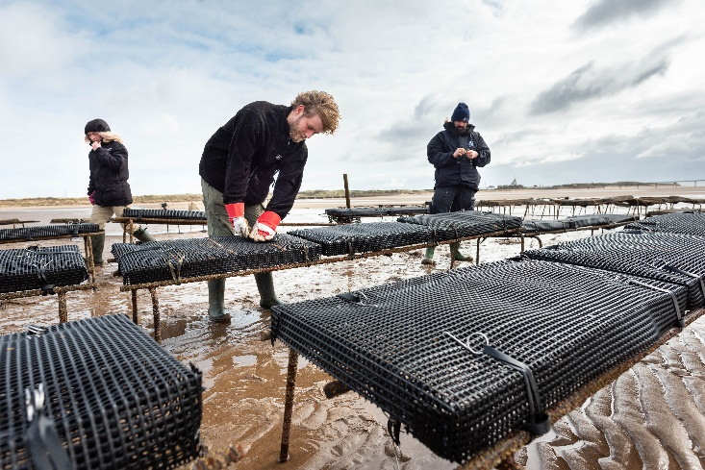
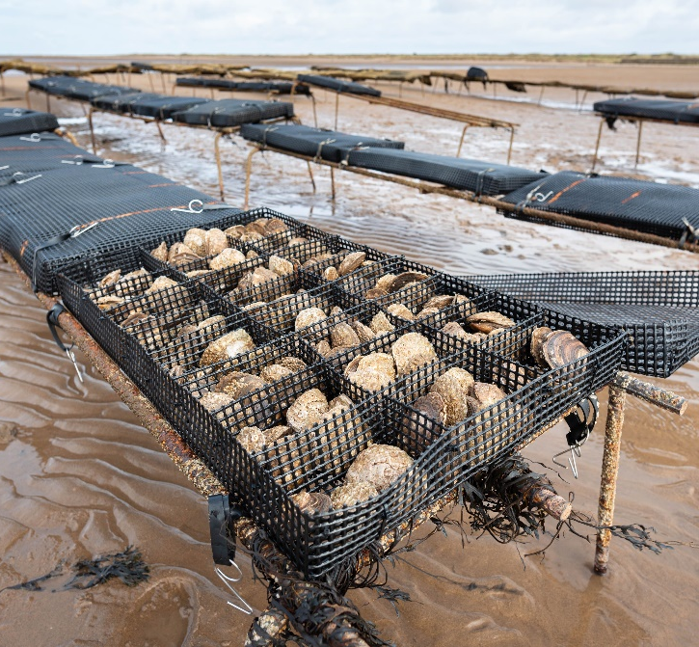
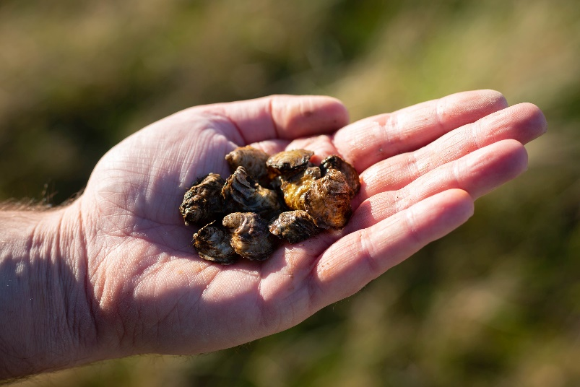
Bringing oysters back to the Humber… Luckily for Ollie and his friends, Yorkshire Wildlife Trust are working hard to bring oyster reefs back to the Humber estuary! Explore the process below that our expert team follow to restore oyster reefs at Spurn National Nature Reserve: Step 1: 100,000 young flat oysters were brought over from the west coast of England Step 2: The oysters were cleaned and checked to make sure that they weren’t carrying any unwanted organisms

Slide 15
Step 3: The oysters were quarantined in UV-treated seawater to make sure the water inside the oysters was clean Step 4: The oysters were then put to bed in special boxes. This is to make sure the oysters are safe and easy to monitor Step 5: Each month, our expert team of marine biologists check the oysters’ health, weight and growth. Hopefully, one day, Ollie and his friends will be able to form a thriving reef in the Humber estuary once more!

Slide 16
Hopefully you’ve learnt lots about oysters and why they are superheroes of the sea. Now have a go at the quiz and the practical activity!

