Slide 2
Learning Outcomes By the end of today, you should be able to: n Describe what a food chain and a food web are n Explain the role of different organisms in a food chain n Explore what would happen if different organisms in the food web increased or decreased in number

Slide 3
Some key definitions
An organism is a living thing.
A habitat is the place where an organism lives.
A community is all the different animals, plants and microorganisms that live together in a habitat.
A community of animals, plants and microorganisms, together with their habitat is called an ecosystem.

Slide 4
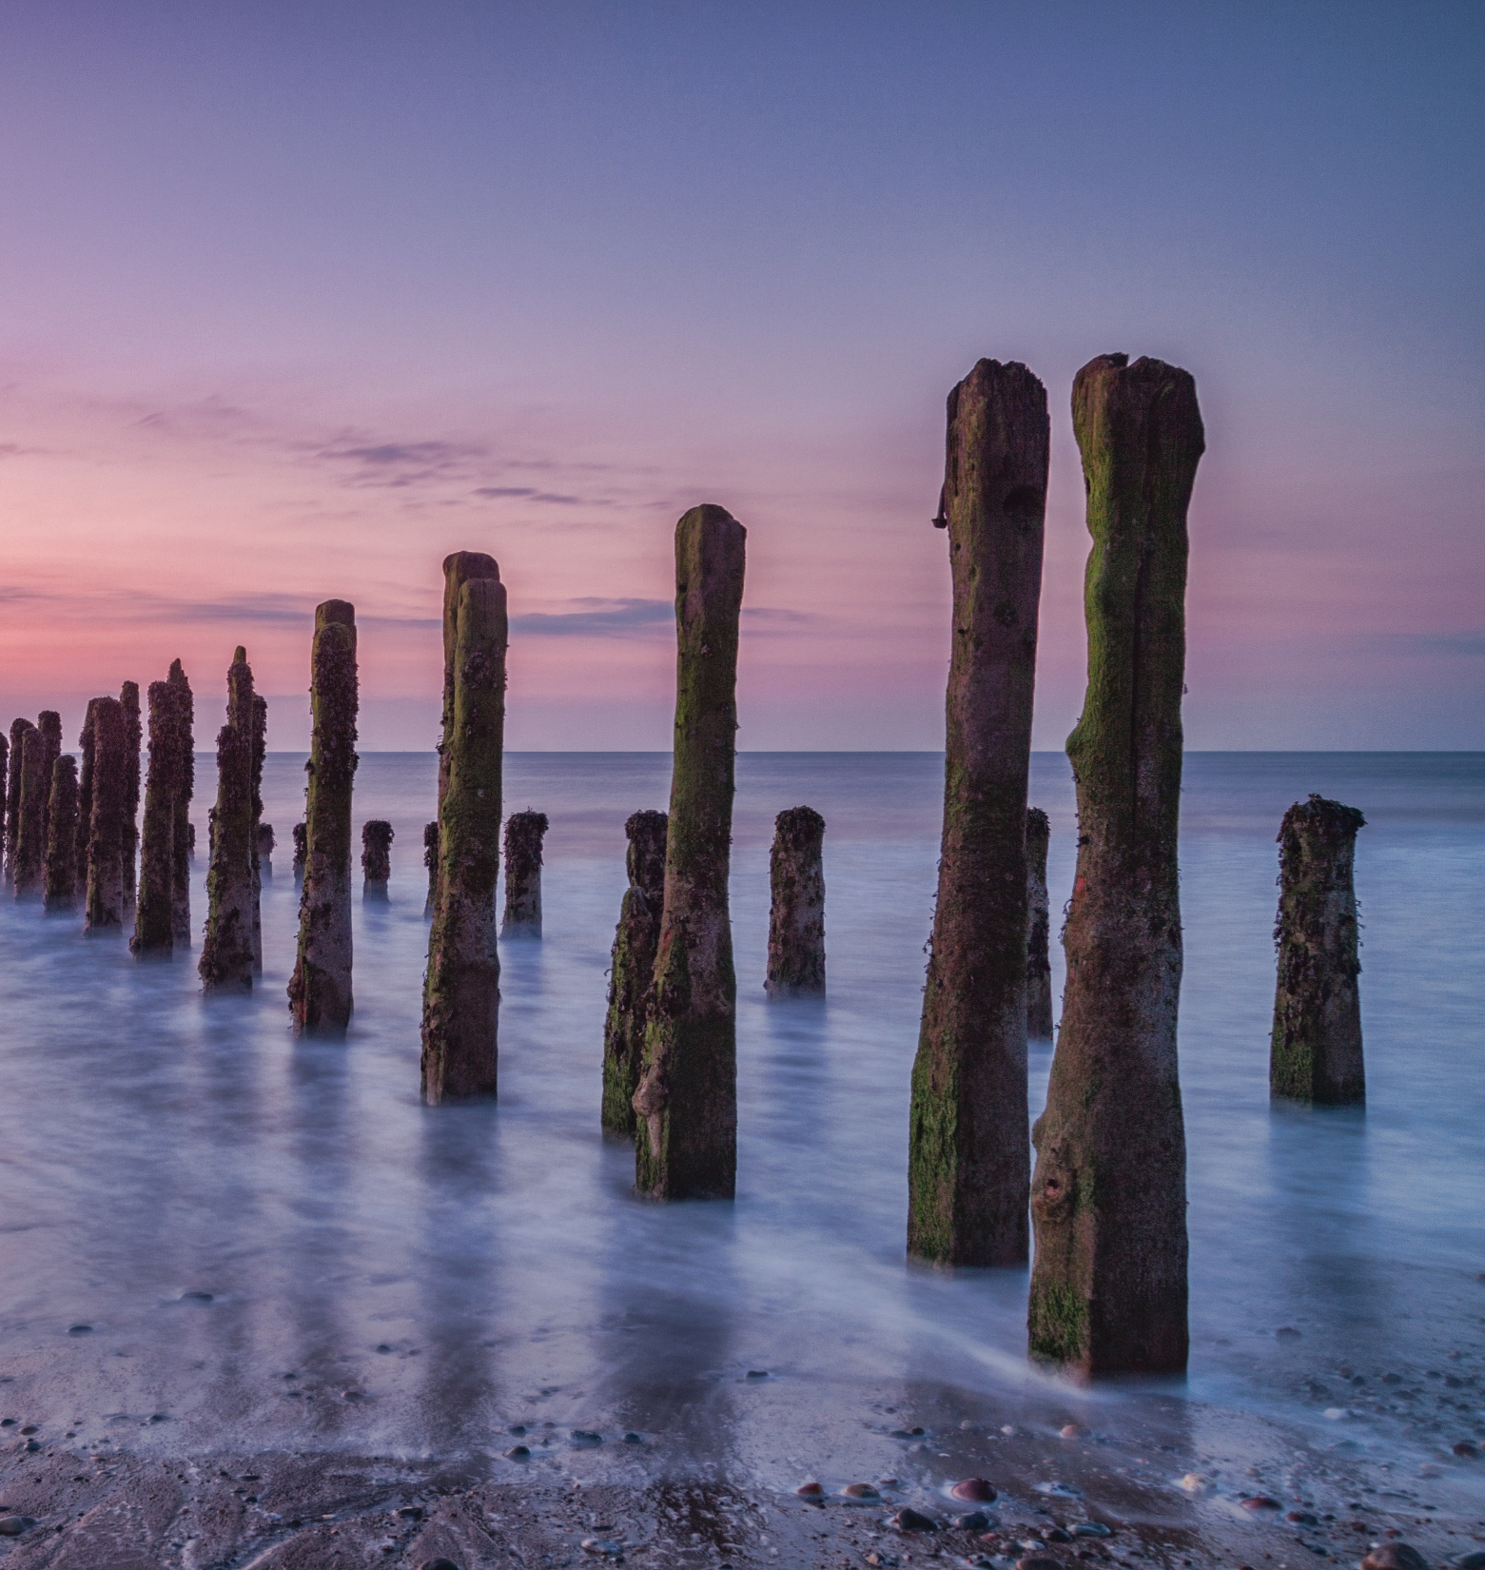
What is a food chain and a food web? n A food chain shows the feeding relationship between organisms and the flow of energy from one organism to another n Food webs show how all the food chains in an ecosystem interact
n The stages in a food chain are called trophic levels.

Slide 5
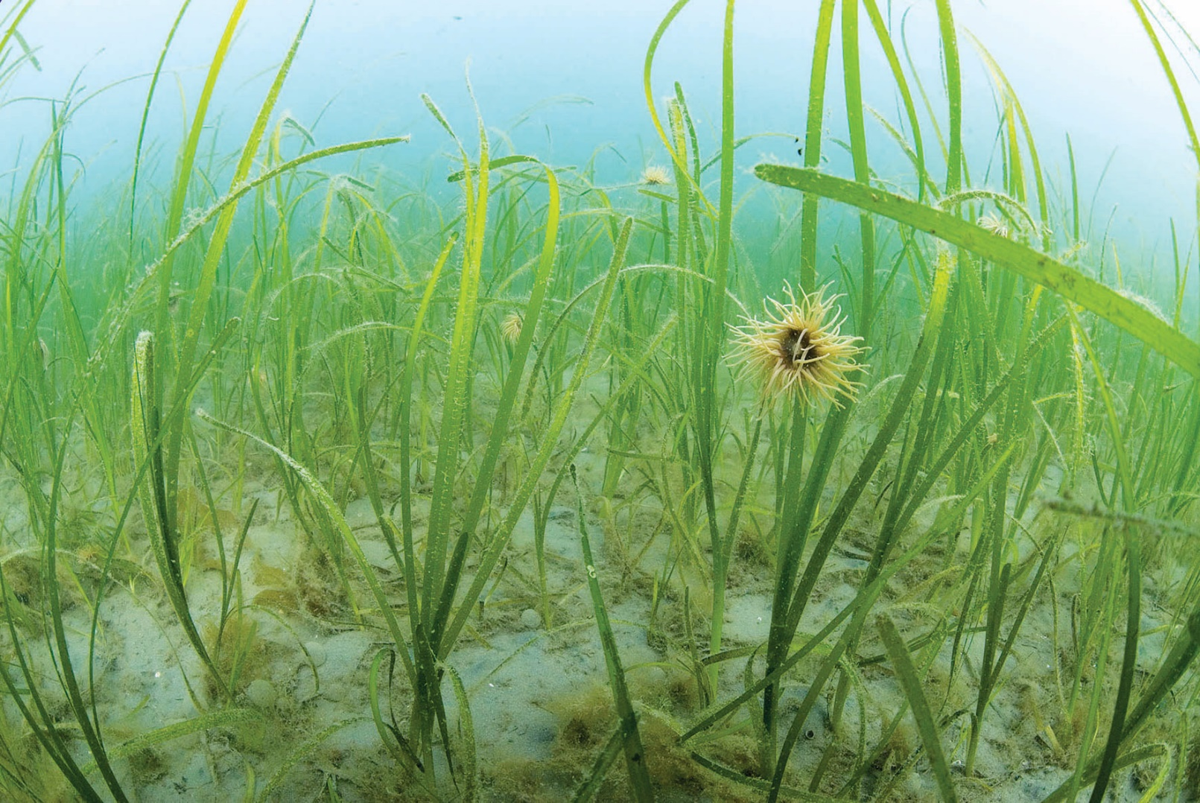
What is a producer? n A food chain always starts with a producer n A producer is an organism that makes its own food. Most food chains start with a green plant because plants make their food through photosynthesis.
Seagrass is an example of a producer!

Slide 6
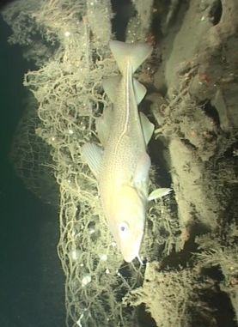
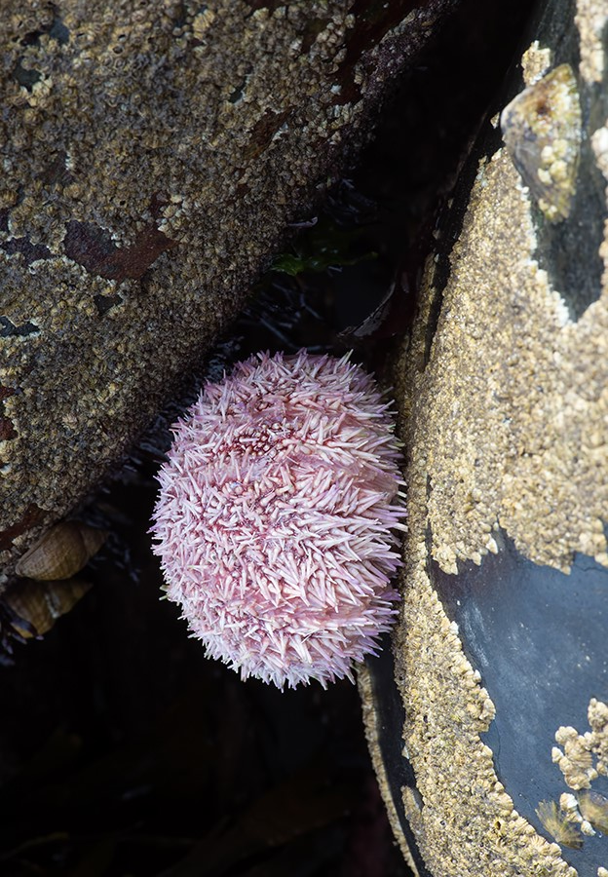
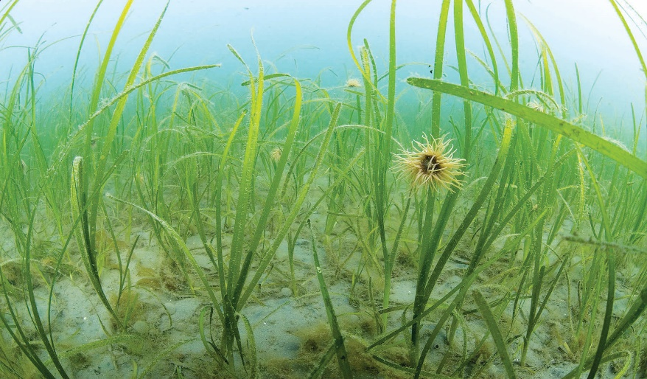
Cod
(Secondary Consumer)
What is a consumer?
n A consumer is an organism that eats other plants and animals
n A primary consumer eats the producer
n The primary consumer is then eaten by the secondary consumer
n The arrows in food chains show the flow of energy from one organism to another.
Urchin
(Primary Consumer)
Seagrass
(Producer)

Slide 7
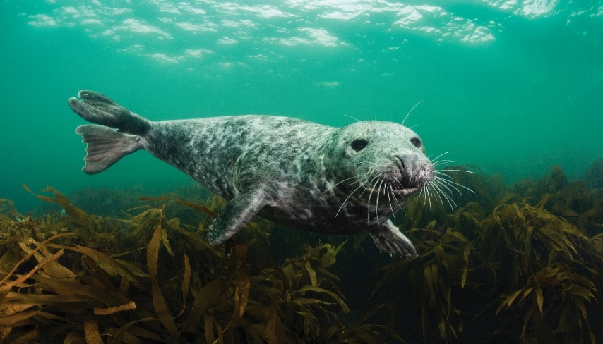
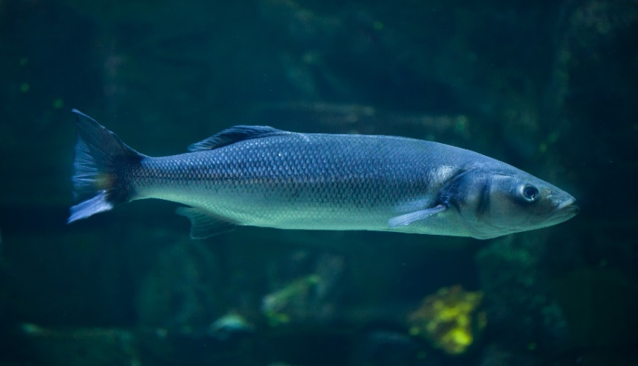
Predator vs. prey A predator is an animal that eats other animals.
The animals that predators eat are called prey.
The final consumer at the top of the food chain is called the apex predator and is not eaten by anything else.
n Who is the predator and who is the prey with the animals below?
Grey seal
Seabass
Notes:
The grey seal is the predator and the seabass is the prey.

Slide 8
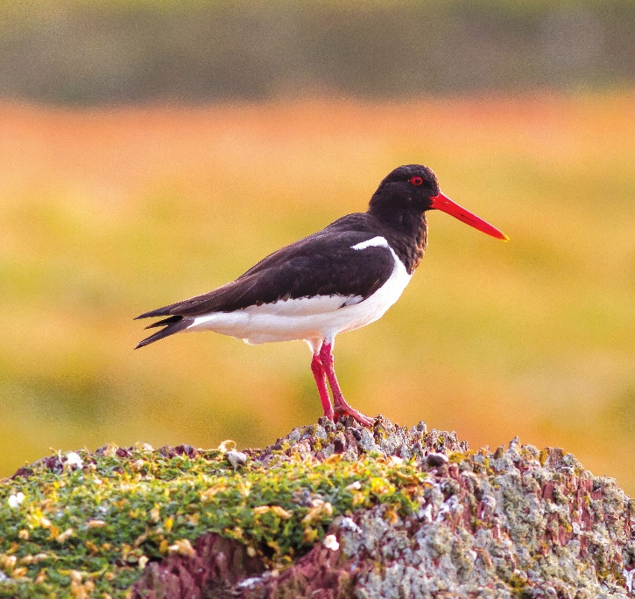
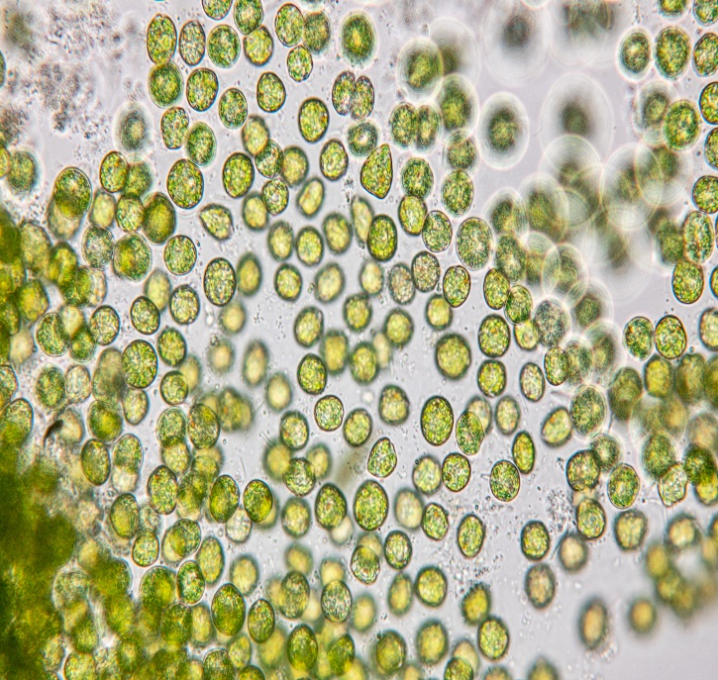
Can you rearrange the food chain?
n Can you put this food chain in order, starting with the producer?
n Who is the producer and who are the consumers?
Oyster catcher
Phytoplankton
Flat oyster
Notes:
Phytoplankton (producer) -> flat oyster (primary consumer) -> oyster catcher (secondary consumer).

Slide 9
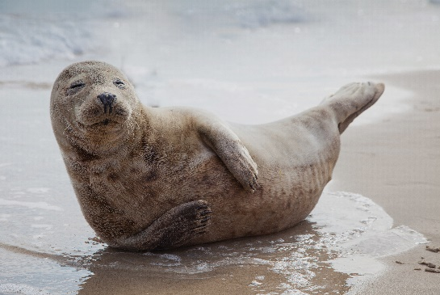
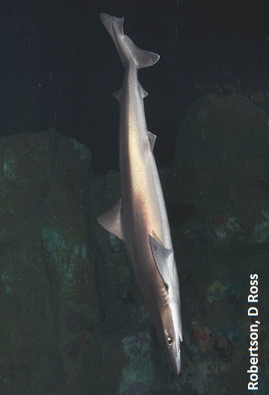
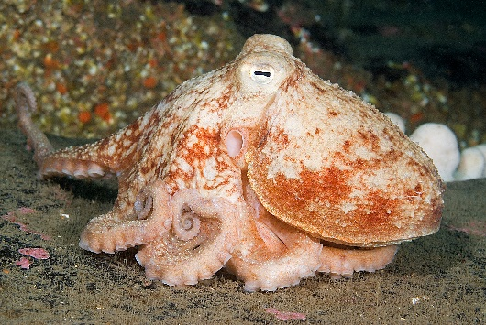
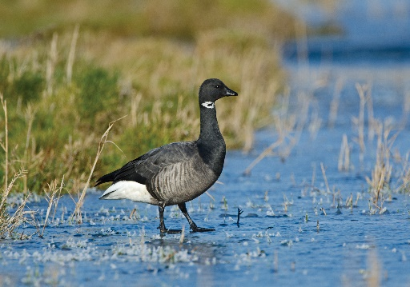
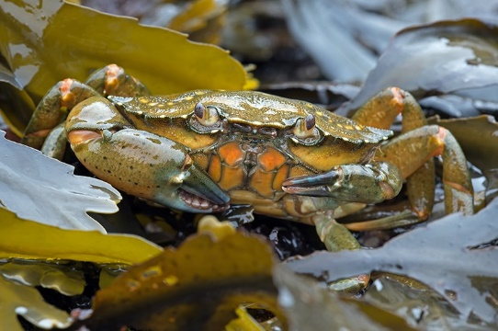
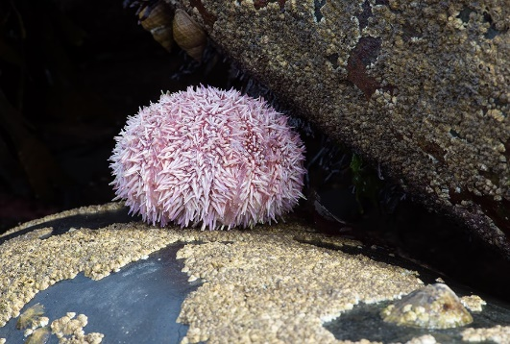
A Food Web
What would happen if there were more seals in the environment?
What would happen if there were fewer shore crabs in the environment?
Notes:
More seals in the environment could lead to a reduction in the number of octopi, seabass and cod, as seals eat these animals.
If there were fewer shore crabs in the environment there would be less prey available for octopi and seabass. There would also be less grazing pressure on seagrass so the seagrass may be more abundant.

Slide 10
Hopefully you’ve learnt lots about marine food webs and the roles different organisms play. Now have a go at the quiz and the practical activity!

